Slide 1
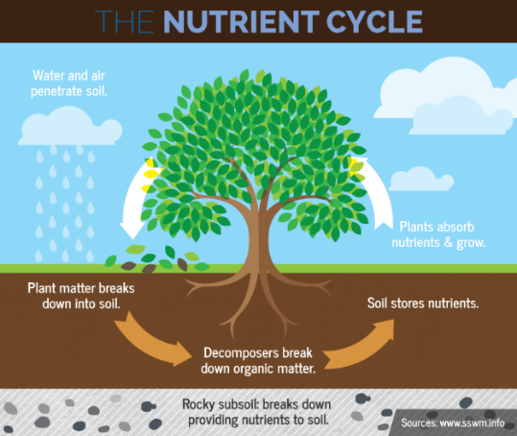
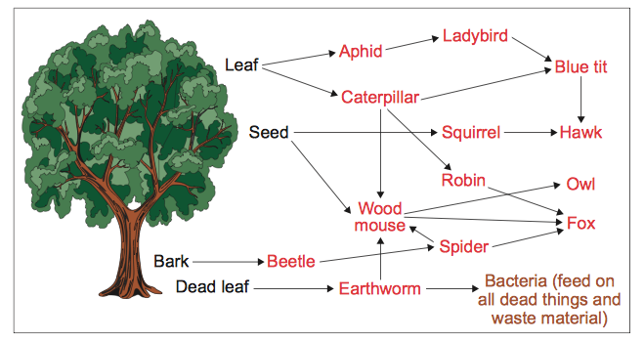
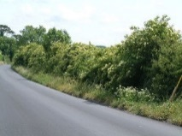
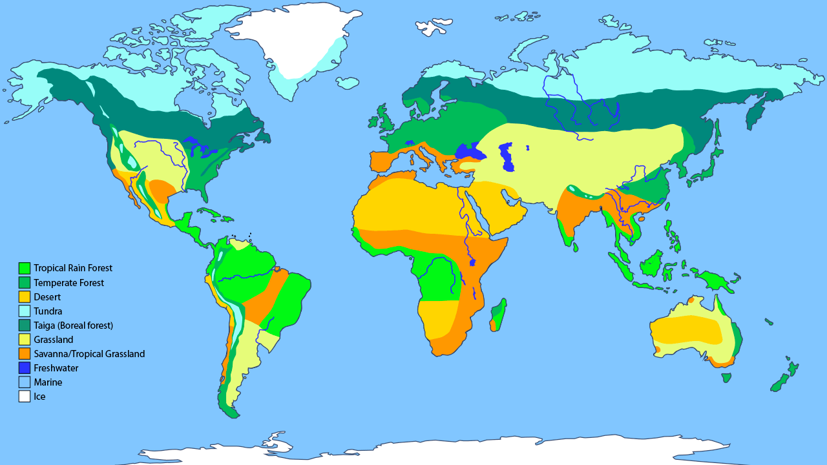
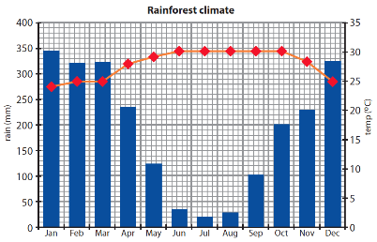
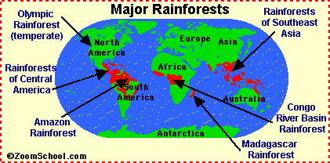
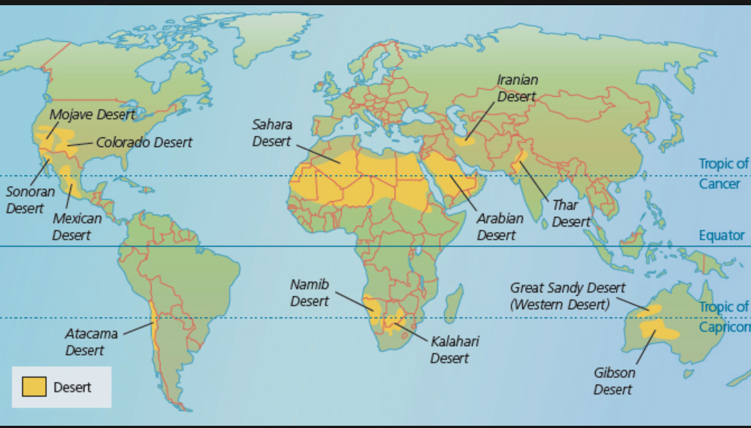
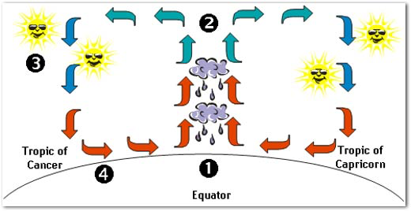
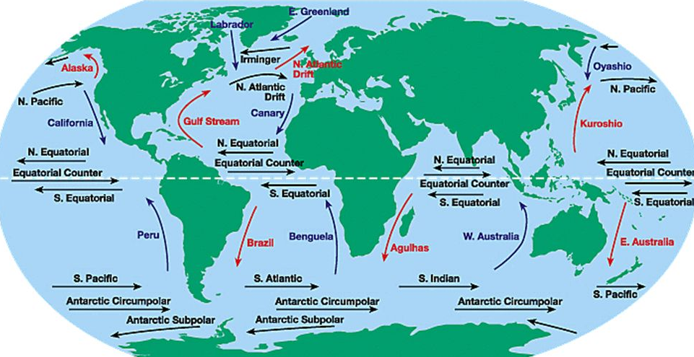
Interactions within an ecosystem
The different parts of the ecosystems interact so it functions effectively. If one part changes, it will effect the whole ecosystem. It includes food chains, food webs and the nutrient cycle.
EXAMPLE – Small scale ecosystem of the UK
Producers | Hawthorn, Beech, Nettles, Dandelions, Grass, Honeysuckle
Consumers | Aphids, Shield Bug, Garden Snail, Garden Spider, Caterpillar, Chaffinch
Secondary consumers | 7 Spot Ladybirds, Blue Tit, Robin, Mouse, Hedgehog
Top predators | Fox, Domestic Cat, Sparrow Hawk
Decomposers | Bacteria
Abiotic | Dead leaves, soil, air, water, sun, stones/rock
Global Ecosystems - BIOMES
Polar – Arctic/Antarctic Very low temperatures and dry conditions – cold desert – Temperatures can fall below -50ºC. Arctic hare, Arctic fox, little vegetation
Tundra – Northern Europe and Canada Low growing plants adapted to cold, windy and dry conditions. Reindeer, wolves. Ground is frozen for most of the year. Snow.
Taiga – Canada and Scandinavia Mainly coniferous forests – trees which are evergreen. Pine needles are difficult to decompose so soil has few nutrients. Temperatures may reach 10ºC. Moose, wolves, bears.
Temperate Deciduous – 30º-40º N of Equator – UK Mainly Deciduous forest – trees lose their leaves in winter, these decompose add in nutrients to the soil. Spring flowers before the tree canopy grows.
Hot Desert – Roughly 30º N and S of equator High daytime and low night time temperatures, very dry, less than 250mm a year. Little vegetation, sandy soils.
Savanah – between Rainforest and Deserts Distinct wet and dry seasons. Large herds graze the grasslands, providing food for predators such as lions and leopards.
Tropical Rainforest – Along the Equator High temperatures and heavy rainfall with no seasons. Cover 6% of Earth’s surface. Over 50% of world’s species live here.
Changes to an Ecosystem – Wolves in Yellowstone National Park
Yellowstone National Park created in 1872.
Early 1900’s: Wolves were considered a danger to visitors Wolves extirpated by 1926. | 1995: Re-introduction of Wolves to Yellowstone National Park .
Ecosystem was forced out of its natural equilibrium. Elk populations grew unchecked and overgrazing caused problems such as soil erosion, reduction of insect habitat. In the absence of wolves the Coyote population grew and had a negative impact on the antelope population. | Number of Coyotes (which hunt smaller mammals) decreased. Increases in Beaver colonies, changed river processes, allowing growth of new habitats i.e. pond and marshes which increased Moose and Otters.
Unit 1: b
Location of global biomes
The Living World
Temperate Deciduous Woodland:
Areas like the UK have a milder climate than you expect at this distance from the Equator. The warmer/cooler currents from the North Atlantic/Pacific Drift Current helps maintain warmer temperatures.
What is an ecosystem
An ecosystem is the (biotic) living and (abiotic) non-living parts of an environment and the relationships that exist between them.
Biotic | Animals, plants, trees, insects, bacteria, fungi
Abiotic | Soil, rock, water, air, sun
The Tundra: Average temperature is the main factor affecting plant growth. Temperature gradually decreases as you move away from the Equator. As latitude increases, so temperature decreases.
Tropical Rainforests:
In the tropics, the sun’s rays are at a high angle in the sky for a whole year. Rays are concentrated over a smaller area than the poles.
Deserts: Continentality, the effect of distance from the sea, also affects vegetation. Away from the sea, the land heats up in the hot season and cools quickly in the cold season. The increases the annual temperature ranges and reduces precipitation.
Rainforest climate
Very wet over 2,000mm of rainfall per year. Very warm with an average daily temperature of 28°C.
Distribution of Rainforest s
Distribution of Hot Deserts and Hot Desert climate
There are four factors which form desert areas:
The presence of high pressure, creating cloud-free conditions
Cold ocean currents – which limit evaporation
Mountain ranges to create rain shadows
Continentality - distance from the sea
The climate is very hot. Summer day time temperatures can exceed 40°C. At night the temperature can drop below 0°C. The climate is very dry with less than 250 mm of rainfall a year.
The sun’s rays are more intense at the Equator which results in high temperatures and convectional rain caused by evaporation.

Slide 2
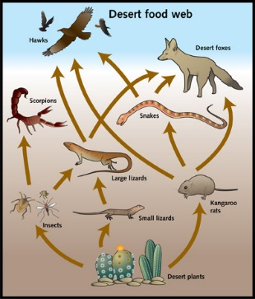
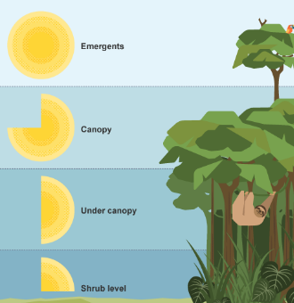
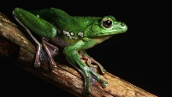
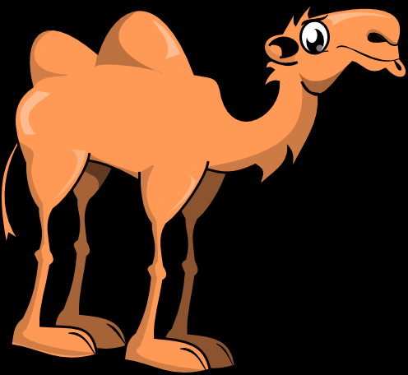
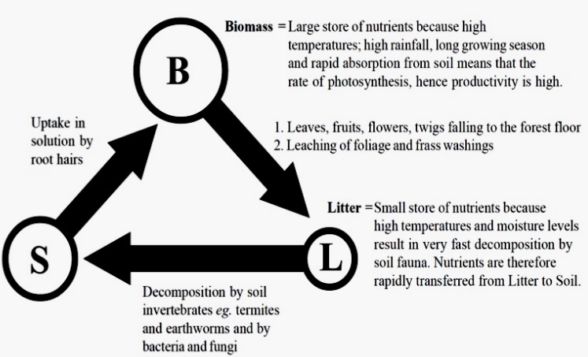
Physical Characteristics of TRF’s
Emergent Layer |  | Tall trees often reaching 50m high. Kapok trees are very fast growing, to compete with other trees to reach the sunlight.
Canopy Layer |  | A mass of leaves, trees grow quickly to reach the light. The leaves sustain the trees through photosynthesis. The majority of species live here - moist air and presence of flowers, seeds and nuts which sustain the food chain.
Under canopy Layer |  | It is very dark. Trees are branchless as there is little sunlight for photosynthesis, so it is not worth growing leaves.
Shrub layer |  | Very dark, poor soils, high humidity
Interactions within hot deserts
Food Web
Plant adaptation in TRF’s
Buttress roots - Massive ridges help them to support large trees. The shallow roots also spread out under the soil to absorb rainwater which quickly evaporates and to take up nutrients from the poor soils. | Drip tips - plants have leaves with pointy tips. This allows water to run off the leaves quickly without damaging or breaking them.
Animal adaptation in TRF’s
Sloth uses camouflage and moves very slowly to make it difficult for predators to spot. | Flying frog has fully webbed hands and feet, and a flap of loose skin that stretches between its limbs, which allows it to glide from plant to plant.
Plant adaptation in TRF’s
Succulents Plants which have fleshy stems or bulbs in order to store water Thorns or spikes to stop animals from eating them | Perennial plants Desert perennials often survive by remaining dormant during dry periods of the year, then springing to life when water becomes available.
Animal adaptation in TRF’s
Physical adaptations Second set of eyelashes Storing fat in humps Colour changes | Behavioural adaptations Nocturnal for cooler temperatures Burrowing to avoid hot surface temperatures
The Balance between components of TRF’s
Value of tropical Rainforests
Home to more than half the world's plant and animal species.
They are home to an estimated 50 million indigenous forest people.
responsible for 20% of the world's rainfall.
Desertification - causes | Reducing the risk of desertification
Population growth - the population in some desert areas is increasing. In places where there are developments in mining and tourism, people are attracted by jobs. | Planting more trees - the roots of trees hold the soil together and help to reduce soil erosion from wind and rain.
Overgrazing - an increasing population results in larger desert areas being farmed. Sheep, cattle and goats are overgrazing the vegetation. This leaves the soil exposed to erosion | Improving the quality of the soil - this can be managed by reducing the number of grazing animals they have and growing crops instead. The animal manure can be used to fertilise the crops grown.
Climate change - the global climate is getting warmer. In desert regions conditions are not only getting warmer but drier too. On average there is less rain now in desert regions than there was 50 years ago | Water management - water can be stored in earth dams in the wet season and used to irrigate crops during the dry season. This is an example of using appropriate technology to manage water supplies in the desert environment.
Case Study –The Sahara Desert – Morocco ()
Development Opportunities | Challenges of developing hot deserts
In 2008 Morocco produced 90,000 metric tonnes of dates and exported 1,200 metric tonnes. In Feb 2016 Ouarzazate, Morocco turned on the first phase of the world’s largest solar energy plant. The power station on the edge of the Saharan desert will be the size of the country’s capital city by the time it is finished in 2018, and provide electricity for 1.1 million people. Moroccan argan oil: the ‘gold’ that grows on trees. It has been used as a medicine by Berbers for centuries, and now the cosmetic and food industries are showing an interest | Water shortages - this is due to human activities, especially the irrigation of agricultural lands. Research has shown that 97% of water used in the Draa valley is used for agriculture, with 2.5% used for domestic purposes A study in 1992 stated that 80% of rural roads in Morocco were in a bad condition, with a third of them impassable for at least 30 days a year and 60% of rural areas at the time were unreachable by a vehicle Extreme temperatures

