Slide 1
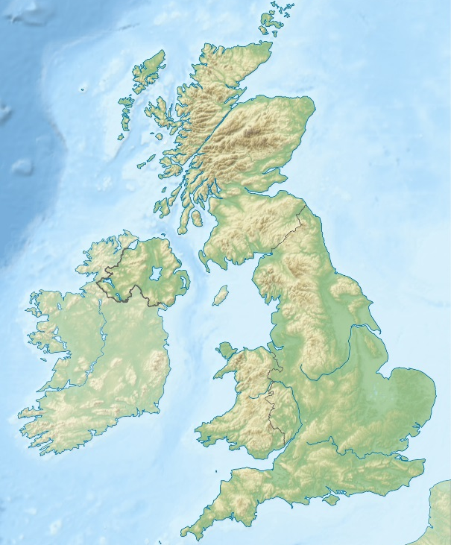
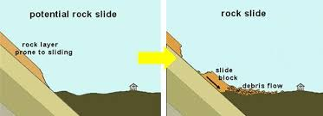
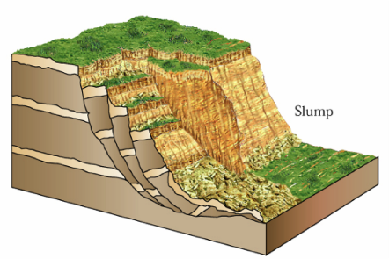
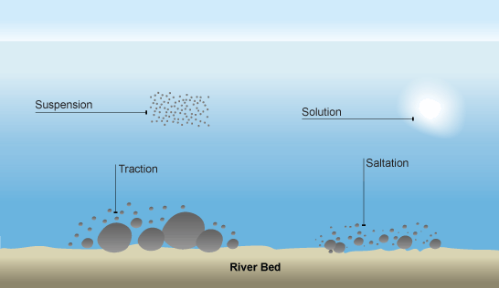
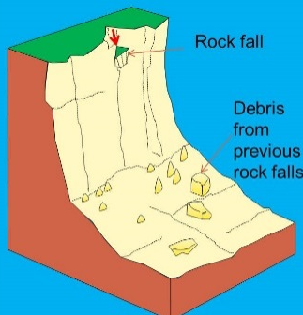
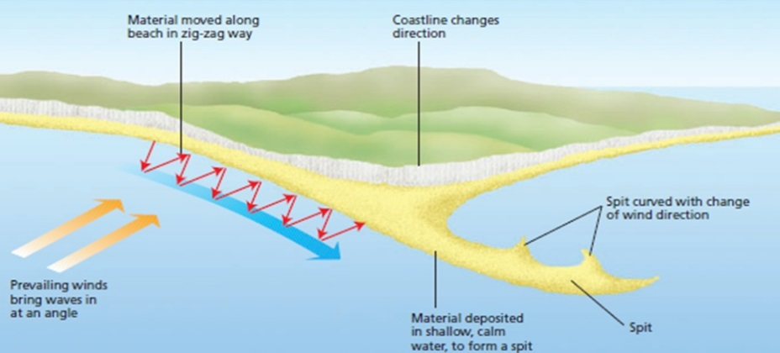


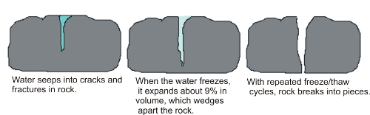
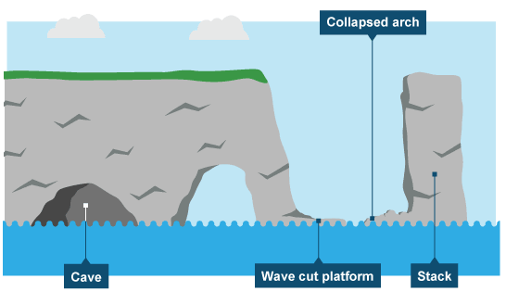
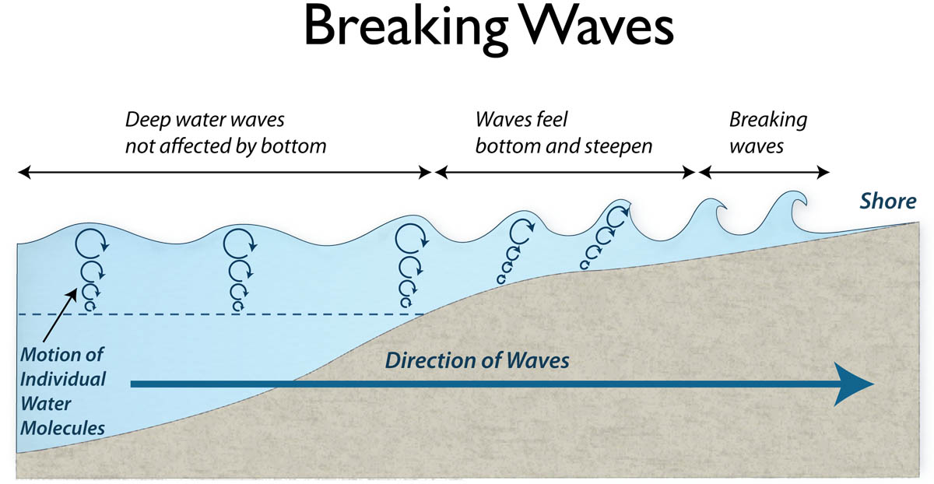
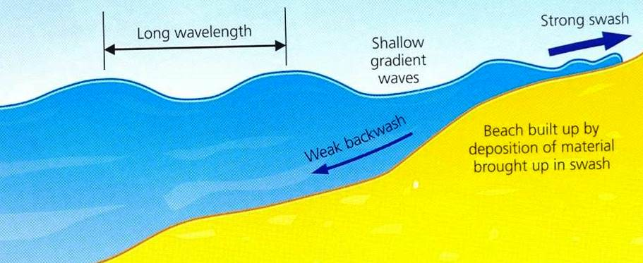
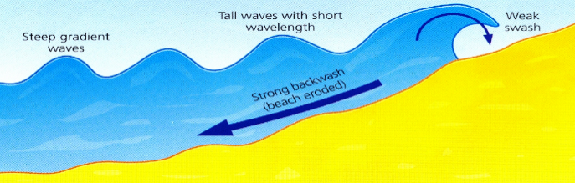
Relief of the UK
Relief of the UK can be divided into uplands and lowlands. Each have their own characteristics.
Key
Lowlands
Uplands
Areas +600m: Peaks and ridges cold, misty and snow common.
i.e. Scotland
Types of Erosion
The break down and transport of rocks – smooth, round and sorted.
Attrition | Rocks that bash together to become smooth/smaller.
Solution | A chemical reaction that dissolves rocks.
Abrasion | Rocks hurled at the base of a cliff to break pieces apart or scraped against the banks and bed of a river.
Hydraulic Action | Water enters cracks in the cliff, or river bank, air compresses, causing the crack to expand.
Types of Transportation
A natural process by which eroded material is carried/transported.
Solution | Minerals dissolve in water and are carried along.
Suspension | Sediment is carried along in the flow of the water.
Saltation | Pebbles that bounce along the sea/river bed.
Traction | Boulders that roll along a river/sea bed by the force of the flowing water.
Mass Movement
A large movement of soil and rock debris that moves down slopes in response to the pull of gravity in a vertical direction.
Rock slides occur when there is a failure along the bedding plane.
Slumping occurs when there is a downward rotation of sections of cliff. Often occur after heavy rain.
Rockfall is the rapid free fall of rock from a steep cliff face because of gravity.
Areas -200m: Flat or rolling hills. Warmer weather.
i.e. Fens
Formation of Coastal Spits - Deposition
Swash moves up the beach at the angle of the prevailing wind. Backwash moves down the beach at 90° to coastline, due to gravity. Zigzag movement (Longshore Drift) transports material along beach. Deposition causes beach to extend, until reaching a river estuary. Change in prevailing wind direction forms a hook. Sheltered area behind spit encourages deposition, salt marsh forms.
Types of Weathering
Weathering is the breakdown of rocks where they are.
Biological | Breakdown of rock by plants and animals e.g. roots pushing rocks apart.
Mechanical | Breakdown of rock without changing its chemical composition e.g. freeze thaw
Example: Spurn Head, Holderness Coast.
What is Deposition?
When the sea or river loses energy, it drops the sand, rock particles and pebbles it has been carrying. This is called deposition. Heaviest material is deposited first.
Formation of Bays and Headlands
 | Waves attack the coastline. Softer rock is eroded by the sea quicker forming a bay, calm area cases deposition. More resistant rock is left jutting out into the sea. This is a headland and is now more vulnerable to erosion.
Bay
Unit 1c
Soft rock
Physical Landscapes in the UK
Hard rock
Headland
How do waves form?
Waves are created by wind blowing over the surface of the sea. As the wind blows over the sea, friction is created - producing a swell in the water.
Mechanical Weathering Example: Freeze-thaw weathering
Stage One Water seeps into cracks and fractures in the rock. |  | Stage Two When the water freezes, it expands about 9%. This wedges apart the rock. |  | Stage Three With repeated freeze-thaw cycles, the rock breaks off.
Formation of Coastal Stack
Hydraulic action widens cracks in the cliff face over time. Abrasion forms a wave cut notch between high tide and low tide. Further abrasion widens the wave cut notch to from a cave. Caves from both sides of the headland break through to form an arch. Weather above/erosion below –arch collapses leaving stack. Further weathering and erosion eaves a stump.
Why do waves break?
1 | Waves start out at sea.
2 | As waves approaches the shore, friction slows the base.
3 | This causes the orbit to become elliptical.
4 | Until the top of the wave breaks over.
Example: Old Harry Rocks, Dorset
Size of waves
Affected by: Fetch how far the wave has travelled Strength of the wind. How long the wind has been blowing for.
Types of Waves
Constructive Waves | Destructive Waves
This wave has a swash that is stronger than the backwash. This therefore builds up the coast. | This wave has a backwash that is stronger than the swash. This therefore erodes the coast.

Slide 2
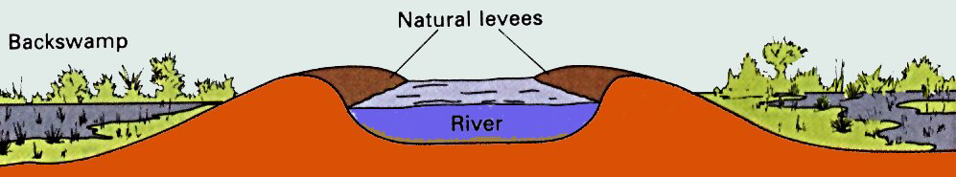
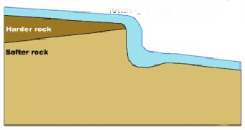
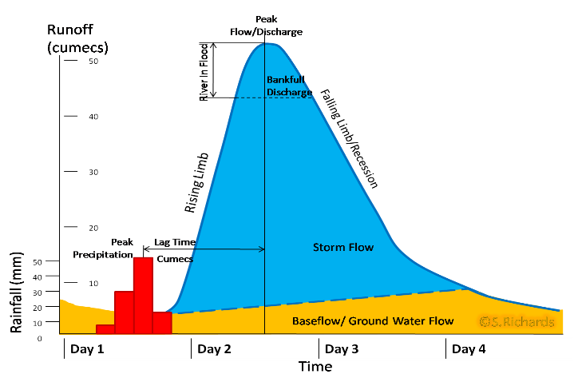
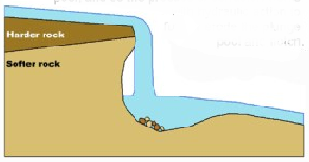
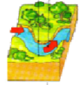
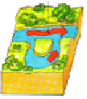
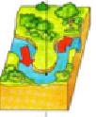
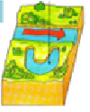


Coastal Defences
Hard Engineering Defences
Groynes | Wood barriers prevent longshore drift, so the beach can build up. | Beach still accessible. No deposition further down coast = erodes faster.
Sea Walls | Concrete walls break up the energy of the wave . Has a lip to stop waves going over. | Long life span Protects from flooding Curved shape encourages erosion of beach deposits.
Gabions or Rip Rap | Cages of rocks/boulders absorb the waves energy, protecting the cliff behind. | Cheap Local material can be used to look less strange. Will need replacing.
Soft Engineering Defences
Beach Nourishment | Beaches built up with sand, so waves have to travel further before eroding cliffs. | Cheap Beach for tourists. Storms = need replacing. Offshore dredging damages seabed.
Managed Retreat | Low value areas of the coast are left to flood & erode. | Reduce flood risk Creates wildlife habitats. Compensation for land.
Water Cycle Key Terms
Precipitation | Moisture falling from clouds as rain, snow or hail.
Interception | Vegetation prevents water reaching the ground.
Surface Runoff | Water flowing over the surface of the land into rivers
Infiltration | Water absorbed into the soil from the ground.
Transpiration | Water lost through leaves of plants.
Lower Course of a River
Near the river’s mouth, the river widens further and becomes flatter. Material transported is deposited.
Formation of Floodplains and levees
When a river floods, fine silt/alluvium is deposited on the valley floor. Closer to the river’s banks, the heavier materials build up to form natural levees.
Nutrient rich soil makes it ideal for farming. Flat land for building houses.
Physical and Human Causes of Flooding.
Physical: Prolong & heavy rainfall Long periods of rain causes soil to become saturated leading runoff. | Physical: Geology Impermeable rocks causes surface runoff to increase river discharge.
Physical: Relief Steep-sided valleys channels water to flow quickly into rivers causing greater discharge. | Human: Land Use Tarmac and concrete are impermeable. This prevents infiltration & causes surface runoff.
River Management Schemes
Soft Engineering | Hard Engineering
Afforestation – plant trees to soak up rainwater, reduces flood risk. Demountable Flood Barriers put in place when warning raised. Managed Flooding – naturally let areas flood, protect settlements. | Straightening Channel – increases velocity to remove flood water. Artificial Levees – heightens river so flood water is contained. Deepening or widening river to increase capacity for a flood.
Upper Course of a River
Near the source, the river flows over steep gradient from the hill/mountains. This gives the river a lot of energy, so it will erode the riverbed vertically to form narrow valleys.
Hydrographs and River Discharge
River discharge is the volume of water that flows in a river. Hydrographs who discharge at a certain point in a river changes over time in relation to rainfall
1. Peak discharge is the discharge in a period of time.
2. Lag time is the delay between peak rainfall and peak discharge.
3. Rising limb is the increase in river discharge.
4. Falling limb is the decrease in river discharge to normal level.
Formation of a Waterfall
 | 1) River flows over alternative types of rocks.
 | 2) River erodes soft rock faster creating a step.
 | 3) Further hydraulic action and abrasion form a plunge pool beneath.
 | 4) Hard rock above is undercut leaving cap rock which collapses providing more material for erosion.
 | 5) Waterfall retreats leaving steep sided gorge.
Don’t forget to look at the case study booklet – North Wales Coastline
Formation of Ox-bow Lakes
Step 1 |  | Step 2
 | Erosion of outer bank forms river cliff. Deposition inner bank forms slip off slope. |  | Further hydraulic action and abrasion of outer banks, neck gets smaller.
Step 3 |  | Step 4
 | Erosion breaks through neck, so river takes the fastest route, redirecting flow |  | Evaporation and deposition cuts off main channel leaving an oxbow lake.
Middle Course of a River
Here the gradient get gentler, so the water has less energy and moves more slowly. The river will begin to erode laterally making the river wider.
Case Study - Boscastle flood August 16th 2004 | Causes of flood - 5 hours of heavy rain (3 inches in 1 hour), Impermeable rock, steep valley sides, thin soils limit vegetation. Buildings narrowing river channel. Narrow bridges trapped debris. Effects of flood - 100 homes and 25 businesses | damaged. 75 cars and 8 boats washed away. 150 people had to be rescued. Damage cost £15 million. Responses to flood - Scheme cost £4.6 million. Beds of rivers lowered and channels widened. Bridges widened. Car park raised. Trees removed from near river.
Boscastle is a small village in Cornwall. It has a permanent population of under 1000. 90% of jobs in the village are linked to tourism.

