Slide 1

Alice Lane
Assistant Head Teacher

Slide 2

In the event of fire

Slide 3

How are we different?

Slide 4

What does that look like?

Slide 5
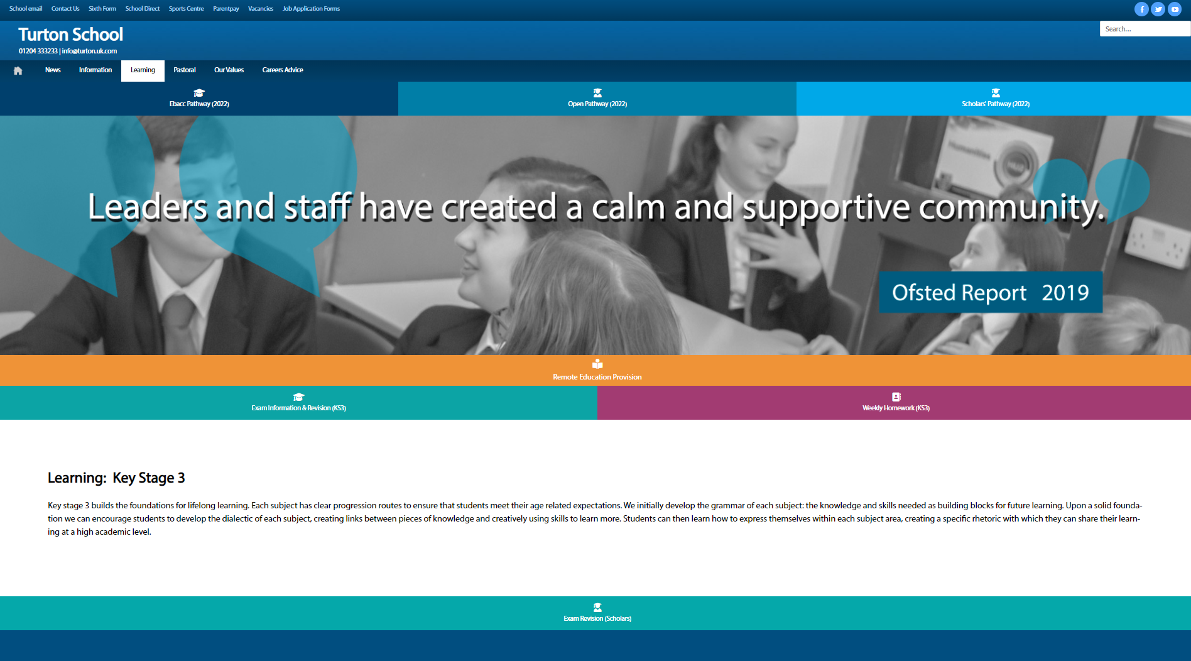
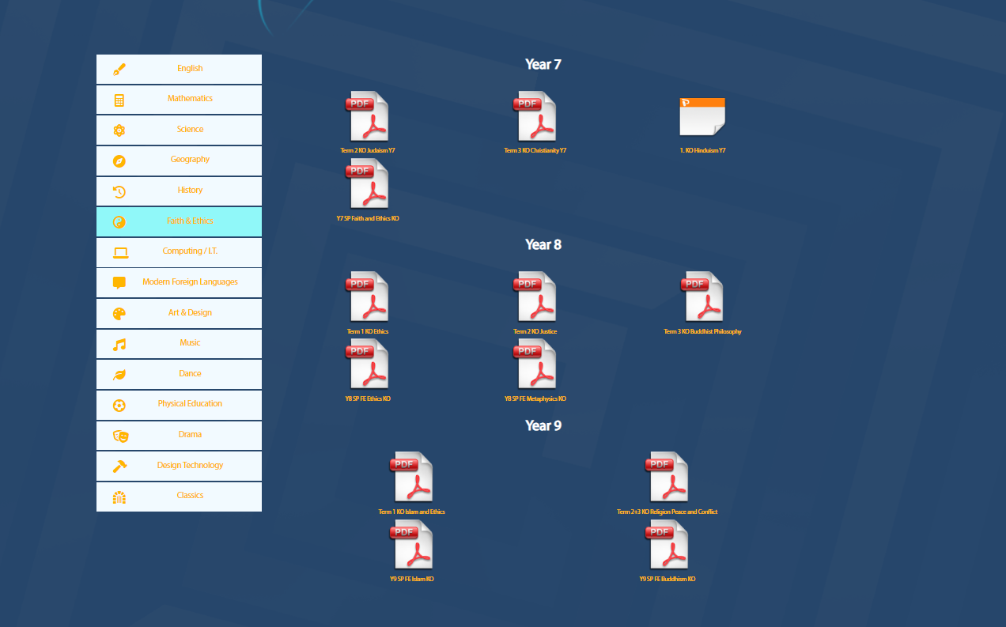
Just Google “Turton Learning” We’re the first link
Learning • Turton School

Slide 6
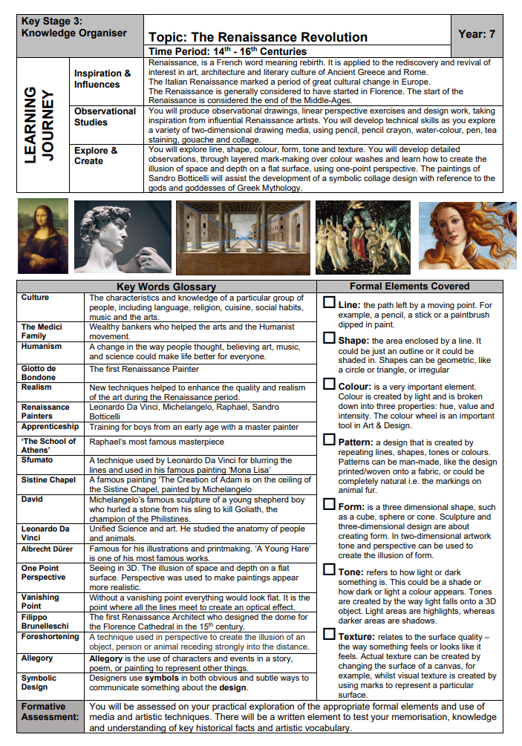
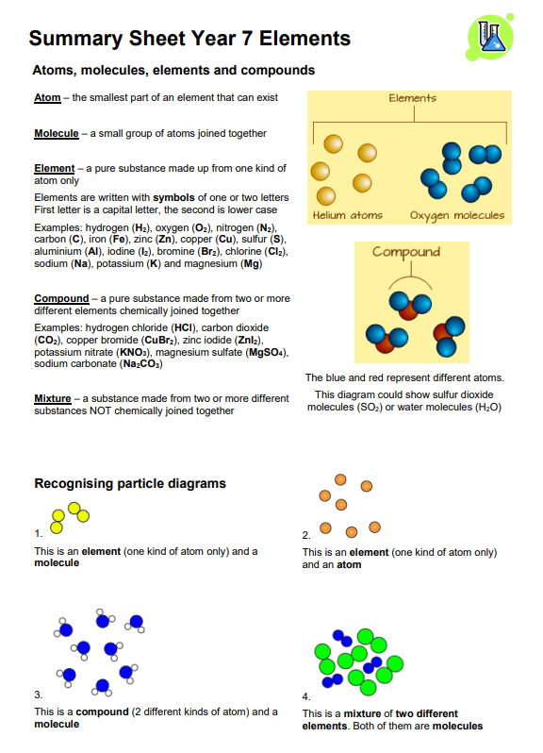

Slide 7
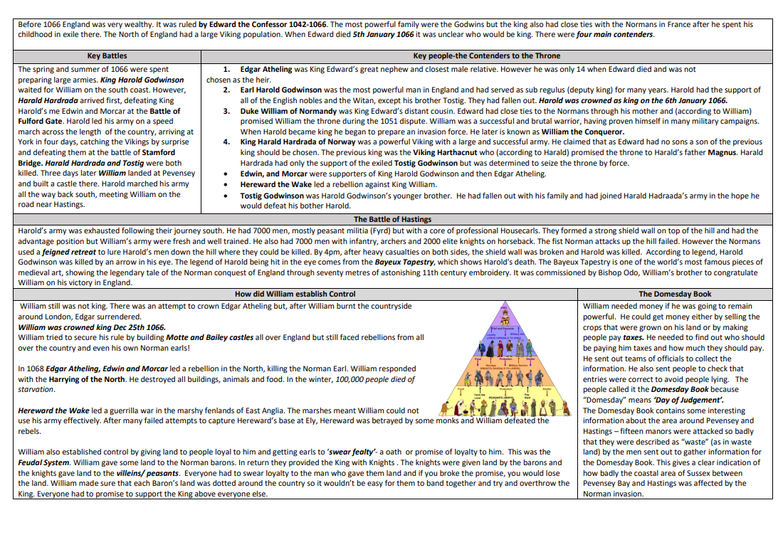

Slide 8
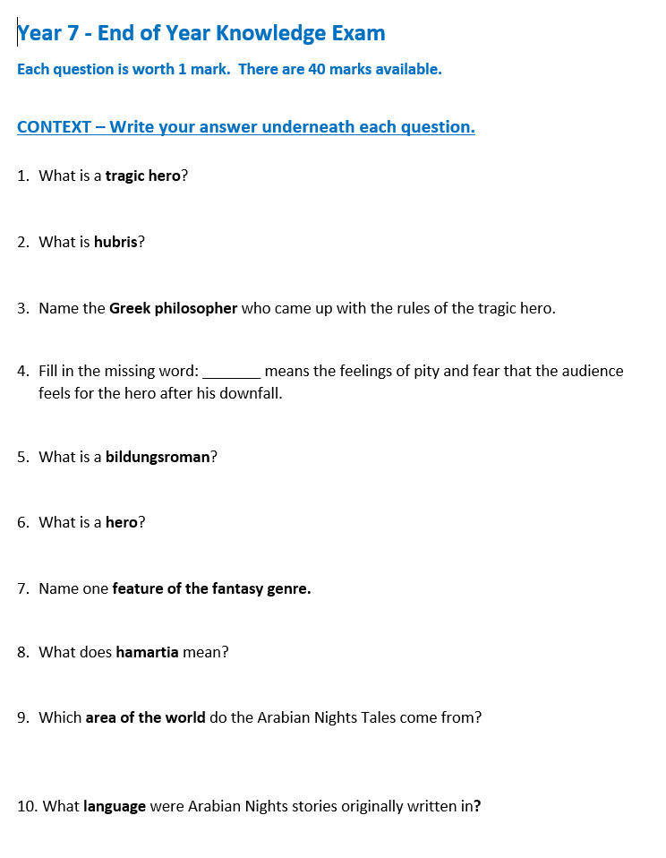
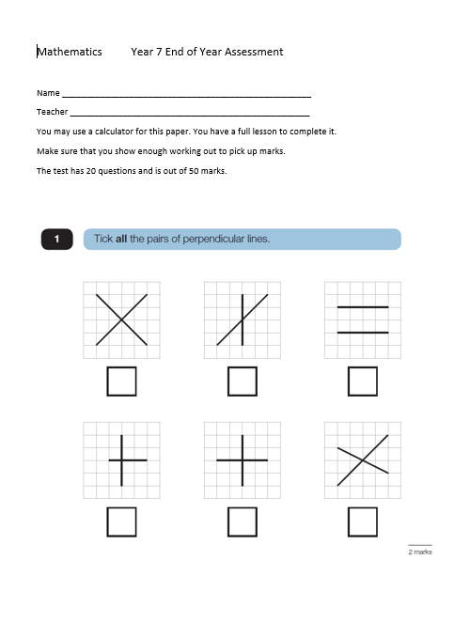
How do we know how pupils are doing?

Slide 9

Just Google “Turton Homework” We’re the first link
https://www.turton.uk.com/homework/

Slide 10
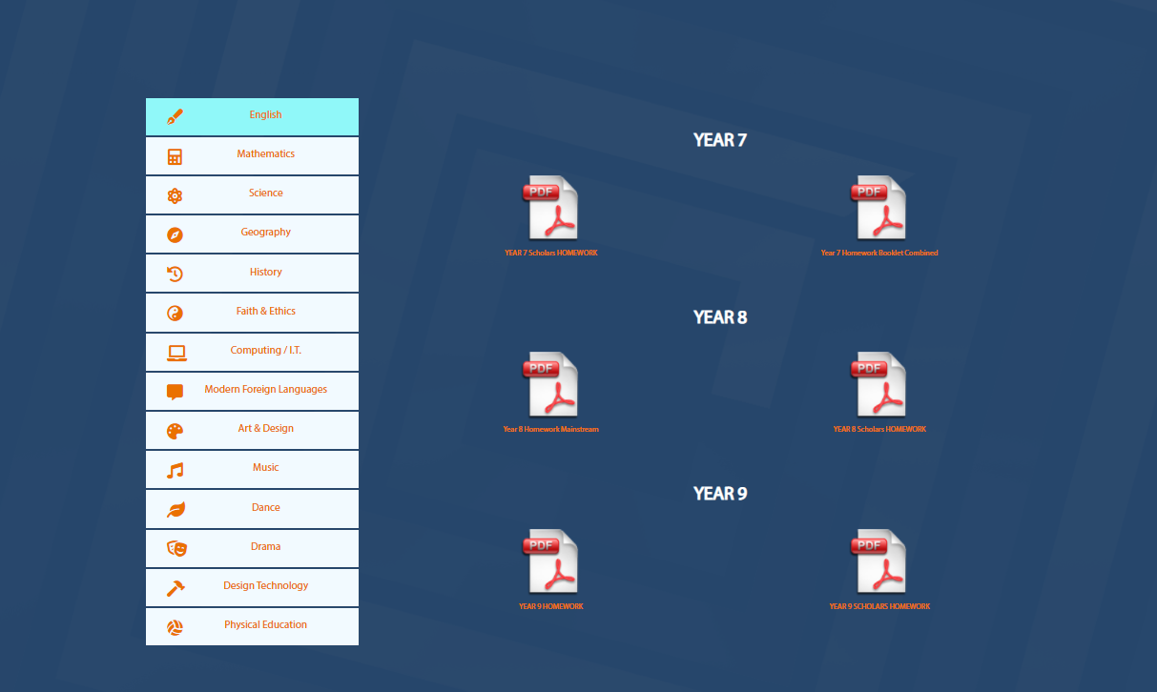

Slide 11



Homework support

Slide 12
How do you know what your son/daughter is doing at school?
Talking to them – good luck!
Curriculum & pastoral evening
KS3 curriculum booklet
Keeping in contact with form tutor
Scores in homework booklets
End of term assessments
Extra-curricular events
Year 9 pathways information
Mid-year work-ethic report
Parents’ evening
Year 8 mini-options evening
Exam preparation evening
End of year profile report

Slide 13


Slide 14
Natalie Parry
Assistant Head Teacher

Slide 15


Mobile Phones

Slide 16



Social Media

Slide 17
Indecent Images of Children
Child Under 18
Indecent
- exposing intimate parts of body
- sexual pose
- sexual act
  Take / possess / distribute

Slide 18
Criminal Offence
Reported to police
Recorded formally on police systems
Phone sent for examination
Possible destruction of phone

Slide 19
Online Predators
Grooming
  Arranging to meet
Sexual Communication with a Child
  Graphic chat
Incite Child to Engage in Sexual Activity
  Requesting images / videos

Slide 20
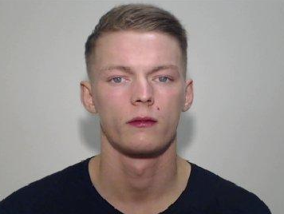
2019-2020
‘Depraved’ Farnworth man jailed for sexual abuse of teens
24 years old
Used social media to befriend teenage girls
Persuaded them to meet him and sexually abused them
Sentenced to 9 ½ years in prison

Slide 21
You must -
Check your child’s phone regularly
Ensure privacy settings are correct
Remove friends that aren’t ‘friends’
Encourage your child to talk to you
Remove at night

Slide 22
Useful Information
www.internetmatters.org
www.ceop.police.uk
www.saferinternet.org.uk
Contact
Police - 101
www.gmp.police.uk – report a crime / incident

Slide 23
Behaviour Consultation
National College and DFE 2021
  Most effective schools teach children the necessary social skills and behaviours for them to make academic progress and flourish in school and beyond.
  Good habits for learning
  Challenge low level disruption
  Pro-actively teach students to behave well

Slide 24
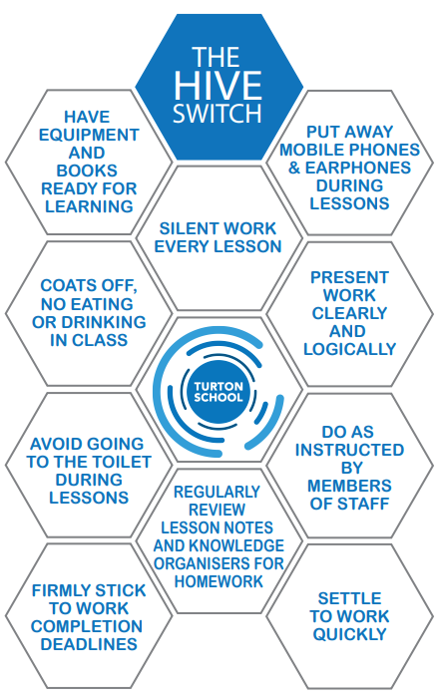
Culture
Shared beliefs and values.
  Demonstration
  Instruction
  Repetition
  The power of social norms – attracting you towards behaving in a certain way

Slide 25
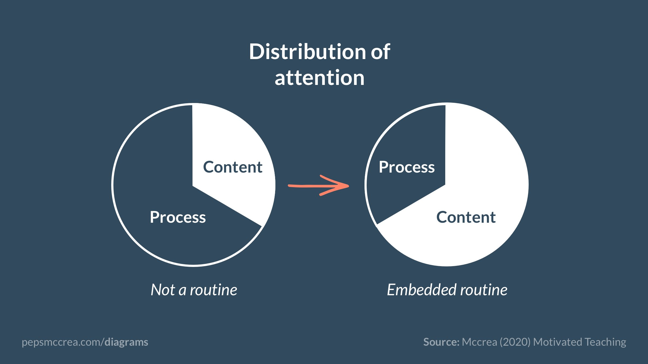
Routines
Perhaps the most single most powerful way to bring efficiency, focus and rigor to a classroom is by installing strong procedures and routines. You define a right way to do recurring tasks; you practise doing them with students so they roll like clockwork.
Doug Lemov
The building blocks of culture.
  Repeat
  Practise
  Consolidate
  The power of routines

Slide 26
