Slide 1
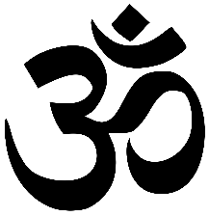
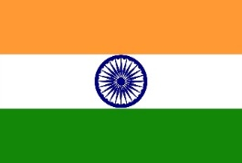
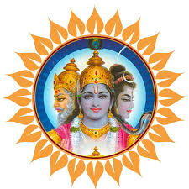
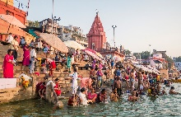
Reincarnation and Samsara
Hindus believe that we are trapped in a cycle of life, death and rebirth and that it is our aim to build our way to paradise and free ourselves from the cycle. We do this by being kind and compassionate to all things and building up as much good karma as possible.
Reincarnation – The Belief that you are reborn after death in a new body.
Samsara – The Hindu cycle of life, death and rebirth.
Moksha – Paradise; Freedom from Samsara – This is every Hindus aim.
Atman – The invisible part of every being that moves on into the next life (soul).
Karma - The idea that all actions have consequences. This determines whether a Hindu will have a good next life or not and whether they will reach moksha.
Hinduism Basic Facts
Founder: Unknown
Began: 4000-6000 years ago.
Place of Worship: Mandir
Belief in God: Monotheism
Hindu Immigration to Britain
India: Many Hindus came from India in 1947 due to the conflict caused by the partition of India and Pakistan.
Uganda: In September 1972, Idi Amin ordered the exile of 30,000 Asian, Ugandan Hindus. They had only 90 days to leave the country and all their possessions. Most came to Britain.
Hinduism Y7
Knowledge Organiser
The River Ganges
Hindus believe that the River Ganges (Ganga) in India is actually a part of God; the goddess Ganga. She is part of the creation story. Brahma sends Ganga down to earth to put out a great fire and Shiva helps ganga by stopping her great force from destroying the Earth. The Ganges is used for everything from funerals to pilgrimages (religious journeys).
God and The Trimurti
Hindus believe in One God (Brahman).
Brahman is split into 3 parts.
Each part of God has it’s “role” or “job”. This helps Hindus to understand God better.
Vishnu – The Preserver (looks after the world).
Shiva – The Destroyer and Re-creator (destroys to make room for new things.
Brahma – The Creator (Created the world but not prayed to anymore as his job is now complete)
Ganesh
Ganesh – Elephant god (lower case g because he is only an aspect of God)
His Story: Made from clay by his mother, Parvarti. He refuses to let Shiva into the home and has his head cut off. Shiva replaces the head with an elephant’s head. He is the most prayed to god in Hinduism and his jobs include: The Remover of Obstacles, Education and Good Fortune. He is prayed to before all other gods.

Slide 2
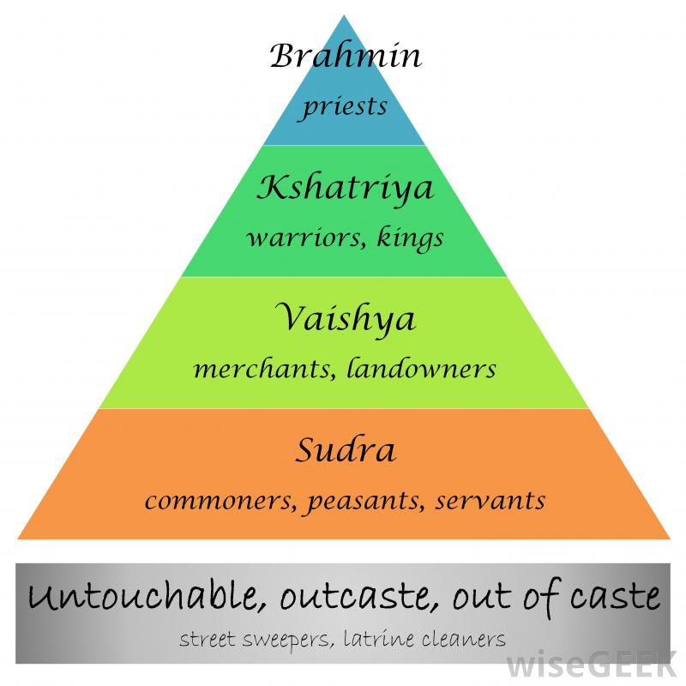
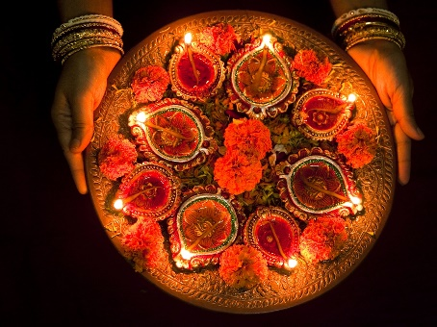
Holi
Murtis
Holi Festival is the festival of colour, it begins at the last full moon, Phalguna, at the start of spring. Hindus will Light bonfires, throw gulal (coloured powder), eat sweets and dance to celebrate.
To Understand God (Brahman) better Hindus split god into demi-gods (Murtis).
Lakshmi – The goddess of Wealth and Beauty.
Lord Rama – The god of “good over evil” from the Diwali story.
Hanuman – The Monkey god from the Dwiali story that helps Lord Rama.
Kali – The Dark Mother.
Saraswati – The goddess of knowledge and music.
Ganesh – The remover of obstacles and the god of education and good fortune.
Puja
Hindu worship is called puja – whether it is at the temple or at home. Puja means ‘giving respect and honour’. The god or goddess they worship is treated as an honoured guest. The main worship ceremony is called arti which is an offering of light to the deity through a murti. The image of god is ‘awakened’ by the lighting of a flame – this is known as Agni, and by the sound of a mantra – holy words.
The Caste System
This is a social hierarchy in India that ranks people in society based on the jobs that they do. This is controversial and many in India think it is wrong as it excludes many people.
The Stages of Life
According to the Hindu Scriptures a human life can be mapped out into important stages or Ashramas.
There are 4 main stages of life:
· The Student stage: This is when a person is old enough to take their spiritual education seriously.
· The Householder stage: When a person gets married and is setting up home.
· The Recluse stage: When a person becomes a grandparent .
· The Spiritual stage: Entered into voluntarily to focus on the next life.
Diwali
The festival of light and the Hindu New Year. The most important day of the year for Hindus. It remembers the story of Lord Rama defeating the demon Ravana and freeing Sita. Hindus light rows of diva lamps to celebrate Rama and Sitas return home. Hindu decorate their homes and set off fireworks to celebrate this festival.

