Slide 1
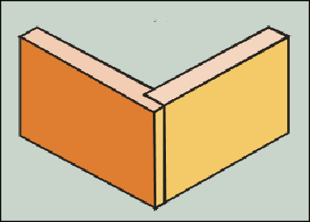
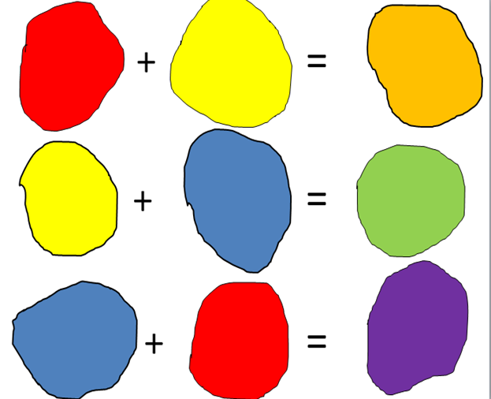
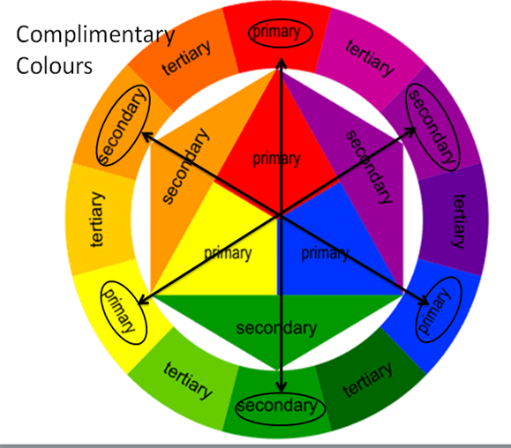
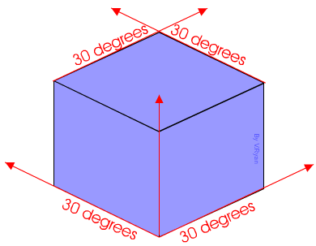
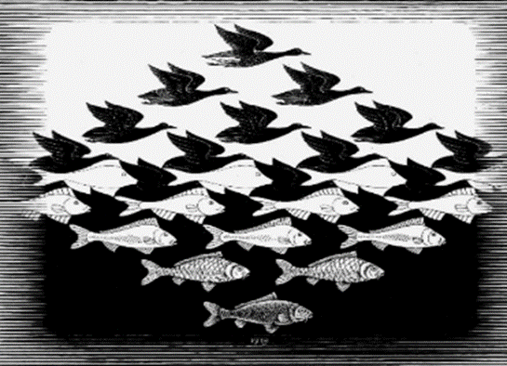
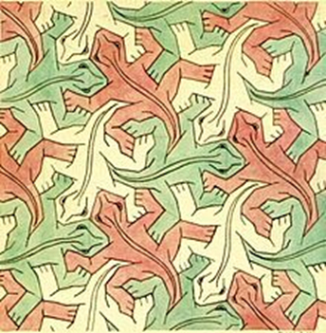
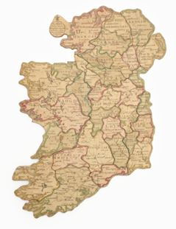
Materials:
Woods- hardwoods- softwoods- manufactured
Hardwoods- lose their leaves- deciduous
Soft woods- keep their leaves-evergreen
Manufactured- man made wood
Advantages of manmade boards: available in large sheets, environmentally friendly/sustainable material, cost effective (cheap), does not have knots/defects.
Plastics- thermoplastic-thermoset.
Thermoplastic- can be recycled- HIPS and Acrylic.
Thermosetting- can’t be recycled and reshaped.
Colour Theory:
Primary-red, yellow and blue
Secondary-orange, purple and green.
Tessellated shapes:
Arrangements of closed shapes that completely cover plane without overlapping and without leaving gaps.
3 regular geometric shapes-equilateral triangle, square and hexagon.
Regular-all sides and internal angles are equal.
Others-parallelograms, rhombus and rectangles
Wood Joints:
Lap joint: a joint made by halving the thickness
of each member at the joint and fitting them
together.
Key words:
PPE
Biomimicry
Injection moulding
Tessellations
Regular
Irregular
Pentagons
Primary
Secondary
Tertiary
Complimentary
Equilateral
Tessellate
Isometric
Heat press
Heat Transfer
MDF
Manufactured Board
Fretsaw
Try square
Goggles
Apron
Plywood
Vice
Bench Hook
Lap joints
Tenon saws
Fabricate
Adhesive
Hammer
Pins
PVA
Vacuum former
HIPS
Thermo plastic
Particles
Molecular
Glass paper
Abrasive
Sanding block
Wax
Wet and dry paper
CAD
CAM
Production processes:
One off production- wedding rings, bespoke furniture, one product being made Manufactured by a skilled craftsperson, very expensive.
Mass production-cars, cookers, Many similar products are made, manufactured by machines, Affordable prices.
Continuous production- plastic bottles, food cans, same product made 24/7, there is a constant demand, very high set up costs
CAD-Computer aided design
Programs-2D design- a design program that links to a CAMM
CAM- Computer aided manufacture
Machine-Heat press- a machine that transfers a design onto a surface using high temperatures and pressure. The images gets transferred through die sublimation.
Advantages of CAD/CAM: Accuracy, consistency, speed and safer.
Disadvantages of CAD/CAM: High initial set up costs, staff require training, higher energy costs, not cost effective for manufacturing in small quantities.
Isometric: a method for visually representing three-dimensional objects in two dimensions in technical and engineering drawings.
Drawn at an angle
of 30 degrees.
Jigsaw puzzle
Saws:
Ancient saw- dates back to the later stone age
Biomimicry inspired- nature inspired from the saw fish and wasp
Egyptian-bronze saws with jewelled teeth
Prehistoric saw- made from flint with irregular teeth
Japanese saw- cuts on the pull, butchers cleaver
Mill saw- driven by wind-power and water power
Band saw- William Newberry Patented the first
Cross cut saw- Cuts on both strokes
Chain saw- Also used by surgeons for bone cutting
Hack saw-Cuts metal with greater ease
History of Toys:
Vikings- 400 AD
Queen Victoria reins-1837-1901
Word soviets would be associated with the dates 1945-1991
World war 1- 1914-1918
World war 2-1939-1945 (wider expansion, more materials used across the war, not many materials for toys)
Tudors- 1485-1603
A Bomb invented- 1945
Taefl- played by the Anglo-Saxons
Egyptians- used papyrus
Coronation of Queen Elizabeth 2nd -1953
Dreadnoughts- relates to naval power in World War 1
Airpower-World War 2
Hnefatafl- played by the Vikings
Moon landing- 1969
Bluetooth invented- 1990s
Development of injection moulding-1946
M C Escher(1898-1972):
He was born in the Netherlands.
Over his life he made over 448 Lithographs, woodcuts, wood engravings. Over 2000 sketches and drawings.
In 1922, on his visit to Spain, he became fascinated with Division Plane, In Switzerland, during WWII, he completed 62 of 137 Regular Division Drawings.
After this adoration, he read more about math, dealing with plane and projective geometry, non-Euclidean geometry.
Tessellations: Escher, took his
basic problems and applied
reflection, glide reflections,
translations and rotations.
Tools and processes:
Claw hammer- is a tool primarily used for pounding nails into, or extracting nails from, some other object.
Coping saw- is a type of hand saw used to cut intricate external shapes and interior cut-outs in woodworking.
Tenon saw- is a type of hand saw used to cut wood straight.
Bench hook- its purpose is to provide a stop against which the piece of wood being worked can be firmly held.
File- a steel hand tool with small sharp teeth on some or all of its surfaces; used for smoothing wood or metal.
Vacuum forming- is a simplified version of thermoforming, whereby a sheet of plastic is heated to a forming temperature, stretched onto a single-surface mould, and forced against the mould by a vacuum (suction of air)
Jigsaw puzzle:
John Spilsbury (1739 – 3 April 1769) was a British cartographer and engraver. He is credited as the inventor of the jigsaw puzzle. Spilsbury created them for educational purposes, and called them “Dissected Maps.
Spilsbury created the first puzzle in 1766 as an educational tool to teach geography.

