Slide 1
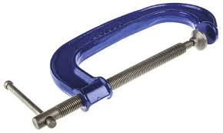
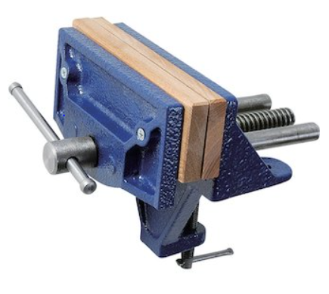
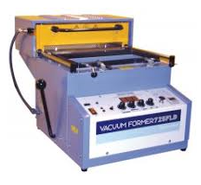
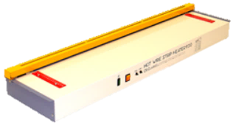
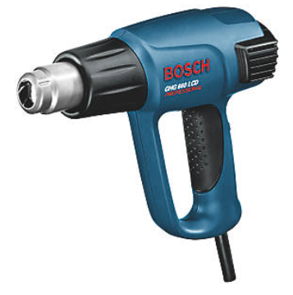
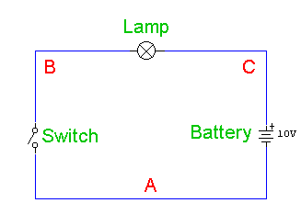
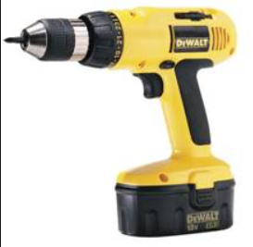
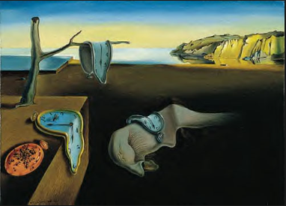
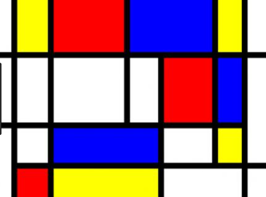
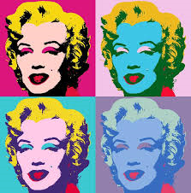
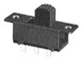
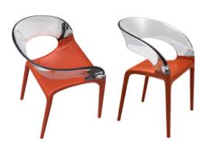
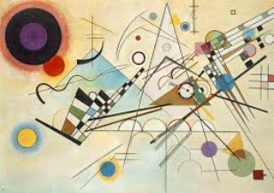
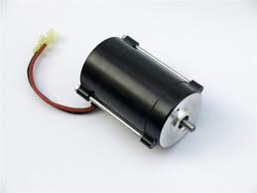
Tools:
Wire cutters- tool used for cutting wire and stripping rubber off wire.
G clamp- used to clamp material in place, looks like the letter G.
Wood vice- a tool with movable jaws to hold work in place.
Machine vice- a tool with movable jaws to hold work in place when using a machine.
Vacuum former- a machine that heats the sheet of plastic to a forming temperature, stretch onto a mould with a vacuum.
Strip heater- heats the plastic in a straight line, so it can be bent by hand.
Hot air gun- used to heat up a material by means of a stream of very hot air.
Drill- a tool with a rotating cutting tip, used to create holes.
PPE:
Safety glasses must be worn,
to prevent damage to your eyes, when using tools and equipment.
Safety gloves must be worn,
to prevent burning your hands, when handing hot objects.
Ear defenders must be worn,
to prevent damage to your hearing, when using loud equipment.
Dust mask must be worn,
to prevent your respiratory system getting damaged, when using equipment, adhesives and paints.
USING CAD Advantages
It is quick to produce/ saving money
It can be easily modified/do not need to redraw the design
It can be rendered to look like it is made in any material/ so you can visualise how it will look.
It can be emailed anywhere in the world/saving the time and expense of postage
It can be transferred to manufacture/saving time and money
It can be shared instantly with the client/reducing the time it takes to get a successful design Disadvantages
Initial set up costs is expensive/hardware and the design software are expensive
If there is a fault all your work can be lost/costly in terms of time and money
Your idea can be hacked/ideas stolen
You need good IT skills to design in 3D/employing a different workforce or retrain the existing workforce
Soldering
Soldering iron- tip gets hot, used to heat up the legs of components, to join the solder.
Wires-
Rubber outside- doesn’t conduct heat or electricity
Copper wire- good conductor or electricity, flexible
Red wire- positive
Black wire- negative
Key words:
Solder
Soldering iron
Wire cutters
Polarised
PVA Adhesive
G Cramp
Vice
Fabricate
Laser cutter
Etch
Kiss cut
Resistor
Capacitor
Battery snap
Slide switch
LED
Buzzer
Lamp
Motor
Rubber
Copper
Conductor
Insulator
Hot air gun
Machine vice
Circuit diagram
Specification
Wax
Gloss paint
Matt paint
Linseed oil
Varnish
Stain
Decoupage
Shellac
Safety glasses
Ear defenders
Dust mask
Safety gloves
Evaluation
Surrealist
Abstract
Pop art
Abstract modern movement
Laser cutter
Technology that uses a laser to cut materials. Speed and power settings can be changed for different materials and thicknesses.
Links to CAD program- 2D design.
Red line- etch
Blue lines- kiss cut
Black lines-cut
Circuit diagrams:
Circuit symbols are used to create a circuit diagram.
Year 9 RM
Knowledge Organiser
Lamps
Electronics:
Polarised indicates whether a circuit component is symmetric or not.
Non-polarised a part without polarity, can be connected in any direction and still function the way it’s supposed to function.
Specification: a detailed description of the design and materials used to make something, this is based on the research conducted.
Evaluation: Designers evaluate their finished products or prototypes in order to test whether they work well and if the design can be corrected or improved.
Artists and designers:
Salvador Dali bizarre surrealist style he was also a skilled classical painter and illustrator.
Mondrian painter who was an important leader in the development of modern abstract art.
Andy Warhol illustrator in New York, famous for his screen-printed images of Marilyn Monroe, soup cans, quickly became synonymous with Pop art.
Philppe stark French designer, wide range of designs, including everything from interior design to household objects to boats to watches. He has also worked as an architect.
Wassily Kadinsky One of the pioneers of abstract modern art, exploited the evocative interrelation between colour and form to create an aesthetic experience that engaged the sight, sound, and emotions of the public.
Resistor non polarised, determines the flow of current through a circuit.
Electrolytic Capacitor polarised, stores energy and releases it when needed.
Speaker polarised, converts electrical energy into sound
Battery snap polarised, a connection from the circuit to the power supply.
Slide switch polarised, when switched this allows the circuit to work.
LED (light emitting diode) polarised, converts electrical energy into light.
Buzzer polarised, converts electrical energy into sound.
Lamp polarised, converts electrical energy into light.
Motor polarised, converts electrical energy into rotary motion.
Finishes:
Wax protects like a varnish against knocks, scuffs and scratches. The difference is in the finish - It leaves your wood looking and feeling natural.
Gloss Paint are generally more resistant to damage than flat paint, more resistant to staining, and easier to clean, adds colour to the material.
Matt Paint dull rather than shiny, adds some protection, adds colour to the material.
Linseed oil adds protection, enhances the grain, dries quickly.
Varnish is a transparent, hard, protective finish or film that is primarily used in wood finishing but also for other materials.
Stain achieve a great deal of different colours, which can be very helpful when matching your wood to existing or planned decorations.
Decoupage decorates the exterior of the product with images, these images can be protected by using glue or resin.

