Slide 1
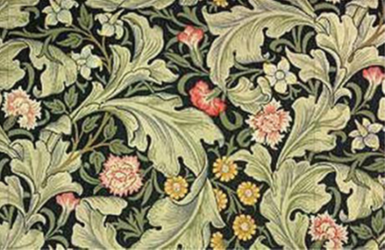
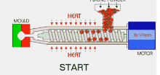
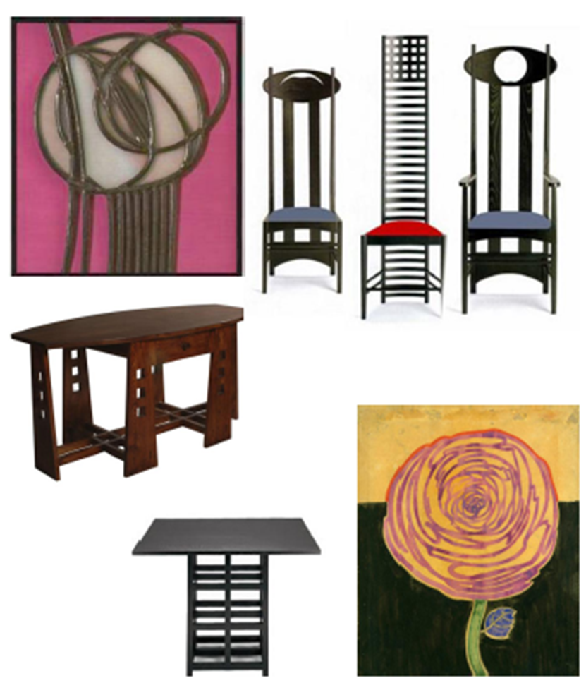

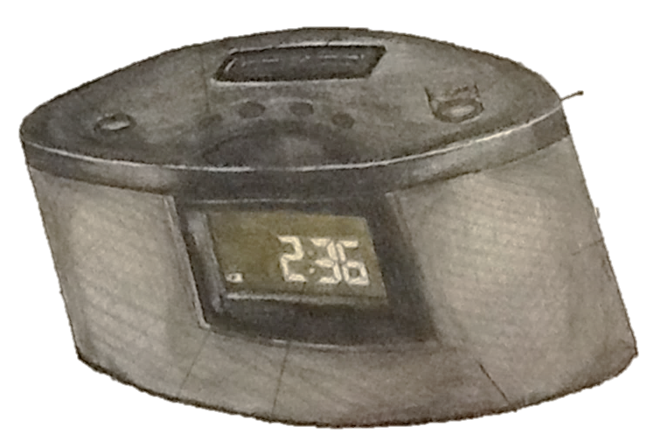
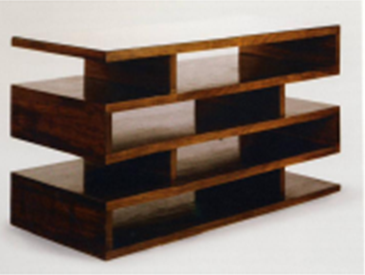

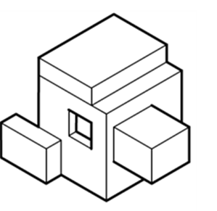

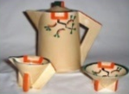
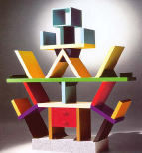


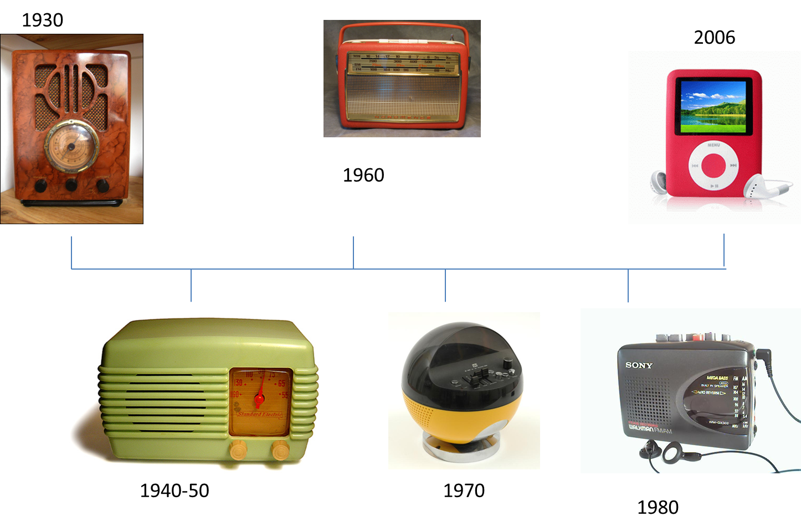
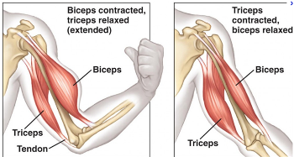


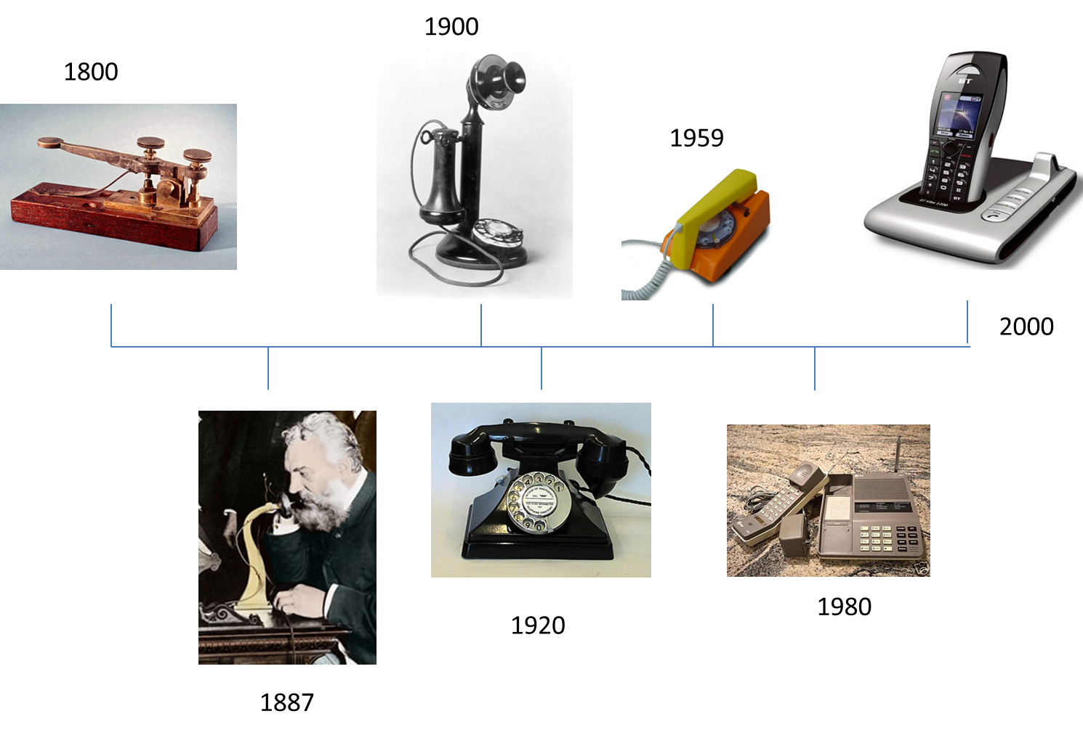
Design movements:
Product age as a result from the exhibition, manufacturers realised that product designers were needed.
Arts and craft 1890-1910 products are functional, natural materials, organic form, nature and expensive. William Morris.
Art Nouveau 1880-1914 designs are intricate linear, flowing curves, elongate, natural floral forms. Mackintosh
Bauhaus 1920- innovative, contemporary, functional, steel, wood, glass, black, white, brown and grey. Walter Gropius.
Art Deco 1920-1939 brought together several movement, geometric shapes, chevron patterns, sunburst motifs. Clarice Cliff.
Memphis 1981-1988 aesthetics rather than function, bright colourful shocking pieces, Ettore Sottsass.
Materials:
Wood-hard-soft-manufactured
Hard-deciduous trees-grow slower-grain closer-expensive
Oak attractive grain, light brown in colour, furniture
Soft-coniferous tress-grow fast-cheaper-grain far apart
Pine easy to work with, knotty, light in colour, simple joinery
Manufactured-fibres and resin-large sheets-don’t warp, cheaper, environmentally friendly
Plywood strong, layers, with the grain opposite, inner panelling
Metal-ferrous-non ferrous-alloy
Ferrous-contain iron, prone to rust are magnetic
Mild steel tough, high tensile strength, railway tracks
Non ferrous- no iron, isn’t magnetic and doesn’t rust
Aluminium ductile, soft, malleable and lightweight, ladders
Alloy-mixture of two or more different metals, to enhance
Plastics-thermoplastic-thermoset
Thermoplastic- can be reheated and reshaped.
ABS-tough material, lightweight, toys
Thermoset-cannot be reheated and reshaped
UF-tough, durable, plug sockets
Drawing:
Isometric
Drawn on
an angle of 30 degrees,
all sides are in
proportion.
Render
adding colour,
shade and texture
to an image.
Thick and Thin lines
Use thick and thin
lines to emphasise
the outline of a
sketch.
Manufacturing processes
Plastic
Injection moulding- plastics are heated and injected into a mould, it can create 3d complex shapes.
Blow moulding- blows air into a mould, creates plastic bottles.
Vacuum forming- sheet of plastic is heated and then stretched over a mould forced by a vacuum.
Line bending- bends plastic in a straight line using strip heater.
Metal
Pewter casting- pouring metal into a mould and wait for the metal to harden.
Pop rivets used to join thin sheets of metal together, it has two parts the pin and the rivet, rivet is deformed to hold sheets.
Key words:
Design movements
Post Modernism
Art Nouveau
Art Deco
Arts and craft
Modernism
Product age
Hardwood
Softwood
Manufactured
Thermoplastic
Thermoset
Ferrous
Non-Ferrous
Alloy
Vacuum forming
Line bending
Injection moulding
Blow moulding
Pewter casting
Jig
Pop rivets
Transistor
Bakelite
Semi-conductive
Electromagnet
Liquid crystal display
Patent
Microchips
PCB
Lap joint
Butt joint
Dowel joint
Finger Joint
Render
Isometric
Thick and thin lines
Laser cutter
CAM
Technology push
Market pull
Invention
Year 9 RM
Knowledge Organiser
Lamps
Anglepoise lamp:
George Carwardine-biomimicry inspired- muscles
Lamp to stretch and bend like an elbow, tension springs work the same as the biceps and triceps, when the lamp is lowered, one spring is relaxed, while the other is in tension.
Research:
Primary- you have completed yourself.
Secondary- using someone research they have conducted.
Product analysis: ACCESSFM
Aesthetics, Cost, Customer, Ergonomics, Safety, Sustainability, Function, Material.
Technological advancement:
Radio
1930-handcrafted casing, fore runner of the transistor, large space for components.
1940s-plastics introduced (bakelite), transistor (two kind of semi conductive materials, only conduct electrons when voltage is applied)
1960s- wood bent veneers, sound improved.
1970s- thermoplastics introduced, injection moulding, smaller components, range of colours and shapes.
1970s onwards-microchips, products became smaller.
Telephone
Morse code-Samuel Morse-electric pulses through a wire to an electromagnet.
Graham Bell-developed a devise to turn sound into visible patterns, realised wave current could be used instead of pulses.
Thomas Edison 1900-candle stick telephone, bakelite was used for casing.
1959- acrylic was used for the casing, dial at the front of phone, electromagnet still used, heavy.
1970- micro electronics, bell was changed to a buzzer, advancements in transmitter made product thinner and lighter.
1980 surface mounted components, PCB boards reduced size and weight.
Late 1980 cordless phone, analogue radio transmitter linked to aerial.
1990 digital technology, micro chips, smaller phones, less interference, can now text and email.
Box wood joints:
Butt joint a weak joint, held together with glue and pins.
Finger joint interlocking joint, with a larger surface for gluing, strong.
Dowel joint easy to produce, uses aligned holes and pegs.
Lap joint stronger than a butt due to larger surface to glue, pins added for strength.
Technology push: basic science and technology drives invention.
Market pull: market research drives invention to meet the needs of the user.
CAM:
Computer aided manufacture
Advantages-quicker, less waste, accurate, consistency, efficiency and safer.

