Slide 1
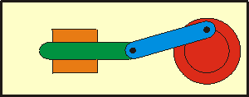
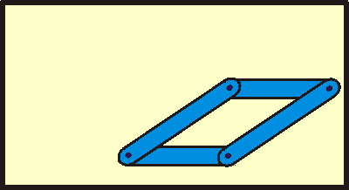
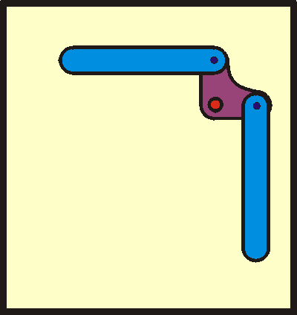
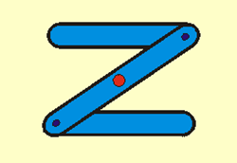
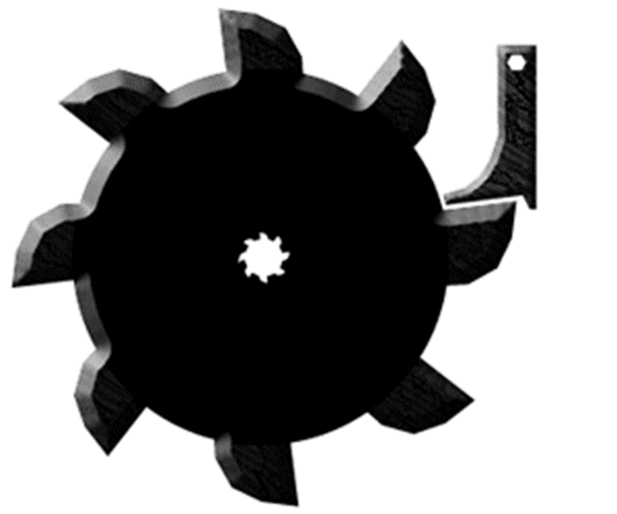
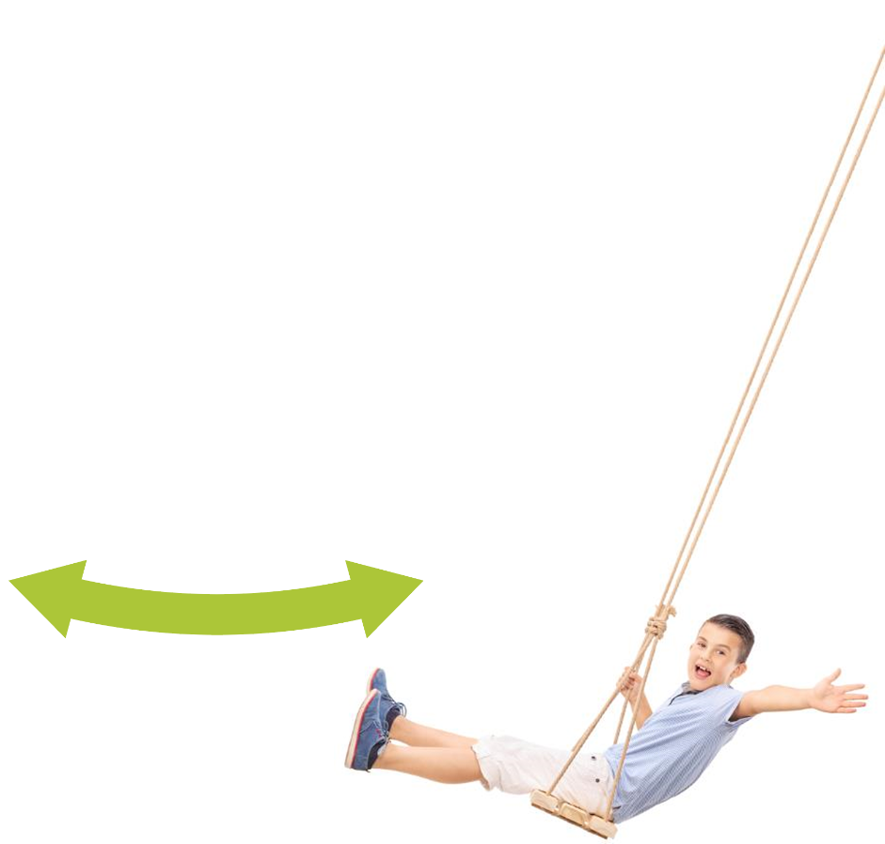
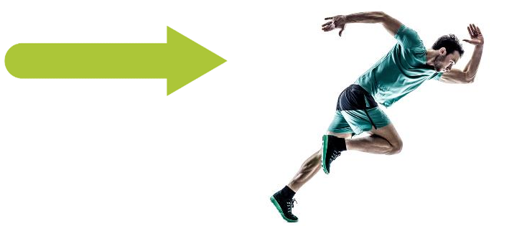

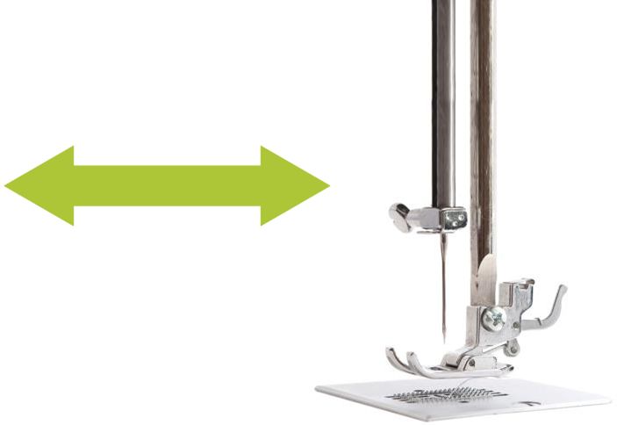
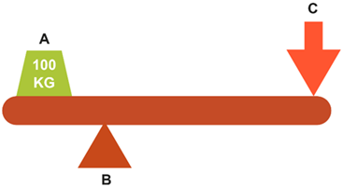





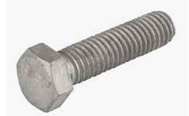

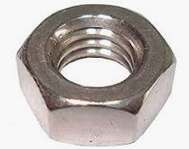



Motions and movement:
Crank and slider Parallel motion Bell crank Reverse motion Ratchet and Pawl
Sustainability when using woods- Wood should only be used from managed forests, trees are replanted once they have been cut down- easy to repair- can be recycled into chipboard, mdf,
card and paper- can be re used to manufacture other wooden products- less effect on the environment than many
other resistant materials-
Biodegradable- used wooden products can fuel bio mass power stations.
Flat pack versus traditional:
Advantages- Compact for ease of transport- Low cost compared to traditional furniture- Large choice of styles and finishes- Easy to assemble with limited tools and experience- Can be disassembled for storage/moving.
Disadvantages- Needs to be constructed yourself or by someone else at an additional cost- Not as robust as traditional furniture- Can be complex to construct for some- Prone to damage by moisture- Can chip and break easily.
Fixings:
Why use pre-manufactured fixings- It is cost effective-Pre manufactured components are made by companies that specialise in this product-they make very high volumes to a low price- High quality- consistent sizes.
Screws Hinge Modesty block Dowels
Washer Bolt Nyloc nut Nut
Key words:
Inset
Coping saw
Fret saw
Allen key
Waste area
Finger joints
Waste side
Try square
Ruler
G clamp
Drill
Dowels
Dowel pegs
Pilot hole
Counter sunk bit
Driver
Drill bits
Screw driver
Halving joint
Nuts and bolts
Spanner
Long nose plyers
Machine vice
Isometric
Parallel
Oblique
Perspective
Excellence
PVA
Clamp
Vice
Glass paper
Wax
MDF
Paint
Grain line
Grain
Degrease
Key
Linear motion-
Moves in a
straight line in
one direction only
Rotary motion-
Rotates around
a central axis
Reciprocating motion- Moves back and forth or up and down along a straight line
Oscillating motion-Moves back and forth along a curved line
A Load
B Fulcrum
C Effort
Health and Safety:
HSE- Health and Safety Executive is an organization which looks after the welfare of employees and enforces the Health and safety at work act.
Heath and safety at work act- It was introduced in 1974, it is legally binding agreement, employers are obliged to provide safe working environment for all employees.
BSI- BSI Group, also known as the British Standards Institution, is the national standards body of the United Kingdom.
Year 8 RM
Knowledge Organiser
Frame
Industrial Revolution:
Changes- A 260 per cent growth in population- A change from agriculture to industry- A move from domestic industry to factory work- A move from water and wind power to steam engines- A revolution in transport and communications.
Inventors- John Kay- It made hand loom weaving quicker. The Flying Shuttle.
James Hargreaves- Hand power. Increased the supply of thread. The Spinning Jenny.
Richard Arkwright- Increased the supply of strong thick thread. The Water Frame
Samuel Crompton- Increased the supply of strong high quality thin thread. The Mule
Edmund Cartwright- Speeded up weaving. The Power Loom
Henry Cort- Produced iron, which revolutionised materials used for machinery. Iron
Machine maintenance:
It is important-
It extends the life of the product -You don’t have to buy a new product when a part is worn out or fails- You can keep the product in optimum working order- A product in optimum working order is more efficient- It is cost effective- You don’t have to buy a complete new product- It increases the sustainability of the product- It is environmentally friendly- It ensures that the product will be safe to use.
Flow chart symbols:
Process
Start/end
Decision
Adhesives:
PVA- Wood-wood-strong glue-takes a long time to dry
Glue gun- modelling materials-quick-not strong
Solvent cement-acrylic to acrylic-dries clear- can damage the finish
Epoxy resin- any materials to any material-strong joint- irritant to skin
Super glue- any materials to any material-quick- irritant
Forces and Loads:
Static load- doesn’t move, easy to design
Dynamic loads- moves, harder to design
Shear-splits at 90 degrees
Torsion- twisting
Bending- compression and tension
Tension-pulling
Compression- squeezing
Quality assurance/ quality control:
Why quality control is important-
Check or test-Make sure the product meets a specific standard-To ensure manufactured products meets an agreed specification-Guarantees the accuracy of a part or component-Manufactured to an agreed tolerance-Fit for purpose-Suitable enough for selling
Importance of tolerance-
Very difficult to make a component exactly correct- Easier to make a component within tolerances-This is the maximum and minimum sizes a component can be- Manufacturer knows that if a product is within
tolerances then it will work.
Method of quality control check-
Visual check- Using a ruler- Using a multimeter- Using a jig/fixture or template- Testing against the specification- Testing to see if the product works.
Jig moulds and templates:
Accuracy: The level of accuracy is improved as human error is limited.
Consistency: The level of consistency is improved as all the products will be identical.
Speed: The time taken to produce a product is reduced as there is no requirement for marking out.
Cost: The cost of producing products is reduced as the use of jigs, moulds and templates means less labour required, initial set up high
Brunel:
The famous engineer payed a key role in Britain's industrial revolution. He was the chief engineer of the great western railway- build a ship that took 15 days to sail from Liverpool to New York- created box tunnel which was when complete the longest tunnel in the world- created Thames tunnel which was the first successful tunnel to be built below a river.
Finishes:
Types of finishes- varnish-paint-wax-stain-oil
It enhances the look-brings out the wood grain- shiny finish- durable- protect- water resistant- smoother finish.

Slide 2
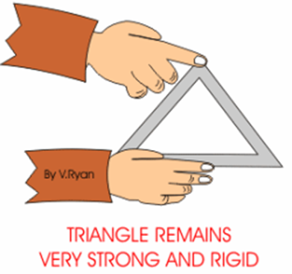
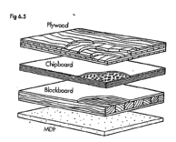
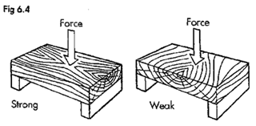
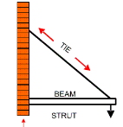
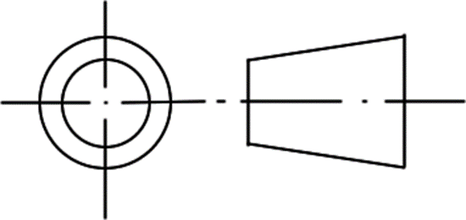
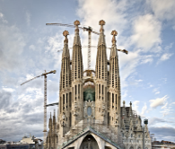


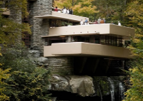

Wood joints:
Bridle Butt
Cross halving Half lap
Tee halving Let in
Structural Engineering:
Triangulation: triangles are strong
and rigid.
Iron Bridge- 1779- Abraham Darby- worlds first iron structure.
Industrial revolution- population increase, change from agriculture to industry, move from water and wind to steam, revolution in transport and communication.
Inventors- Richard Arkwright- water frame, Samuel Crompton- the mule, James Watt- steam engine, Edmund Cartwright- the power loom and Henry Cort- Iron.
Brunel-He built bridges- changed transportation-created railway between Bristol and London, built a ship that took 15 days from Liverpool to New York.
Shell- strength reloads into the outer surface.
Frame- combinations of beams, slabs and columns to resist the lateral and gravity loads.
Struts- support the beam underneath.
Ties-supports the beam on top.
Materials
Natural- soft wood and hard wood
Manmade timbers-Manufactured boards advantages: cheaper, larger board available, doesn’t warp, no knots or defects.
Seasoning-Removes the moisture from the natural wood to prevent warping.
Strength in wood- wood is stronger along the grain
Conversion- slap sawn and quarter sawn
Key words:
Design brief
Engineer
Triangulation
Struts
Ties
Blast Furnace
Weaving
Water Power
Industrial
Revolution
Empire
Architect
Shell structure
Frame structure
Natural
Manmade
Static
Dynamic
Compression
Tension
Torsion
Shear
Bending
Load
Linkage
mechanism
Reverse motion
Parallel
Crank and slider
Bell crank
Ratchet and Pawl
Orthographic
Isometric
Perspective
Seasoning
Hardwood
Softwood
Quality Control
Temporary fixing
Permanent fixing
Gusset Plates
Evaluation
Designing:
Third angle orthographic Projection- show multiple views of the same object
Dimensions- numbers sit on the top of the line
Plan- view from the top
Side- view from the side
Front- view from the front
Construction lines
Mechanical Devices:
Crank and slider Parallel motion Bell crank
Reverse motion linkage Ratchet and Pawl
Year 8 RM
Knowledge Organiser
Structures
Architects:
Antoni Gaudí: love of natural design and modernism. Famous works: Sagrada Familia in Barcelona.
Le Corbusier: icon of Modernism, His early works- smooth, white concrete and glass structures elevated above the ground. His later work- rough, heavy forms of stone, concrete, stucco, and glass
Famous works: The Villa Savoye in Poissy.
Walter Gropius: Pioneer of the Bauhaus movement: less is more, merge fine arts and craftsmanship; use modern materials such as steel, cement, and glass; and the idea that form follows function.
Famous works: Sommerfeld House
Frank Lloyd Wright: low pitched roofs, overhanging eaves, a central chimney, and open floor plan. Change to the confined, closed-in architecture of the Victorian era.
Famous works: Falling water
Zaha Hadid: strong, unique, powerful, curvy and interesting, bold and contemporary. She explores new aspects of design through technology and materials.
Famous works: Evelyn Grace Academy.
Forces and Loads:
Static load- doesn’t move, easy to design
Dynamic loads- moves, harder to design
Shear-splits at 90 degrees
Torsion- twisting
Bending- compression and tension
Tension-pulling
Compression- squeezing
Tools:
Claw hammer- is a tool primarily used for pounding nails into, or extracting nails from, some other object.
Coping saw- is a type of hand saw used to cut intricate external shapes and interior cut-outs in woodworking.
Tenon saw- is a type of hand saw used to cut wood straight.
Vice- used for holding work in place while cutting or hammering pins into the material.
Bench hook- its purpose is to provide a stop against which the piece of wood being worked can be firmly held.
File- a steel hand tool with small sharp teeth on some or all of its surfaces; used for smoothing wood or metal.
Try square- used for marking and measuring a piece of wood. The square refers to the tool's primary use of measuring the accuracy of a right angle (90 degrees).
Design Heroes:
Stephanie Kwolek- - Kevlar, Zaha Hadid- London Olympic pool, Milton Glaser- New York logo, Sir Norman Foster- Wembley Stadium, Sir Jonathan Ive- Mac Mini 2005, Phillipe Starck- Zartan chair 2011.

