Slide 1
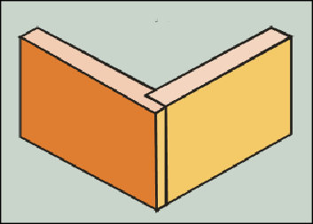
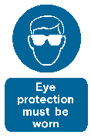
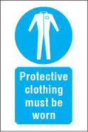



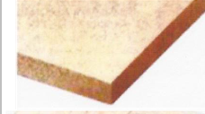



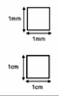

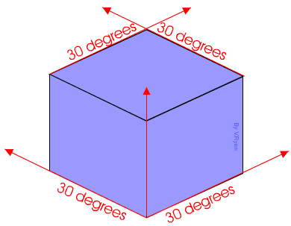


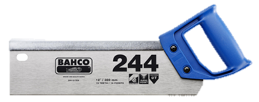
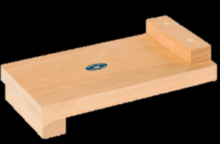
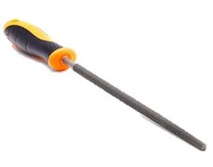
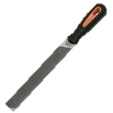
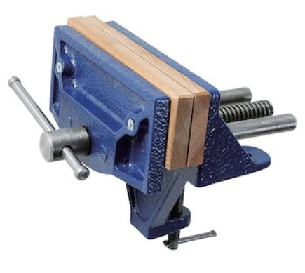
Materials:
Woods- hardwoods- softwoods- manufactured
Hardwoods- lose their leaves- deciduous- ash, saple and beech
Soft woods- keep their leaves-evergreen-pine, fir and spruce
Manufactured- man made wood- plywood, MDF and chipboard
Advantages of manmade boards: available in large sheets, environmentally friendly/sustainable material, cost effective (cheap), does not have knots/defects.
Operation | PPE | Hazard | Safety Symbol
Drilling, cutting | Goggles | Dust
workshop activities | Apron | Clothing may get caught in machinery or chemicals can spill onto clothing
Handling hot/sharp | Heat proof gloves | Burning hands/ fingers when working with hot materials.
Using machinery | Ear defenders | Damaged hearing after repetitive or continuous loud noise.
Applying a finish | Face mask | Lung damage from inhaled dust or fumes
Carrying equipment | Steel toe cap shoes | Damaged or crushed toes and feet caused by falling materials
Wood Joints:
Lap joint: a joint made by halving the thickness
of each member at the joint and fitting them
together.
Key words:
PPE
Deciduous
Evergreen
Softwoods
Hardwoods
Manufactured boards
Equilateral
Tessellate
Isometric
Glass paper
Round file
Straight file
Tenon saw
Bench hook
Claw hammer
Vice
Fret saw
Goggles
Apron
PVA
Glass paper
Abrasive
Sanding block
Wax
Wet and dry paper
Computer aided design
Computer aided manufacture
Laser cutter
2d design
Lap joint
Plywood
Sapele
Ash
MDF
Pine
Millimetre
Centimetre
Metre squared
Kilometre squared
CAD/CAM:
Computer aided design is the design of new products using specialist software.
Computer aided manufacture uses the CAD files to realise these designs into porotypes or finished products.
Advantages:
Quicker- Easy to modify designs-Can be rendered in CAD software-
CAD can be emailed to be manufactured and shared with the client-Safer to use- Greater consistence- Greater accuracy- Cost effective when manufacturing in large quantities- Less work force required
Disadvantages:
High initial set up costs- Staff require retraining- Higher energy costs- Not cost effective for manufacture in small quantities- Cad designs can be lost if computers fail- Cad design could be stolen by hackers
Maths: Area
The area of a 2D shape is a measure of
the spec inside its perimeter
We measure using squares:
1mm “one millimetre squared”
1cm “One centimetre squared”
1m “One metre squared”
1 km “One kilometre squared”
Year 7 RM
Knowledge Organiser
Box
Isometric: a method for visually representing three-dimensional objects in two dimensions in technical and engineering drawings.
Drawn at an
angle of 30
degrees.
Finishes:
Protects the surface of a product to prevent decay.
Varnish enhances the look, brings out the grain, provides a shiny finish, it makes it water resistant, smoother finish and protects.
Wax enhances the look, makes it water resistant and protects
Applying cleaning with an abrasive paper (glass paper), cleaning (washing/wiping), apply a first coat,
creating a key in between coats with wet and dry paper, wait for the varnish to dry in between coats and apply 3 coats.
Finishing Natural Timbers:
Timbers can be treated with a number of surface finishes these include Paint, Stain, Wax & Varnish. Applying these finishes can:
❑ Seals the wood to protect the surface from heat and water
❑ Enhance the grain & surface
❑ To colour the surface
❑ To give a specific aesthetic appeal.
Saws:
Egyptian-bronze saws with jewelled teeth-cutting stones.
Mill saw- driven by wind-power and water power-cutting wood
Band saw- William Newberry Patented the first- 1808- cutting metals, plastic and wood.
Chain saw- cuts with a set of teeth attached to a rotating chain surgeons for bone cutting.
Tools and processes:
Claw hammer- is a tool primarily used for pounding nails into, or extracting nails from, some other object.
Tenon saw- is a type of hand saw used to cut wood straight.
Bench hook- its purpose is to provide a stop against which the piece of wood being worked can be firmly held.
Round file- a steel hand tool with small sharp teeth on some or all of its surfaces; used for smoothing wood or metal.
Straight file- a steel hand tool with small sharp teeth on some or all of its surfaces; used for smoothing wood or metal.
Wood vice- a tool with movable jaws to hold work in place.
Finishing manufactured boards
Veneer
A sharp blade cuts very thin layers wood called veneer. A layer of veneer can be glued onto less expensive manufactured board to produce a more attractive finish and imitate natural timbers but maintain the properties of a manufactured board.
Lamination
Laminating involves bonding by gluing strips of materials together in layers to create a strong structure. An example of this is wooden beams.
Palm Sander: abrasive pad which comes in various sizes and grades. Fit the users hand and often come with soft grip handles.
Belt sander and disc sander: A belt sander is a machine used to sand down wood and other materials for finishing purposes.
Plane-used for shaving the wooden edge off a longer piece of wood.
Thickness planer: is a woodworking machine to trim boards to a consistent thickness throughout their length and flat on both surfaces

