Slide 1
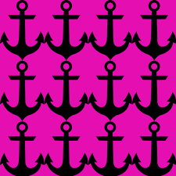
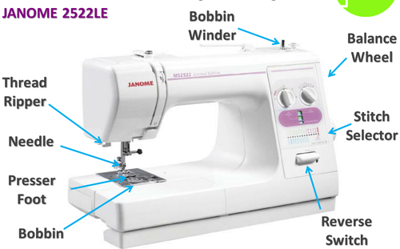
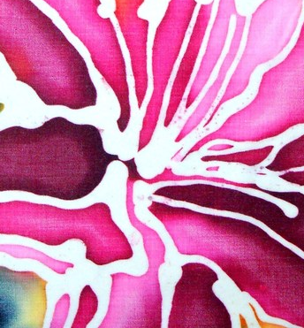
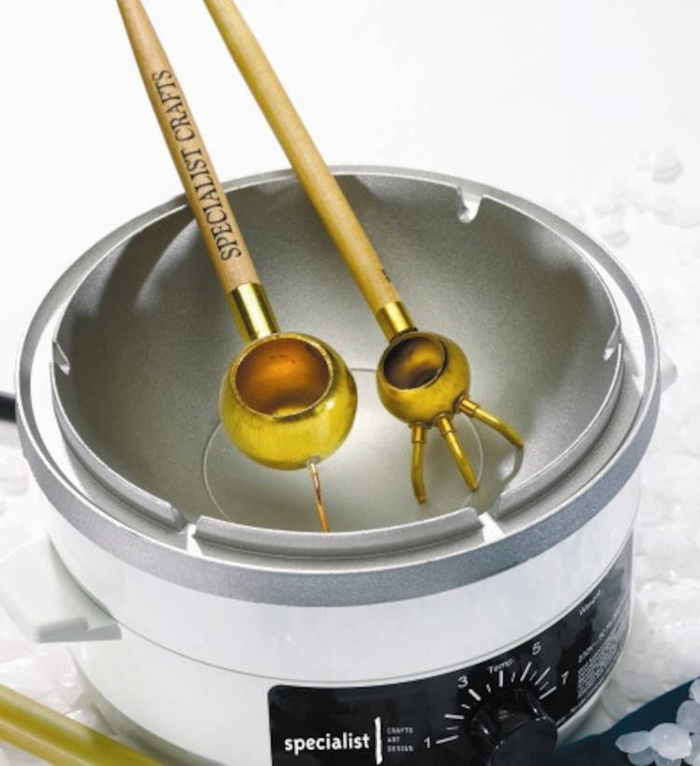
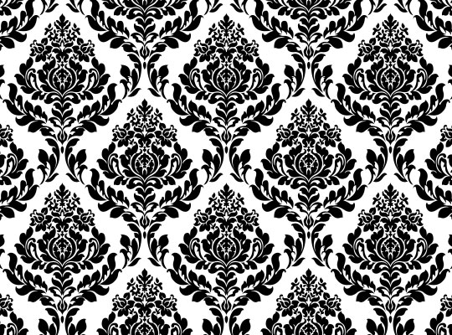
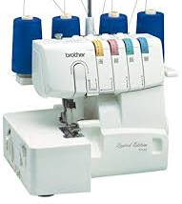
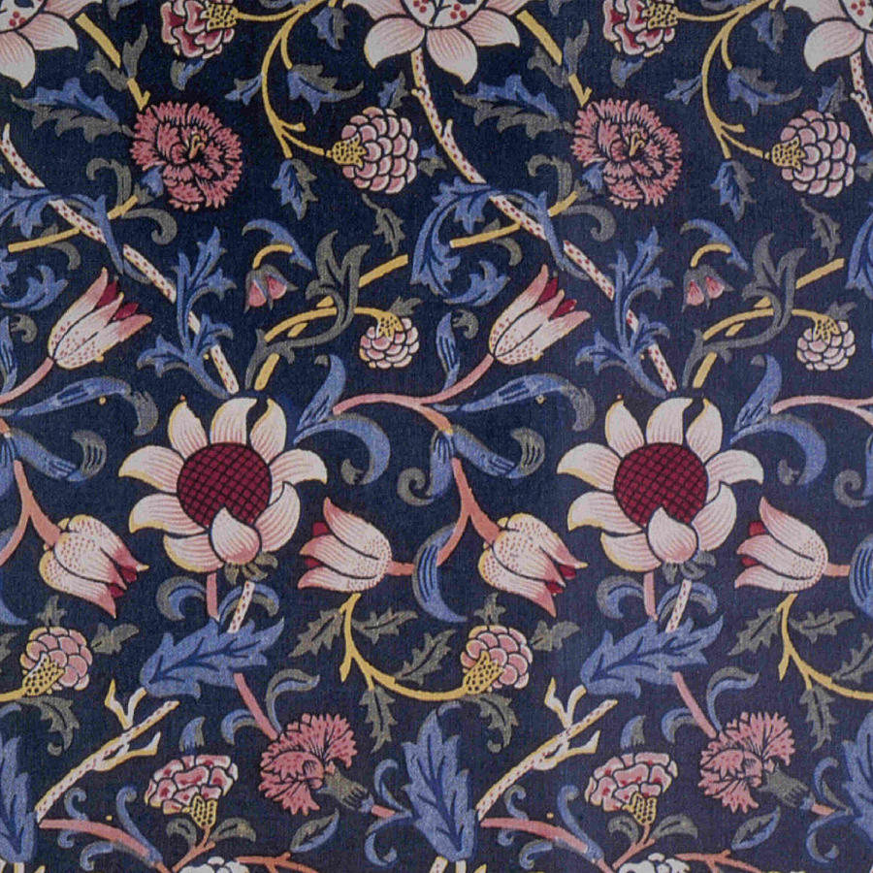
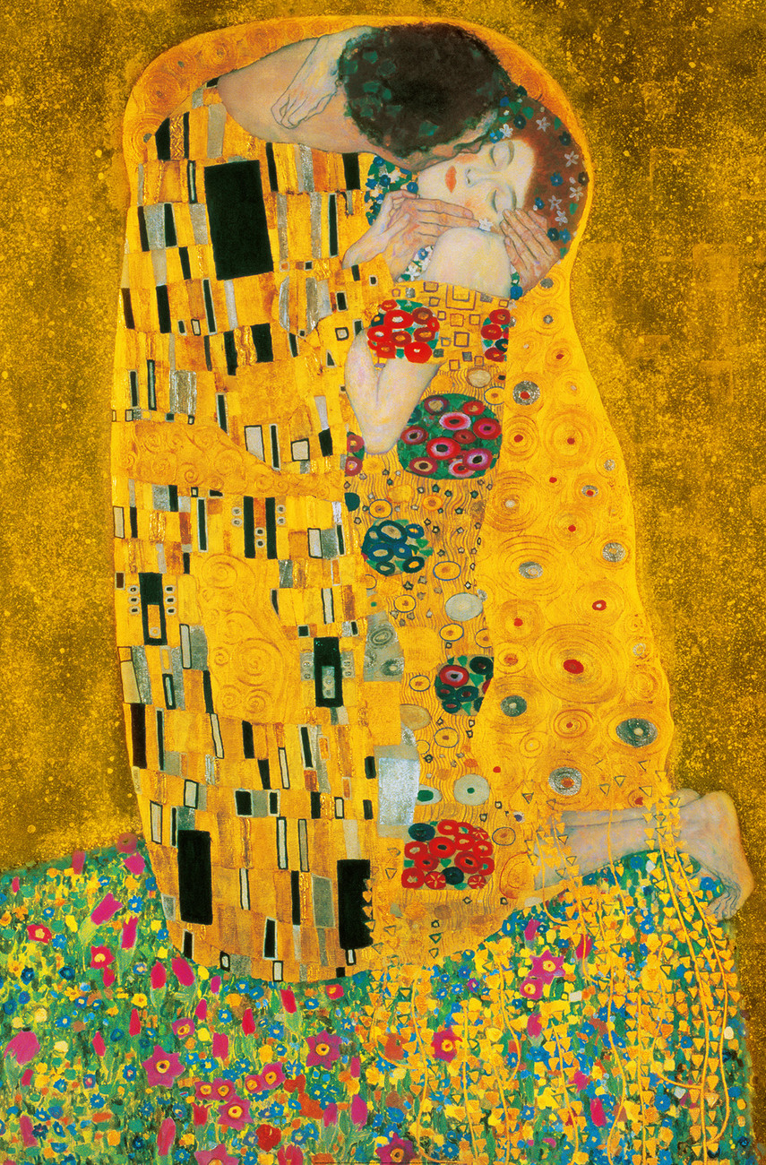
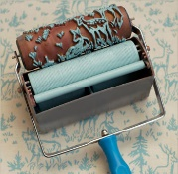
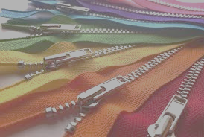
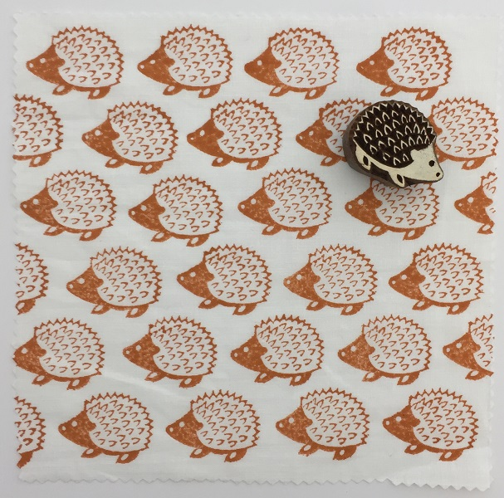
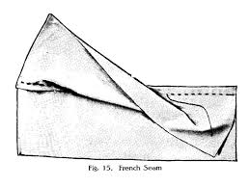
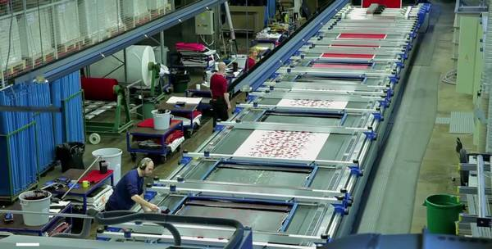
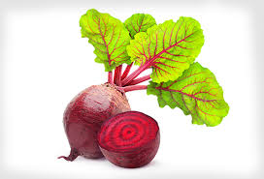
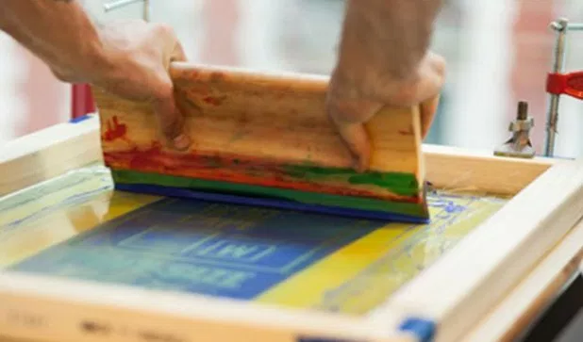
Synthetic Dying
Patterns
Year 8 Textiles
Colour Application techniques
Pattern
Batik: A traditional technique from Indonesia, resist dying where the wax stops the dye reaching the fabric
Straight repeat: is produced by repeating your image at measured intervals, placing each image directly under the previous one.
Key Words
Overlocker
Zigzag
Natural Dye
Cotton
Synthetic Fibre
Polyester
Resist Dyeing
Batik
Tjanting tool
Screen Printing
Squeegee
Block
Patchwork
Applique
Embroidery
Zip
Buttonhole
Mirror repeat: A mirror image reflects a pattern.
Tjanting tool
Wax pot
Half- drop repeat: This is produced by repeating the image at the side as the straight repeat, but moving the image half along on the second row, like a brick pattern
Resist Dyeing
Artist Research
Sewing Machine
Tie dye: A traditional resist dyeing, where the fabric is folded and tied with string or elastic bands to stop the dye getting to the fabric. Used on natural fabrics.
Mood board: is a physical or digital collage of ideas/images meant to inspire the design process at the start of a project
Quilting
is the process of sewing two or more layers of fabric together to make a thicker padded material
OverlockerUsed to finish,
neaten
and trim edges.
Roller printing creates a continuous pattern
Can you name these artists?
Components are pre manufactured items added to textile products that are not the fabric. E.g fastenings, zips, buttons, beads
Manufacture
All techniques can be scaled up and used in mass manufacture/production.
Key words: Industrial, batch production
Seams and Construction
Relief Printing
Using a raised surface to apply colour
Fabrics:
Cotton
Polyester
Wool
Silk
Types of seams:
Plain Overlocked
Flat fell
French
Block Printing Used for fabrics and wallpaper
Dyeing
Screen Printing
Natural vs Synthetic fibres
Natural fibres in fabric absorb dye more readily than man made.
Cotton = natural
Polyester = synthetic
Ink is pushed through mesh using a template create an image. You can use several layers of colour
Natural Dyes can be made boiling vegetables, fruit or spices to create colour. Adding salt helps to fix the dye to the fabric
Onion
Coffee
Beetroot
Cabbage
Spices
Any more?
Environmental Considerations
Recycle Reuse
Rethink Repair
Reduce Refuse
Squeegee
Screen
Screen printing

