Slide 2
Expectations
Zero tolerance for any unacceptable behaviour in all technology lessons.
Any situations deemed unsafe inform the classroom teacher or technician straight away.
Well-presented neat work
Date and title underlined with a ruler
Separate each lessons work with a straight line
Ensure any work that has been stuck in has been stuck in neatly

Slide 3
Food
Fairtrade
Colours of chopping boards
Food Provenance
Transportation of food
Red Tractor
Correct fridge and cooking temperatures
Rennet
Staple foods
Religions
Languages
What is cuisine

Slide 4
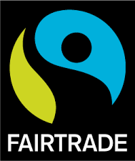
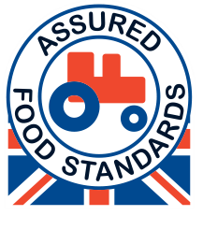

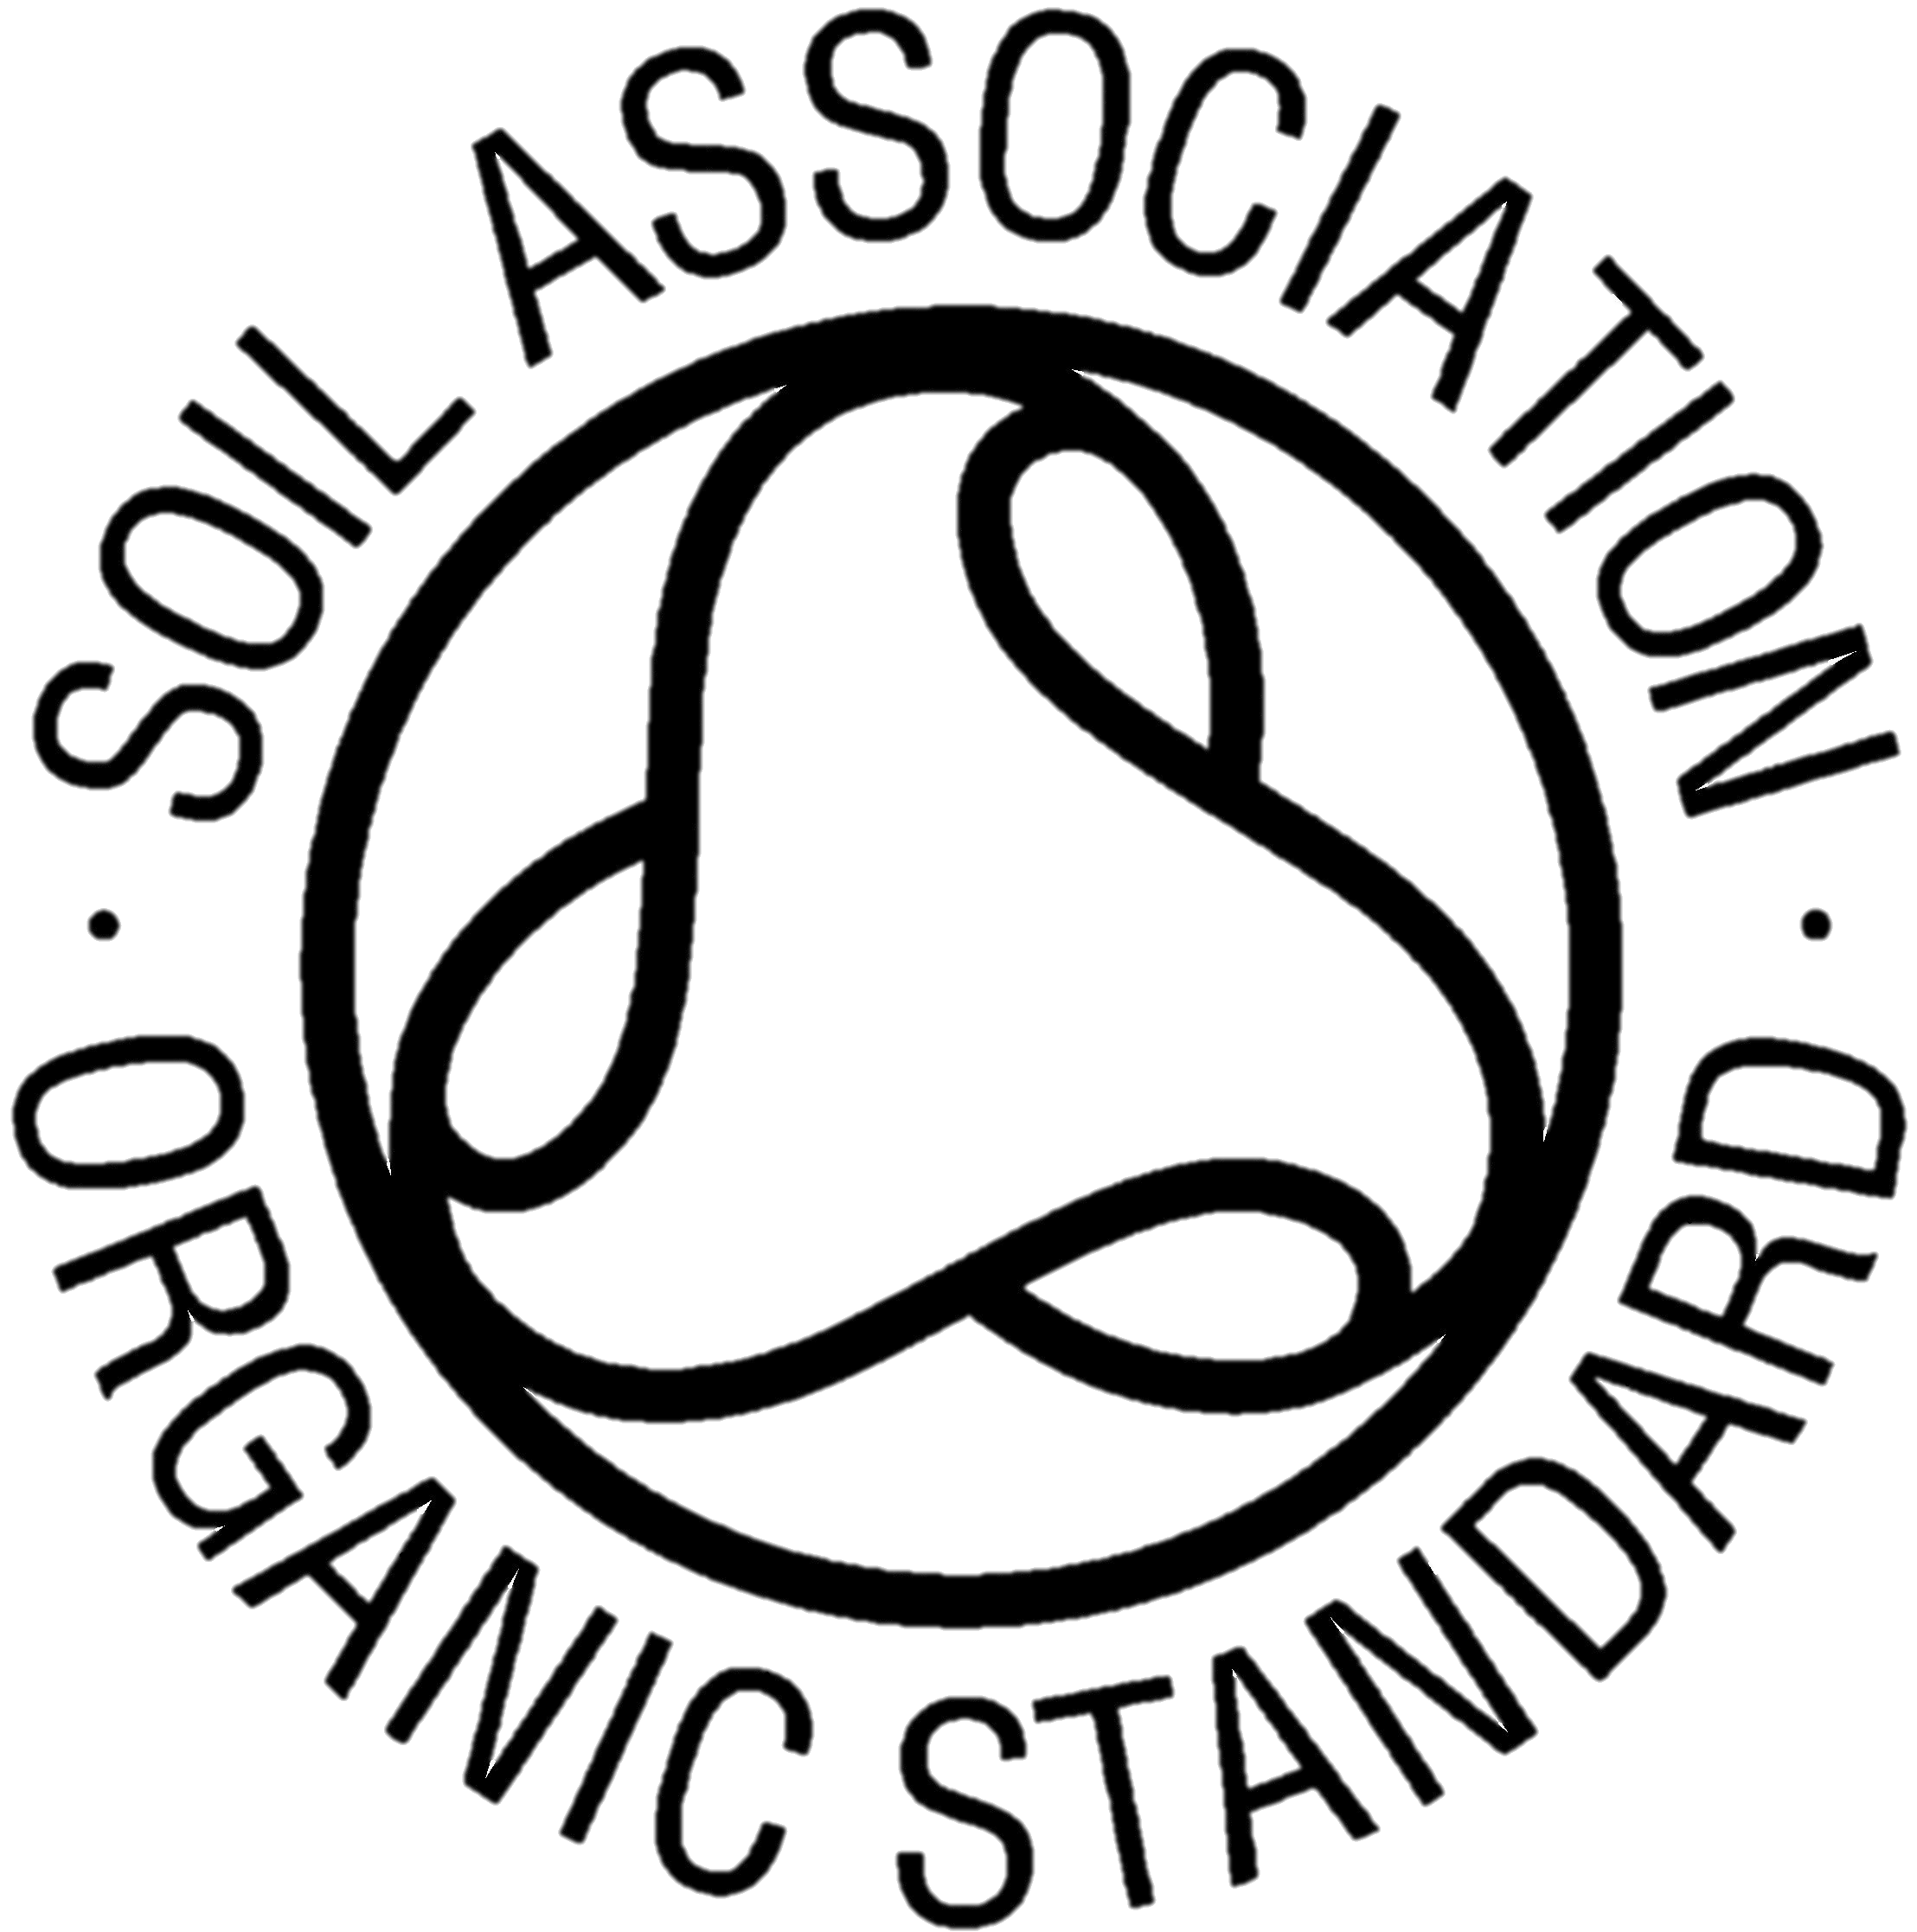
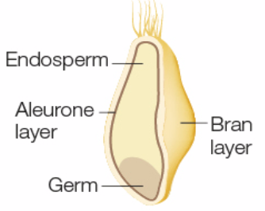
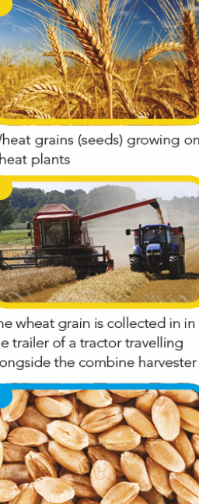
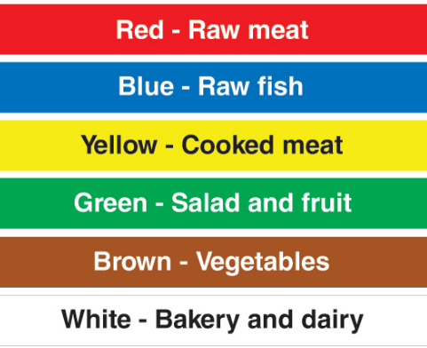
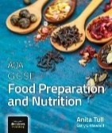
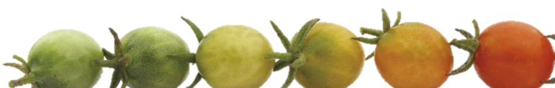
Year 8 Knowledge Organiser
Sustainability & Environment
Wheat into Flour
Hygiene | To prepare food in a clean way to stop food spoilage or poisoning occurring
Cross contamination | The transfer of food spoilage/poisoning from one food to another
Food Provenance | Where foods and ingredients originally come from
Food security | The ability of people to buy sufficient safe, nutritious and affordable food
Sustainability | Producing food in a way that can be maintained over a long period of time and protects the environment
Food Miles | More food is being transported by air & driven by lorries. This creates food miles, carbon footprint, food waste
Fairtrade promotes better prices, decent working conditions, local sustainability, and fair terms of trade
for farmers and workers in developing countries.
Stage 1: Harvest
When the wheat grains ripen, combine harvesters are used to cut the plants and separate the grains from the rest of the plant.
Stage 2: Cleaning and storage
The wheat grains are then cleaned and stored until they are ready to be milled.
Stage 3: Milling the grain to produce flour
The wheat grains are then cleaned and stored until they are ready to be milled. The main nutrients are held under the aleurone and bran layers. The germ is responsible for the reproduction of the grain if it were to be planted and grown again.
Red Tractor covers: Animal welfare, food safety, traceability and environmental protection.
Experts check that food is farmed and
prepared to a good standard.
●Fairtrade ●Red Tractor ●Soil Association ●Freedom food ●Carbon footprint ●Sustainability ●Food miles
● Animal welfare
Packaging
Food labels are used to show different things, they protect the consumer and manufacturer by giving certain information by law:
Cheese Making
Curds are separated from the liquid whey by coagulating milk, curds are then used in the cheese making process
Rennet is used to help separate the milk into curds and whey and to help set the cheese
When cheese is made, there are two types of micro-organisms used – bacteria and moulds
Non-pathogenic bacteria does not cause food poisoning and is used in a variety of food products such as cheese.
Milk is pasteurised, this sterilisation process starts to irradiate pathogenic bacteria, heating to 72°c makes milk safe to drink
●Name and description of food product ●Ingredients list ●weight or volume ●Storage ●Name and address of food manufacturer distributor ●Place of origin of food How to prepare and cook the product ● Allergy warnings ●Additives information ●Shelf-life, use-by and best before dates
Food Spoilage
Enzymes cause foods like fruit to ripen, change the texture, alter the flavour and alter the smell
Yeast targets foods that contain a high amount of sugar. They settle on food, grow, ferment the sugar e.g. in fruit.
Enzymic browning can be prevented by cooking, putting the food into cold water, adding acid like lemon or orange juice and blanching
Bacterial Contamination
• Micro-Organisms that make food unsafe to eat and cause food poisoning are called pathogens.
• Danger zone 5°c to 63°c
• Fridge temp: 0c to 5c
• Freezer temp: -18°c to -24°c
• Re-heat/ cook raw food to at least 75°c to kill bacteria
Online textbook
http://www.illuminate.digital/aqafood/
Chopping
Board
Coding
Student Username:
STURTON3
Student Password: STUDENT3
Key Terms
Pathogens, Non-pathogens, Danger zone, Bacteria

