Slide 1
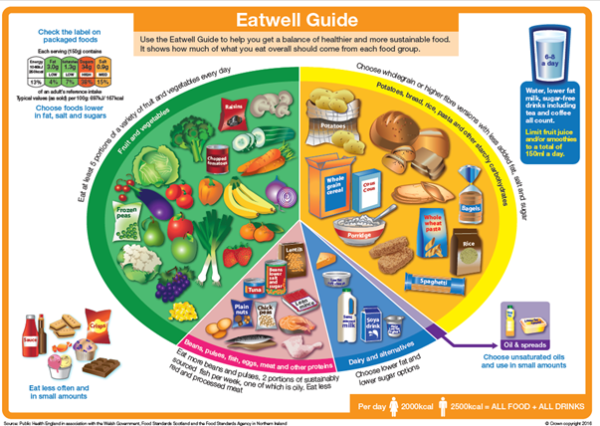
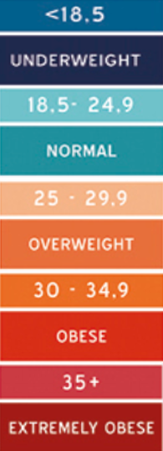





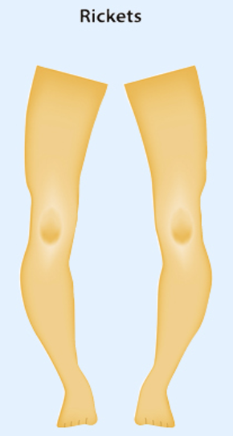
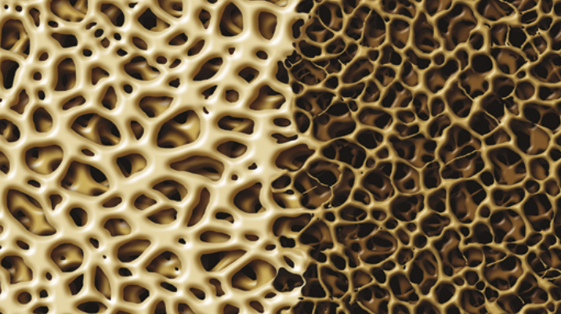
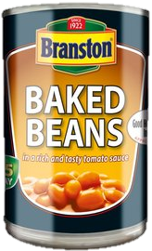
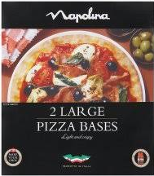
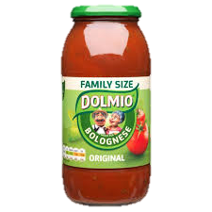
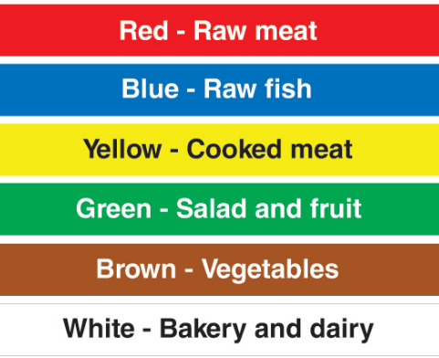
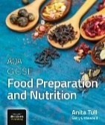
Year 7 Knowledge Organiser
Sustainability & Environment
Diet, Nutrition & Health
● Air & water pollution effecting health in animals, humans and plants ● Use of fertilisers, damaging land, polluting water supplies, effecting human health ● Transporting food and creating food miles, carbon footprint, food waste ● Sustainable fishing and farming
Certain diseases or health conditions develop over time due to a poor diet. One or more of the risk factors for developing a disease or health condition are a result of what or how much you consume over a period of time.
Heat Transfer p84-85
The way in which heat energy is passed into food
Conduction - Transferring heat through a solid object into food
e.g. Frying bacon in a pan, using a pan on the hob, a metal spoon in water
Convection - Transferring heat through a liquid or air into food
e.g. Baking a cake, boiling water, cooking in an oven
Radiation - Transferring heat by infra-red waves that heat up what they come into contact with
e.g. grilling sausages or bacon, making toast
healthy
un-healthy
Standard Components
A pre-prepared ingredient that is used during the production of a product.
✓ensures consistency
✓ saves time and effort
✗ can be more expensive
✗ may not be as good as fresh
✗ need storage space
Macro nutrients These are nutrients needed by the body in large amounts. (Proteins, Fats and Carbohydrates)
Micro nutrients These are nutrients needed by the body in smaller amounts. These are Vitamins and Minerals
Nutrients
Function
Source
Key Terms to know and use!
Carbohydrates | Gives the body energy | Sugar, honey, jam Potatoes, pasta, rice
Protein | Growth and repair of the body Secondary source of energy | Meat, fish, milk, eggs cheese, lentils, soya, nuts, wheat, beans and peas
Fat | Protection and insulation (warmth) of the body. Gives the body some energy | Butter, Cheese, Oily fish, meat
Vitamin A | Help eyes see in dim light Healthy skin and tissue | Liver, eggs, butter, soft spreads, carrots and apricots
Vitamin B | Transfer and release of energy Formation of red blood cells | Cereals, meat, fish, eggs, dairy products, pulses, yeast products
Vitamin C | Healthy skin. Helps the body heal faster and helps resist infection. | Fruit and vegetables e.g. oranges, lemons, blackcurrants
Vitamin D | Growth and maintenance of strong bones. Aids the absorption of calcium | Made by the body with skin exposed to sunlight, oily fish and eggs
Iron | Formation of red blood cells which carry oxygen around the body | Red meat, dark vegetables, eggs, chocolate, dried fruit, cereals
Calcium | Keeps bones and teeth strong Healthy muscles and nerves | Dairy foods, white bread, canned fish, green leafy vegetables
Water | For all body actions Removes waste products | Drinking water, fruits and milk
Hygiene | To prepare food in a clean way to stop food spoilage or poisoning occurring
Cross contamination | The transfer of food spoilage/poisoning from one food to another
Body Mass Index (BMI) | Weight (kg) divided by height (m). A high BMI can be an indicator of high/low body fat.
Gluten Intolerant Coeliac | Cannot digest gluten in the small intestine. Avoid foods such as bread and cakes. These can be made with gluten-free flour
Lactose Intolerant | Cannot digest the sugar lactose, it is found in milk and dairy products. Lacto-free products have be eaten.
Chopping
Board
Coding
Online textbook http://www.illuminate.digital/aqafood/
Student Username: STURTON3
Student Password: STUDENT3

