Slide 1
Knowledge Organiser
KS3 textiles year 9

Slide 2
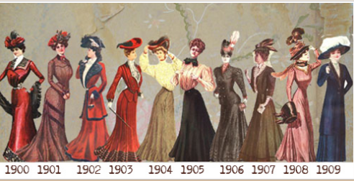
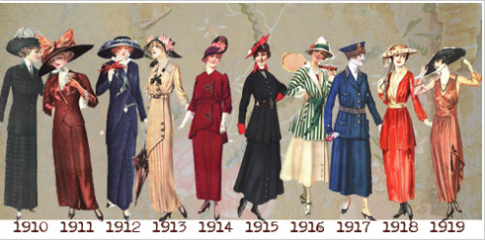
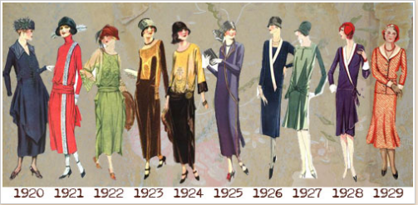
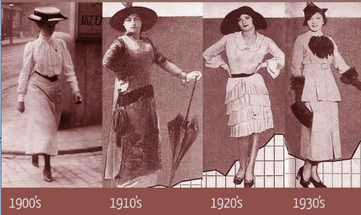
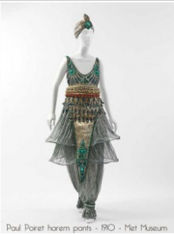
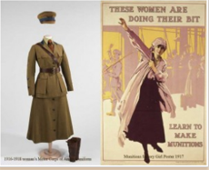
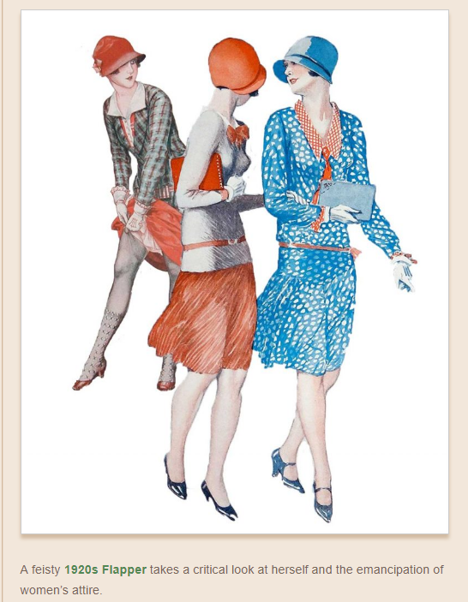
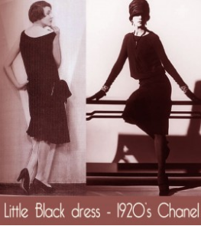
Year 9 Textiles Knowledge Organiser
Technological developments
Pace of life speeding up, cars (automobiles) popular - 1905
Industrial revolution
Rayon developed followed by nylon
Zip invented
Iconic designers:
Paul Poiret - 1900
Coco Chanel
Dior – late 1940’s
Influences:
The Great Gatsby
Les Modes – magazine
Art nouveau
Charles Rennie Mackintosh
Key words
Research
Utilitarian
Silhouette
Bustle
Industrial revolution
Emancipation
Influence:
Technology
Moral
Environmental
Equipment:
Sewing machine
Overlocker
Buttonhole attachment.
Computer aided design (CAD) embroidery machine.
Moral Impact
Emancipation of women – Emily Pankhurst
Unbecoming behaviour and dress
Conflicting attitudes
Music art & design influences
Industrial revolution women working/child labour
The silhouette changed from the S bend to the empire line by 1910
Environmental Impact
Industrial revolution – dirty towns , energy consumption.
Mass production of cotton & wool fabrics (denim)
Development synthetic fibres – non renewable resources/ easy care – emulates silk.
Social changes
More women entering professions,
More women playing sports
Liberal attitudes to life, reflected in dress.
Loose clothing – flowing lines, not restricted - corseted
Women get the vote;,
WW1 has a huge impact on women and the work place
Trousers still not considered appropriate early 1900’s.
WW1 social classes mixed
History of fashion
1900 - 1930
Key style changes
Fabrics : natural silks, linen, cottons & wool.
Artificial silk, - rayon
Silk, satin:- evening wear
Cotton/wool/linen – day wear
Organza (silk), chiffon (cotton/silk/rayon).
Jersey & denim.
1914 – WW1: sensible clothing, tailored jackets,, trench coats, breeches.
Military influence
1905 Poiret.
1905 Poiret.
1920’s Flappers.
A practical, freeform feminine styles developed through women's fight for independence – belle Epoch ( beautiful era).
1920’s fashion is less stern and rigid, gone are the S bend corsets 10 years earlier.
Two principals in women's dress – freedom and convenience
http://glamourdaze.com/history-of-womens-fashion

Slide 3


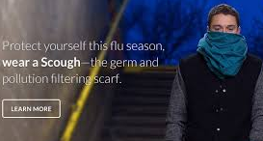
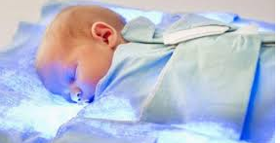
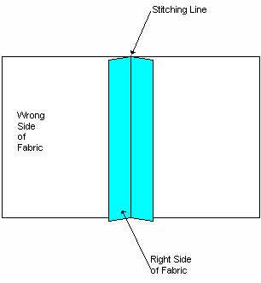
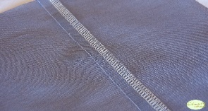
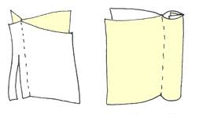
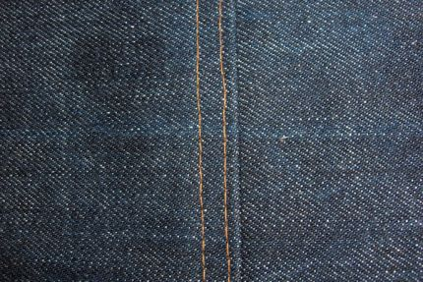
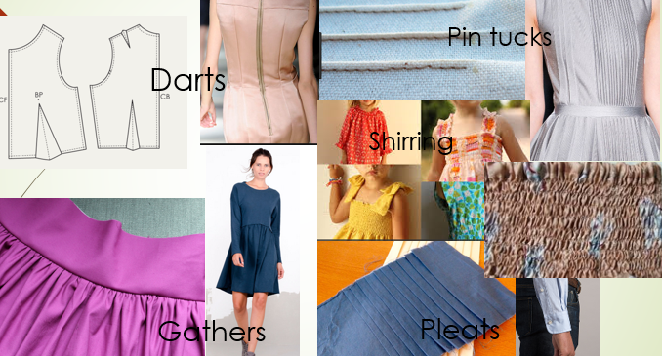
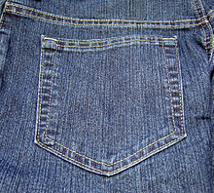
Key words:
Smart fabrics
Environment
Encapsulated
Seam
6 R’s
Overlock
Open seam
Flat fell seam
Absorbent
Non- absorbent
Durable
Abrasion
Resistant
Bio degradable
Pesticide
Easy care
Durable
Organic
Smart fabrics : are defined as textiles that can sense and react to the environmental conditions or stimuli from mechanical, thermal, chemical, electrical or magnetic sources
Environmental issues with: manmade fibres
Non – renewable resource
Not biodegradable
Chemicals/dyes
High water consumption
6 R’s
Reduce
Rethink
Refuse
Recycle
Reuse
Repair
Sun protecting fabrics such as T-shirts with built in SPF
Encapsulated fabric: Moisturizing fabrics such as in moisturizing tights Odour control fabrics such as odour control socks
Thermochromic: Colour and heat change fabrics such as shirts worn by soldiers that change colour to suit the environment - camouflage
fabrics used in the construction of artificial limbs
Speedo studied the shark, a creature which is incredibly fast in water and has a highly developed skin to minimise drag and maximise swimming efficiency
Environmental issues: Cotton (Natural)
Growing – pesticides and herbicides/large quantities of water/deforestation/energy consumption for picking/ Fairtrade (child labour – education /working conditions/fair pay/input of money to the village)/transportation – carbon foot print, use of non renewable resources/fossil fuels
Fibre to fabric – chemicals/ bleaching/dyes/ water consumption/energy consumption- global warming /waste water & materials/transport – carbon foot print -use of non renewable resources/fossil fuels
/ chemicals for fabric finishes – disposing of
Product – care of (washing drying, ironing) , high temperatures - energy consumption – global warming, large water consumption and disposal, chemicals & dyes bleed from washing, disposal of- 6 r’s
Cotton is biodegradable/recyclable
Organic cotton
Seams : a line where two pieces of fabric are sewn together.
Natural Fibres:
Plants – cotton & linen, animals wool & silk . Short staple fibres except silk which is a continuous filament.
Cotton: Jeans & T-shirts
Cool to wear
Very absorbent, dries slowly
Soft handle
Creases easily
Wool: Jumpers, suits & blankets.
Warm to wear
Absorbent, dries slowly
Breathable, repels rain
Soft or coarse to handle
Creases drop out
Can shrink
Open seam
General , any fabric type
Overlock seam
Neat, neaten edge, excellent for stretchy fabrics.
French seam:
For delicate sheer fabrics.
Used on expensive
clothing
Flat fell seam: strong
Used on denim products
Synthetic /manmade fibres: Made from petro chemicals. Fibres are continuous filaments and can be cut to a staple (short fibre) Nylon, polyester, viscose
Disposal of fullness
Nylon (polyamide): active sportswear, outdoor wear, tights
Strong
Non absorbent, dries quickly
Very durable
Crease resistant
Easy care
Abrasion resistant.
Polyester: medical textiles, fleece, children's nightwear
Strong
Non absorbent, dries quickly
Very durable
Crease resistant
Easy care
Flame resistant
Patch pocket

