Slide 1
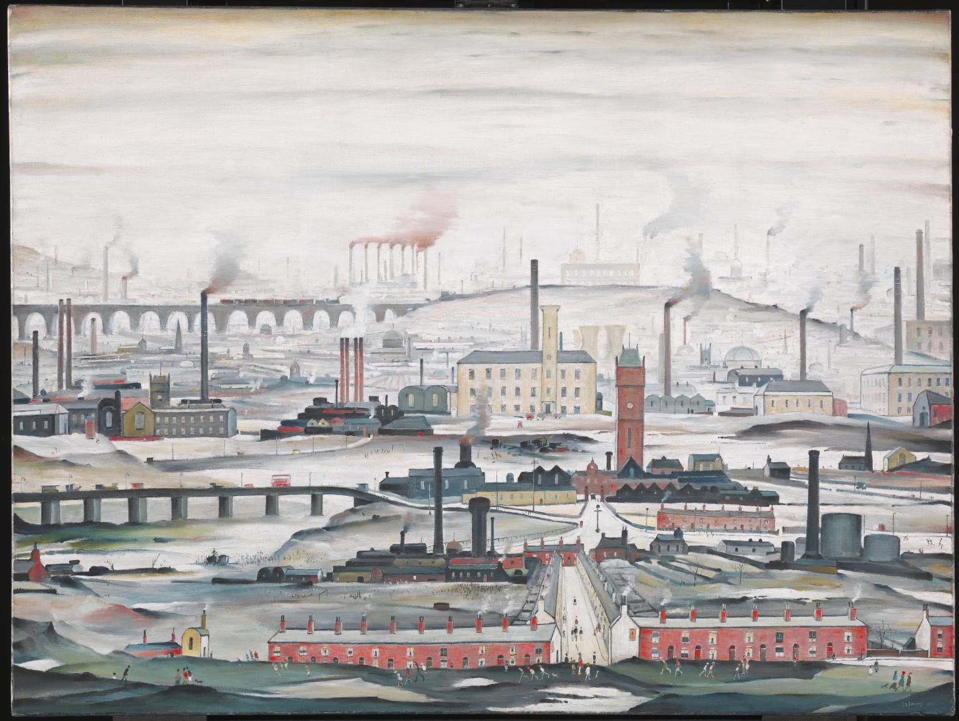
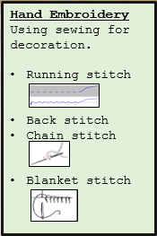
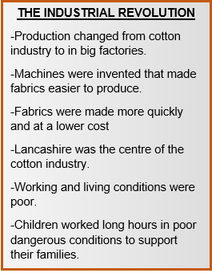
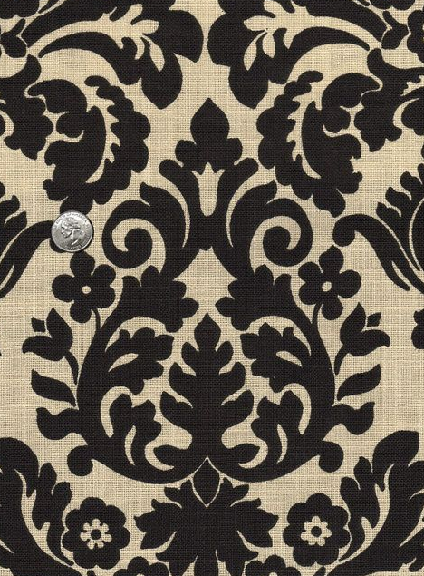
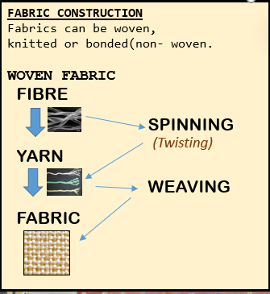
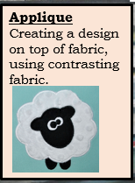
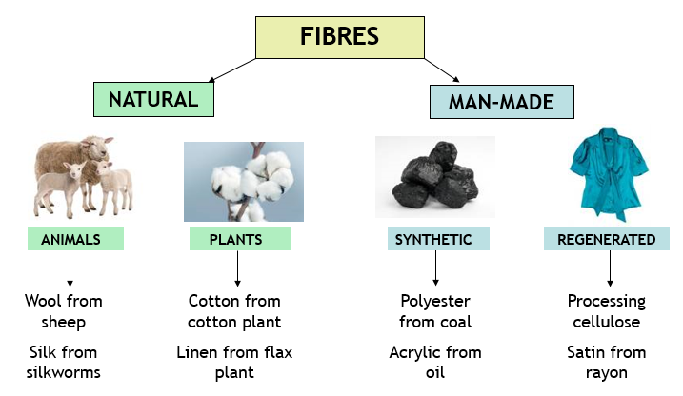
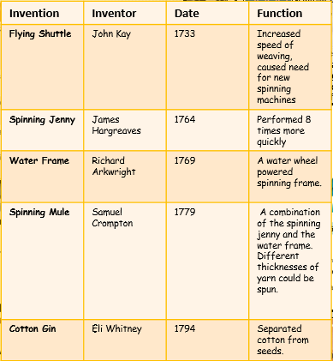
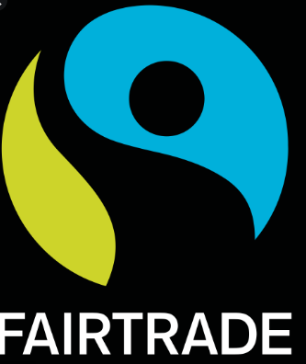
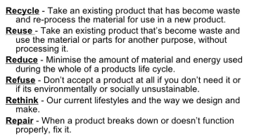
Key words
Damask Weaving
WEAVE PATTERNS
Textiles
Needle
Thread
Embroidery
Fibre
Fabric
Weaving
Spinning
Bonding
Knitting
Source
Origin
Property
PLAIN
-Equal amounts of warp and weft.
-Used for fashion & furnishing fabrics
A type of weaving where a pattern is woven into the fabric.
TWILL
-Diagonal effect
-Hardwearing, used for jeans, jackets etc.
SATIN
-Complex pattern. Long floating threads give a smooth often shiny effect.
Year 7
Textiles
ORIGINS OF FIBRES
CAD – Computer aided design
CAM – computer aided manufacture
6 R’s
L. S . Lowry - Artist
Grew up in Pendlebury, Salford
Captured industrial scenes in his paintings
He is famous for his simplistic style and muted colours.
Fairtrade symbol
Fair pay
Good working conditions
No child labour
weft

