Slide 1


GCSE PE Interactive Revision
Mr Edwards
Any questions feel free to send me an email
d.edwards@preston-manor.coM
Introduction Video | How to use the Interactive Revision PowerPoint
Click videos for instructions

Slide 2
Click a Topic to start
HAL and your skeletal system
Healthy, active lifestyles (HAL) and how they can benefit you
Influences on your HAL
HAL and your muscular system
GCSE PE
Exercise and fitness as part of your HAL
HAL and your respiratory system
Physical activity as part of your HAL
A HAL and your cardiovascular system
Physical activity and your healthy mind and body
Your personal health and well-being

Slide 3





Topic 1.1.1: Healthy, active lifestyles (HAL) and how they can benefit you
Topic | Key Concepts | 1-2 Mark Questions | Mark Questions Answers | 6 Mark Questions- Healthy, active lifestyles (HAL) and how they can benefit you | 6 Mark Questions Answers
Explain what makes up a HAL
Classify the benefits of a HAL into 3 categories (mental, social & physical).
Describe the 6 main benefits of physical activity.
Explain the why people take part in sport (5 main ones).

Slide 4

Explain what makes up a HAL
Healthy Active Lifestyle is a lifestyle that contributes positively to physical, mental and social well-being and includes regular exercise and physical activity.
Benefits of fall into three main categories
Mental / psychological reducing stress and relieving related problems
Social making and developing friendships and building teamwork skills
Physical improving health and fitness

Slide 5
Classify the benefits of a HAL into 3 categories (mental, social & physical).
A healthy active lifestyle has a positive effect on physical and mental well being.
People who exercise regularly and have an active social life with a network of friends tend to cope better with the stresses of daily life.
Physical | Social | Mental (Psychological)
Contribute to a good physical health | Mix with others | Relieve and/ or prevent stress and tension
Physical Challenge (can I do it) | Make new friends | Mental challenge (can I do it)
Increase fitness | Meet current friends | Increase self-esteem and confidence
Improve performance | Develop teamwork | Help the individual feel good
Improve any of the health related factors | Develop cooperation | Contribute to enjoyment of life.

Slide 6
Describe the 6 main benefits of physical activity.
Exercise and physical activity help to improve the following:
Increase fitness
Helps relieve stress
Increase self esteem and confidence
Helps individuals feel good
Contribute to good health
Contribute to enjoyment of life
Provide a mental challenge
Cardiovascular fitness
Increase strength
Improve body composition
Flexibility
Tone muscle

Slide 7
Explain the why people take part in sport (5 main ones).
People take part in Physical activity for the following reason/benefits
Co-operation
Competition
Physical Challenge
Aesthetic Appreciation
The development of friendships and social mixing

Slide 8



Explain what makes up a HAL

Slide 9

Classify the benefits of a HAL into 3 categories (mental, social & physical).

Slide 10

Describe the 6 main benefits of physical activity.

Slide 11

Explain the why people take part in sport (5 main ones).

Slide 12
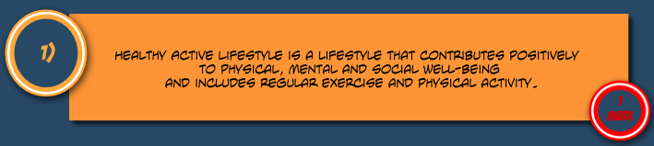
Explain what makes up a HAL

Slide 13

Classify the benefits of a HAL into 3 categories (mental, social & physical).

Slide 14
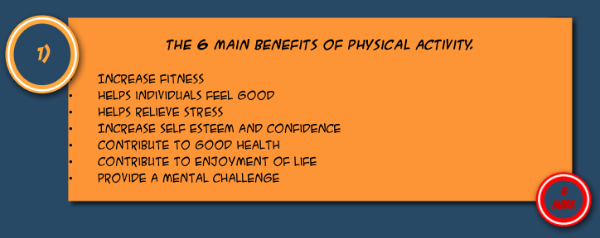
Describe the 6 main benefits of physical activity.

Slide 15
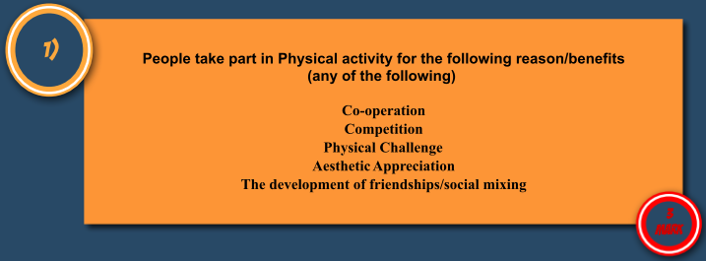
Explain the why people take part in sport (5 main ones).

Slide 16
Explain what makes up a HAL
Physical activity can stimulate an individual. These stimulants are Cooperation, Competition, Physical Challenge, Aesthetic Appreciation and the development of friendships and social mixing.
Describe 4 of these factors (4)

Slide 17
Classify the benefits of a HAL into 3 categories (mental, social & physical).
A person may become involved in physical activity in order to improve their social well-being.
Describe social benefits of exercise they might experience by becoming involved in physical activity. (4)

Slide 18
Describe the 6 main benefits of physical activity.
An individual may want to increase the amount of exercise they take part in to improve their physical fitness.
State and explain factors which would be a result of improvement in physical fitness (6)

Slide 19
Explain the why people take part in sport (5 main ones).
Explain differences between reasons for participation in physical activity for a young, talented games player and a retired person (4)

Slide 20

Explain what makes up a HAL
Physical activity can stimulate an individual. These stimulants are Cooperation, Competition, Physical Challenge, Aesthetic Appreciation and the development of friendships and social mixing.
Describe 4 of these factors (4)
COOPERATION – opportunity to get involved with others to achieve something together, working towards common goals
COMPETITION – as a player improves the level of competition rises, a person may seek harder competition regularly
PHYSICAL CHALLENGE – seeing problems through individually or as a member of a team, reaching a set goal or target
AESTHETIC APPRECIATION – recognising the beauty of a performance and attempting to replicate it
DEVELOPMENT OF FRIENDSHIPS AND SOCIAL MIXING – attending social events, meeting new people, becoming more outgoing

Slide 21
Classify the benefits of a HAL into 3 categories (mental, social & physical).
A person may become involved in physical activity in order to improve their social well-being.
Describe social benefits of exercise they might experience by becoming involved in physical activity. (4)
DEVELOPMENT OF TEAMWORK - Needing To Cooperate And Work With Others Towards A Goal
FULFILMENT BY BEING PART OF A TEAM – May Fulfil A Part Of Their Life That Is Currently Unfulfilled
CHALLENGE AS YOU OVERCOME OPPOSITION – Having a common target with others may motivate
INCREASE OF SELF-WORTH – Gaining respect from others
CHANCE TO MEET NEW PEOPLE – Increase social group
MIX WITH PEOPLE – Having Common Interests To Others, Sustaining Friendships More Easily

Slide 22
Describe the 6 main benefits of physical activity.
An individual may want to increase the amount of exercise they take part in to improve their physical fitness.
State and explain factors which would be a result of improvement in physical fitness (6)
Any physical, mental or social factor with relevant reasoning
e.g. improvement in body image may make an individual more likely to continue physical exercise to continue their improvement as they are happy with how they look

Slide 23
Explain the why people take part in sport (5 main ones).
Explain differences between reasons for participation in physical activity for a young, talented games player and a retired person (4)
YOUNG PERSON – PERSONAL DEVELOPMENT, MAKE NEW FRIENDS
RETIRED PERSON – TO INCREASE LIFE EXPECTANCY, LIFE’S PROBLEMS CAN BE FORGOTTEN
*ANY ANSWER CAN BE ACCEPTED FOR EITHER BUT MUST HAVE REASONING TO IT*

Slide 24
Topic 1.1.2: Influences on your HAL
Topic | Key Concepts | 1-2 Mark Questions | Mark Questions Answers | 6 Mark Questions – on Influences on your HAL | 6 Mark Questions Answers
Identify the key influences that impact participation (6 main categories)
Explain the different opportunities for getting involved in sport.
Explain the sports participation pyramid (including the foundation, participation, performance and elite stages).
Identify agencies involved in getting people involved in physical activity and sport.

Slide 25
Identify the key influences that impact participation (6 main categories)
People: family, peers, role models
Image: fashion, media coverage
Cultural factor: age, disability, gender, race
Resources: availability, location, access, time
Health and wellbeing: illness and health problems
Socio-economic: cost, status

Slide 26
Explain the different opportunities for getting involved in sport.
Most activities offer opportunities to participate in a variety of roles, including teaching or coaching, officiating, and volunteering.
Training opportunities are available through most sports’ governing bodies.
It is important to know about the latest policies on PE and school sport. Initiatives change over time so check their official websites for the most up to date information.
Initiatives to keep people involved
Government initiatives
Active Kids programme
PE school sport and club links (PESSCL)
School Sport Partnership
The organisation Sport England
The youth Sport Trust Top link
Click on the initiative for more information

Slide 27
The government set up the PE school sport and club links (PESSCL) strategy to increase the take up of sporting opportunities by 5-16 year olds.
Sport England and the youth sport trust manage two important areas in the Club Links and step into sport programmes.
These provide opportunities for young people to take part in sport as performers, leaders official and as young volunteers
The PESSCL programme aims to strengthen links between schools and local sports clubs.
Government initiatives
School Sport Partnership
Recently the government introduced a policy to ‘ensure all pupils receive their entitlement to two hours of high quality Physical Education per week.
This will encourage more participation and improve students’ fitness
School sports partnerships are based around a group of schools with a sports college at the centre, or hub.
The aim of the scheme is to develop sporting opportunities in a wide range of sports and offer high quality coaching and competitions within the local community.
PE school sport and club links (PESSCL)

Slide 28
The organisation Sport England
Active Kids programme
top programs are designed to encourage people of all abilities to get involved in Sport. Top link is aimed at encouraging students in the 14-16 age category to organise and manage sports activities and dance festivals.
Students are taking physical education GCSE or taking a wart in, for example sports leadership are offered the opportunity to put their skills to good use. Experience as a leader or official may even count towards their GCSE.
This organisation believe sport has the power to change people's lives. Sport England is committed to creating opportunities for people to start, stay and succeed in sport.
Start: increase participation in sport in order to improve the health of the nation, with a focus on priority groups
Stay: retain people in sport through an effective network of clubs, sports facilities, coaches, volunteers and competitive opportunities.
Succeed: create opportunities for Talented performance to achieve success
Various supermarkets and other Enterprises run a volunteer programs in which vouchers collected by parents can be used by schools to buy a sporting and other equipment.
One example of this is the active kids program
The youth Sport Trust Top link

Slide 29
Explain the sports participation pyramid (including the foundation, participation, performance and elite stages).
Performance: during this stage young people begin to concentrate on sport specific skills and to develop talent in specific Sports
Elite/Excellent this page is the peak of the pyramid where individual are reaching sporting excellence
Elite
Performance
Participation
Foundation
Foundation: this is the base of the pyramid at this stage most participants are likely to be learning /experimenting basic sporting skills.
The type of activity which contribute to the stage include primary PE lessons, top play activities, multi sports sessions.
Participation: this is the stage when young people begin to participate regularly in specific activity for enjoyment

Slide 30
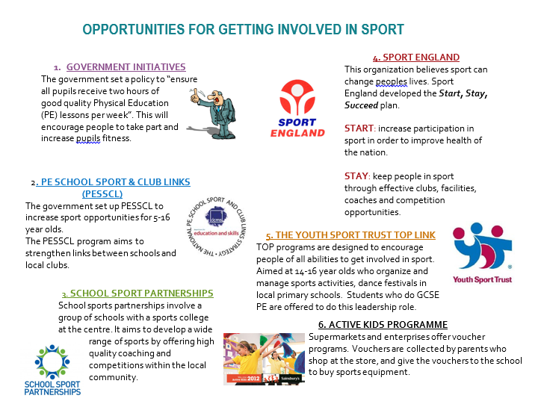
Identify agencies involved in getting people involved in physical activity and sport.
Click picture to enlarge

Slide 31
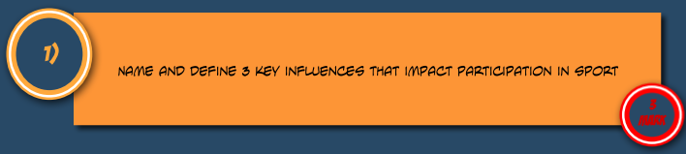
Identify the key influences that impact participation (6 main categories)

Slide 32
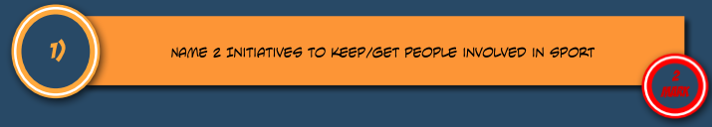
Explain the different opportunities for getting involved in sport.

Slide 33

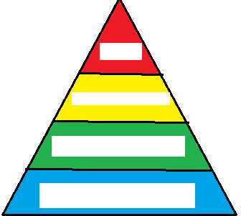
Explain the sports participation pyramid (including the foundation, participation, performance and elite stages).

Slide 34

Identify agencies involved in getting people involved in physical activity and sport.

Slide 35
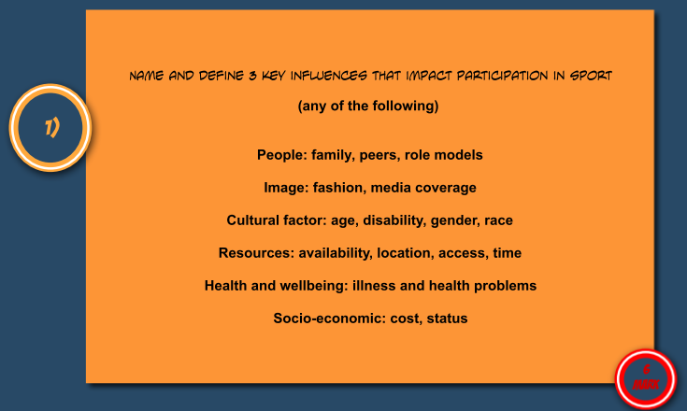
Identify the key influences that impact participation (6 main categories)

Slide 36
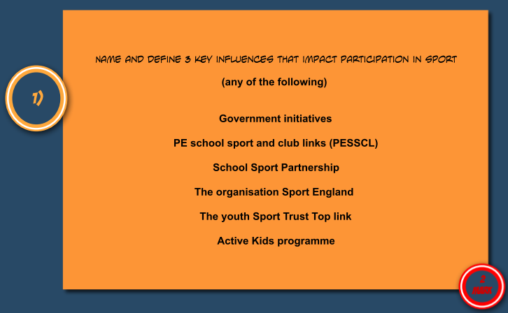
Explain the different opportunities for getting involved in sport.

Slide 37
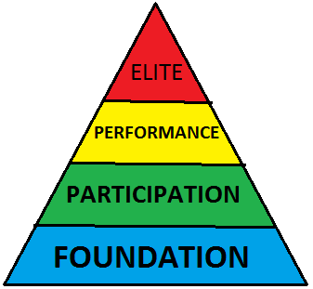
Explain the sports participation pyramid (including the foundation, participation, performance and elite stages).

Slide 38
Identify agencies involved in getting people involved in physical activity and sport.

Slide 39
Identify the key influences that impact participation (6 main categories)
What difficulties may a disabled person encounter when participating in sport (5)

Slide 40
Explain the different opportunities for getting involved in sport.
Influential people can have an impact on the level and type of participation a person is involved in. Describe and explain the different ways that people can influence participation (6)

Slide 41
Identify agencies involved in getting people involved in physical activity and sport.
There are different ways in which private sports clubs can encourage more people to be involved in physical activity, state some of these below(4)

Slide 42
Identify agencies involved in getting people involved in physical activity and sport.
How does Sport England cater for top class facilities, but also ensure a healthy, active lifestyle for the public? (3)

Slide 43
Identify the key influences that impact participation (6 main categories)
What difficulties may a disabled person encounter when participating in sport (5)
Social prejudice, lack of available facilities, reduction in number of sports available, poor access into buildings, apparent lack of equality, difficulties with transport to venues etc..

Slide 44
Explain the different opportunities for getting involved in sport.
Influential people can have an impact on the level and type of participation a person is involved in. Describe and explain the different ways that people can influence participation (6)
3 answers plus a reason will gain 6 marks
e.g. a role model may influence a person as the individual may strive to become like their idol, they would try to copy their performances and therefore work harder to achieve success

Slide 45
Identify agencies involved in getting people involved in physical activity and sport.
There are different ways in which private sports clubs can encourage more people to be involved in physical activity, state some of these below(4)
Holding open days, school visits, organizing trips to events, advertising

Slide 46
Identify agencies involved in getting people involved in physical activity and sport.
How does Sport England cater for top class facilities, but also ensure a healthy, active lifestyle for the public? (3)
Support local authorities in planning of facilities; give advice on what facilities are needed; create a network of clubs, volunteers, coaches; fund talented performers

Slide 47
Topic 1.1.3: Exercise and fitness as part of your HAL
Topic | Key Concepts | 1-2 Mark Questions | Mark Questions Answers | 6 Mark Questions – on Exercise and fitness as part of your HAL | 6 Mark Questions Answers
Explain the terms health, fitness and exercise.
Know the 5 Health-related components of fitness.
Define each health-related component of fitness and explain why it is important for different activities.
Know the 6 Skill-related components of fitness.

Slide 48
Explain the terms health, fitness and exercise.
Health: a state of complete mental, physical, and social well-being and not merely the absence of disease and infirmity
Exercise: performance physical activity which maintains or improves health and/or fitness
Fitness: the ability to meet the demands of the environment
Performance: how well a task is completed

Slide 49
Know the 5 Health-related components of fitness.
Cardiovascular fitness
Muscular strength
Muscular endurance
Flexibility
Body composition

Slide 50
Define each health-related component of fitness and explain why it is important for different activities.
Health related exercise component | Definition | Why it is important within Sport
Cardiovascular Fitness | The ability to exercise the entire body for long periods of time | This is a fitness that is required to allow sports men and women to play a long hard matches in a range of sports. A high level of cardiovascular fitness is essential for all athletes
Muscular Strength | The amount of force a muscle can exert against a resistance | It is particularly important in such activities as weightlifting where the competitor is required to make 1 massive effort
Muscular Endurance | The ability to use voluntary muscles many times without getting tired | It is an important part of general fitness, since many people need muscular endurance in their everyday life
Flexibility | The range of movement possible at a joint | This reduces injuries and increases the range of movement possible at a joint
Body Composition | The percentage of body weight that is fat, muscle and Bone | Depending on the sport different body compositions may be required for example an endomorph for sumo wrestling

Slide 51
Know the 6 Skill-related components of fitness.
Agility - the ability to change the position of the body quickly and to control the movement of the whole body
Balance - ability to retain the centre of mass of a body about the base of support.
Co-ordination - the ability to use two or more body parts at once
Power- the ability to undertake strength performances quickly. Power = strength x speed
Reaction Time - the time between the presentation of a stimulus and the onset of movement
Speed - the differential rate at which an individual is able to perform a movement or cover a distance in a period of time

Slide 52

Explain the terms health, fitness and exercise.

Slide 53

Know the 5 Health-related components of fitness.

Slide 54

Define each health-related component of fitness and explain why it is important for different activities.

Slide 55

Know the 6 Skill-related components of fitness.

Slide 56
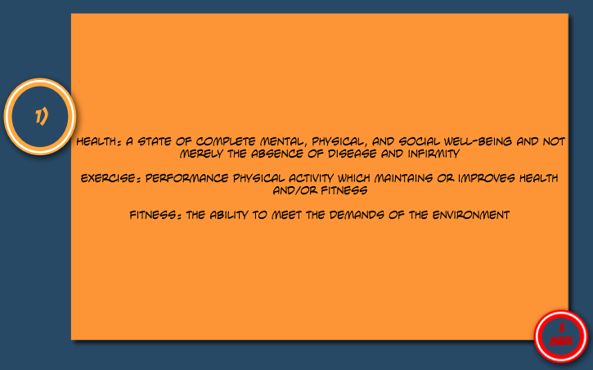
Explain the terms health, fitness and exercise.

Slide 57
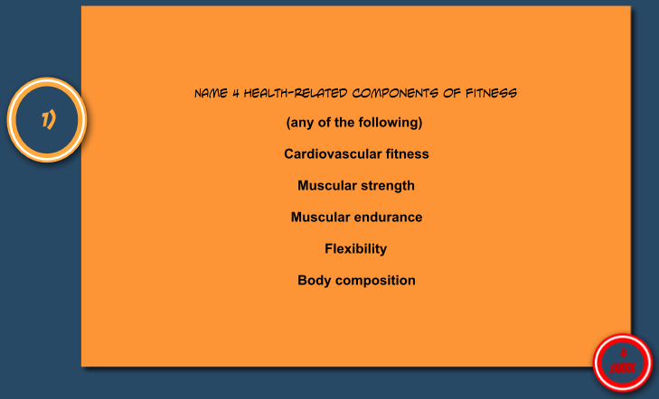
Know the 5 Health-related components of fitness.

Slide 58
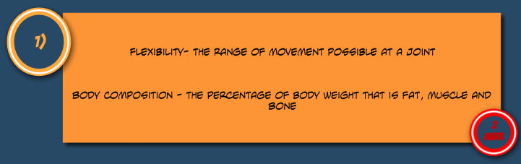
Define each health-related component of fitness and explain why it is important for different activities.

Slide 59
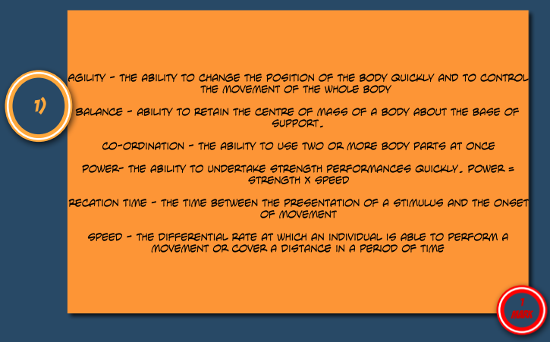
Know the 6 Skill-related components of fitness.

Slide 60
Explain the terms health, fitness and exercise.
Which health related component is described by ‘The percentage of body weight which is fat, muscle and bone’?
Name this component and give an example of how this is important to a sportsperson (2)

Slide 61
Know the 5 Health-related components of fitness.
Describe ways in which a lack of exercise effects physical performance (4)

Slide 62
Define each health-related component of fitness and explain why it is important for different activities.
Rank the following components of health or skill-related components of fitness with reference to their importance to a 100m sprinter (1 being most important and 5 being least).
Rank and give a reason why it is or is not important (5)

Slide 63
Know the 6 Skill-related components of fitness.
Describe how a hurdler utilises different components of fitness.
You may choose either health or skill related? (3)

Slide 64
Explain the terms health, fitness and exercise.
15. Which health related component is described by ‘The percentage of body weight which is fat, muscle and bone’?
Name this component and give an example of how this is important to a sportsperson (2)
Body Composition
Can influence what sport a person could be involved in, better knowledge of body shape and competencies can aid training requirements

Slide 65
Know the 5 Health-related components of fitness.
Describe ways in which a lack of exercise effects physical performance (4)
Weight increase – weight gained if calories not burned off
Less flexibility
Become breathless sooner
Aerobic capacity reduced
Loss of strength

Slide 66
Define each health-related component of fitness and explain why it is important for different activities.
Rank the following components of health or skill-related components of fitness with reference to their importance to a 100m sprinter (1 being most important and 5 being least). Rank and give a reason why it is or is not important (5)
Speed
Muscular Strength
Reaction Time
Flexibility
Agility

Slide 67
Know the 6 Skill-related components of fitness.
Describe how a hurdler utilises different components of fitness.
You may choose either health or skill related? (3)
Reaction Time – To Be Out Of The Blocks First
Speed – To Make It To Each Hurdle Quickly
Power – To Make Take-off Before The Hurdle
Coordination – Using All Limbs In Unison To Clear The Hurdle
Agility – To Clear The Hurdle Efficiently
Balance – To Land, Keeping The Body Stable After Clearing The Hurdle, And Resume The Running Phase

Slide 68

Topic 1.1.4: Physical activity as part of your HAL
Part 1
Part 2

Slide 69
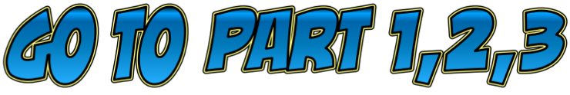




Topic 1.1.4: Physical activity as part of your HAL – Part 1
Topic | Key Concepts | 1-2 Mark Questions | Mark Questions | 6 Mark Questions - on Physical activity as part of your HAL | 6 Mark Questions Answers
Assess personal readiness (PAR-Q)
Assess fitness levels for use in an exercise programme (know the tests for Health-related exercise and skill-related fitness)
Explain the principles of training (individual differences/needs, progressive overload, specificity, rest and recovery, FITT principle, reversibility).
FITT principle & Reversibility
Explain the components of the FITT principle, and how it can improve your performance.

Slide 70
Assess personal readiness
(PAR-Q)
Before starting an exercise program you make sure you are ready to do the physical activity, you do this by taking the Physical Activity Readiness Questionnaire
Before you can complete the questionnaire you to be sure that your medical history any medical conditions, respiratory problems or other concerns
The questions that you should consider are
Have you any medical conditions e.g. a heart condition?
Do you experience chest pains
Do you have any ongoing injuries
Do you have high or low blood pressure
Do you have diabetes
Do you have asthma
Have you had a cold or flu a virus in the last 4 weeks
Is there any reason why you should not do physical activity

Slide 71
Assess fitness levels for use in an exercise programme (know the tests for Health-related exercise and skill-related fitness)
Fitness test | Component it tests | Sporting Example
Cooper run (12 minute run) | Muscular endurance | Long-distance events
Hand grip strength test | Muscular strength | Javelin
Sit and reach flexibility test | Flexibility | Gymnastics
Illinois agility run | Agility | Invasion games
Standing stork test | Balance | Gymnastics
Sargent jump test | Power | Basketball
Standing broad jump | Power | Football
Ruler drop test | Reaction time | cricket
30 metre sprint | Speed | Athletics
Three ball juggle | Coordination | Badminton

Slide 72
Explain the principles of training (individual differences/needs, progressive overload, specificity, rest and recovery, FITT principle, reversibility).
Specificity
Progressive overload
Rest
Individual needs / differences
Matching the training requirements of The Activity
Gradually increasing the amount of overload so as to gain fitness without risk of injury
The period of time allowed for recovery. Recovery the time required to repair damage to the body cause my training or competition
Recovery
The time required to repair damage to the body cause my training or competition
Taking into consideration the individual's needs before creating an exercise program

Slide 73
FITT principle & Reversibility
Frequency
Intensity
Time
Type
How often you train
How hard you train
How long is training session is
The method of training you choose
Reversibility means gradually using sickness instead of progressing remaining at the current level

Slide 74
Explain the components of the FITT principle, and how it can improve your performance.
Component of FITT | How it can improve your performance | Sporting example
Frequency | Frequency should be a minimum of 3 times a week, but could be increased to four times a week. Frequency overlaps with the principles of rest and recovery and can be used to make good use of these. More often you train effectively the better your development | Increasing Football training 4 times a week compared to previously only doing 3
Intensity | This overlaps with the principle of progressive overload. To increase cardiovascular fitness you have to be working within the training zone | Changing the intensity of training when you're working up to a big competition
Time | In terms of cardiovascular fitness to increase it's you must train for least 20 minutes within the training zone | Professional players with train for 2 to 3 hours at the time
Type | Depending on your sports you would change the method of training you use | For example a triathlete may use cross training because within their sport they work at variety of muscles / components

Slide 75

Assess personal readiness
(PAR-Q)

Slide 76

Assess fitness levels for use in an exercise programme (know the tests for Health-related exercise and skill-related fitness)

Slide 77

Explain the principles of training (individual differences/needs, progressive overload, specificity, rest and recovery, FITT principle, reversibility).

Slide 78

FITT principle & Reversibility

Slide 79
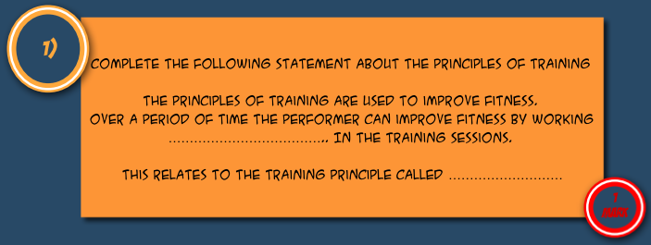
Explain the components of the FITT principle, and how it can improve your performance.

Slide 80
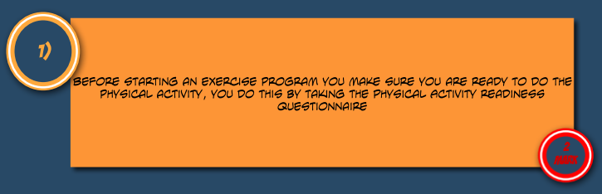
Assess personal readiness
(PAR-Q)

Slide 81
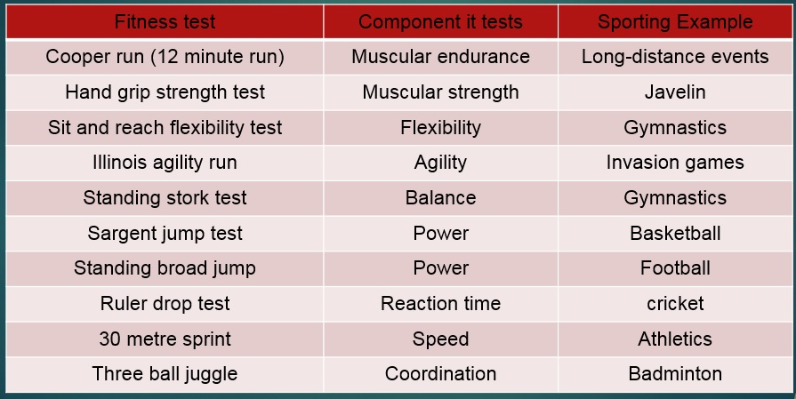
Assess fitness levels for use in an exercise programme (know the tests for Health-related exercise and skill-related fitness)

Slide 82
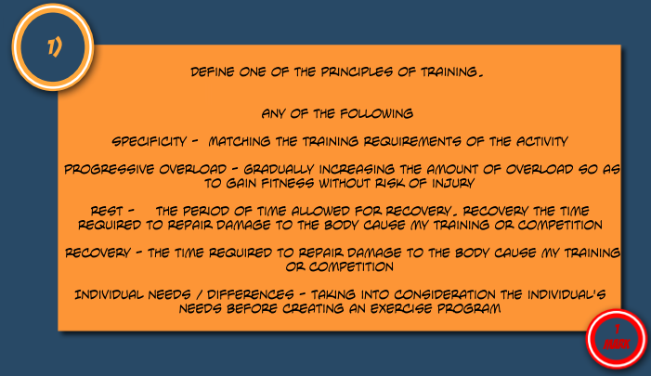
Explain the principles of training (individual differences/needs, progressive overload, specificity, rest and recovery, FITT principle, reversibility).

Slide 83

FITT principle & Reversibility

Slide 84
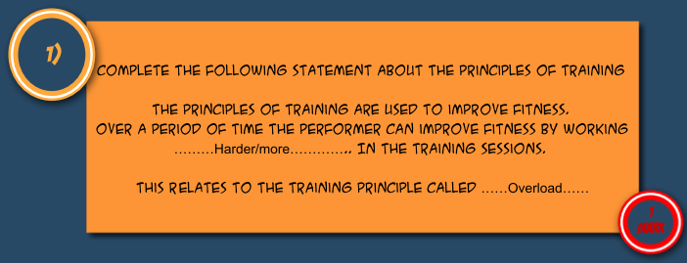
Explain the components of the FITT principle, and how it can improve your performance.

Slide 85
Assess personal readiness
(PAR-Q)
Agility and balance are components of fitness that are important to a gymnast.
Define each and give the fitness test used (4)

Slide 86
Assess fitness levels for use in an exercise programme (know the tests for Health-related exercise and skill-related fitness)
Describe the aerobic training zone and name a sport which primarily uses this zone? (3)

Slide 87
Explain the principles of training (individual differences/needs, progressive overload, specificity, rest and recovery, FITT principle, reversibility).
An individual wishes to improve fitness and performance and decides to plan a training programme.
Discuss why the individual should consider each principle stated below. (5)
Rest and Recovery – Individual Needs – Progressive Overload – Specificity – FITT Principle

Slide 88
Know how to use the principles of training to improve your fitness and/or skills in a personal exercise programme.
Circuit training is used by a variety of sports people in order to improve performance.
Describe advantages and disadvantages of circuit training for an individual (6)

Slide 89
Explain the components of the FITT principle, and how it can improve your performance.
Describe how the principle of progressive overload would be applied to a training programme to improve performance (2)

Slide 90
Assess personal readiness
(PAR-Q)
Agility and balance are components of fitness that are important to a gymnast.
Define each and give the fitness test used (4)
Agility definition – The ability to change the body’s position quickly whilst under control
Agility test – Illinois agility test
Balance definition – The ability to retain the body’s centre of mass above the base of support
Balance test – Stork stand

Slide 91
Assess fitness levels for use in an exercise programme (know the tests for Health-related exercise and skill-related fitness)
Describe the aerobic training zone and name a sport which primarily uses this zone? (3)
The aerobic training zone occurs between 60-80% of the maximum heart rate.
A sport which would use this zone primarily would be marathon running, cycling etc.

Slide 92
Explain the principles of training (individual differences/needs, progressive overload, specificity, rest and recovery, FITT principle, reversibility).
An individual wishes to improve fitness and performance and decides to plan a training programme. Discuss why the individual should consider each principle stated below. (5)
Rest and Recovery – Individual Needs – Progressive Overload – Specificity – FITT Principle
Rest And Recovery – Rest Days Must Be Placed In The Programme To Ensure Injury Does Not Occur And Allows For Development And Repair Of The Body
Individual Needs – The Person Must Take Into Account Their Own Level Of Fitness And The Aspects They Need To Improve
Progressive Overload – The Person Must Make Sure That They Put Progressions In Their Programme In Order To Improve, If Exercise Demands Stay The Same Then The Person Will Not Improve
Specificity – The Person Must Take Into Account The Sport They Are Training For And Make The Programme Relevant To Those Requirements
Fit Principle – The Amount Of Training, Level Of Training, Time Trained For And Type Of Training Are Essential Considerations To Make Sure The Programme Is Beneficial And Provides Opportunity For Improvement

Slide 93
Know how to use the principles of training to improve your fitness and/or skills in a personal exercise programme.
Circuit training is used by a variety of sports people in order to improve performance.
Describe advantages and disadvantages of circuit training for an individual (6)
Advantages – adaptable, do not need much space, use a variety of exercises, can be done on own, can need little equipment
Disadvantages – could be boring, may get repetitive, can be limited by equipment, can be limited by space

Slide 94
Explain the components of the FITT principle, and how it can improve your performance.
Describe how the principle of progressive overload would be applied to a training programme to improve performance (2)
Progressive overload must be applied in order for the individual to make progress, for example the length of time of a session ma increase throughout the programme, the intensity may increase or the weight/reps increase

Slide 95


Topic 1.1.4: Physical activity as part of your HAL – Part 2
Topic | Key Concepts | 1-2 Mark Questions | Mark Questions | 6 Mark Questions - On Physical activity as part of your HAL | 6 Mark Questions Answers
Explain the term reversibility, why it might occur and its impact on performance.
Explain the value of goal setting in terms of planning, developing and maintaining regular involvement in physical activity.
Describe, explain and apply the principle of setting SMART targets.
Describe the 6 main methods of training.
Explain which sports/activities each method is most suited to.
Explain the term reversibility, why it might occur and its impact on performance.
Explain the value of goal setting in terms of planning, developing and maintaining regular involvement in physical activity.

Slide 96
Explain the term reversibility, why it might occur and its impact on performance.
Reversibility means gradually using sickness instead of progressing remaining at the current level
Reversibility can occur when an injury takes place.
This would in turn reduce the athletes abilities
As the athlete may not be able to continue training at the level they did before the injury
For example their fitness levels
Reversibility may also occur if an individual stops training

Slide 97
Explain the value of goal setting in terms of planning, developing and maintaining regular involvement in physical activity.
Targets must be specific to your ability and be easily measurable. It also important that the targets set are achievable and realistic. Targets must also be time-phased.
Short-term targets influence long-term targets. Short-term targets usually relate to specific areas of development. Try to ensure that achieving short term goals provides satisfaction and that they are linked to daily and weekly action plans.
Long-term goals are often classified as outcome goals. Try to use outcome goals such as improving your performance.

Slide 98
Describe, explain and apply the principle of setting SMART targets.
Specific
Measurable
Achievable
Realistic
Time bound
Specific: clearly state what is to be achieved, e.g. increased fitness.
Measurable: the desired outcome is a number value that can be measured, e.g. increase time in 100m
Achievable: it is something you could achieve.
Realistic:
Timed: the target will be met within a given period of time, e.g. 12 months.

Slide 99
Describe the 6 main methods of training.
Circuit training
Continuous training
Cross training
involves performing a series of exercises in a special order called a circuit. Each activity takes place at a 'station'. It can be designed to improve speed, agility, coordination, balance and muscular endurance.
involves working for a sustained period of time without rest. It improves cardio-vascular fitness.
involves using another sport or activity to improve your fitness. It happens when an athlete trains in a different environment. For example a volleyball player uses the power training for that sport to help with fitness for long jump.
Fartlek training or 'speed play' training
involves varying your speed and the type of terrain over which you run, walk, cycle or ski. It improves aerobic and anaerobic fitness.
Interval training
involves alternating between periods of hard exercise and rest. It improves speed and muscular endurance.
Weight training
uses weights to provide resistance to the muscles. It improves muscular strength (high weight, low reps), muscular endurance (low weight, high reps, many sets) and power (medium weight and reps performed quickly).

Slide 100
Explain which sports/activities each method is most suited to.
Method of training | Examples of sports that would use it
Circuit training | Develops general fitness - all sports can benefit
Continuous training | Marathon Running, Long distance events
Cross training | Sprinters, racket sports
Fartlek training | Invasion games – football, basketball, rugby
Interval training | Football, Hockey, Swimming, Athletics
Weight training | Rugby, Weight Lifting,

Slide 101
Explain the term reversibility, why it might occur and its impact on performance.
Reversibility means gradually losing fitness instead of progressing or remaining at the current level.
This happens when a person is ill or injured.
Some people keep their fitness longer than others; this may be related to how long they have taken to build up their fitness or how serious their illness/injury was.
However, anyone will lose fitness if they stop training.
THIS IS A PRINCIPLE OF TRAINING YOU DO NOT WANT TO USE

Slide 102
Explain the value of goal setting in terms of planning, developing and maintaining regular involvement in physical activity.
People who set sensible goals, plan, record and monitor their progress are far more likely to meet their goals than those who do not.
It is very important to set goals write out a plan, monitor each training session and evaluate each weeks training.
Goal setting increases motivation, therefore make you more likely to achieve.
Remember to look at SMART Targets
(Click for SMART TARGETS)

Slide 103

Explain the term reversibility, why it might occur and its impact on performance.

Slide 104
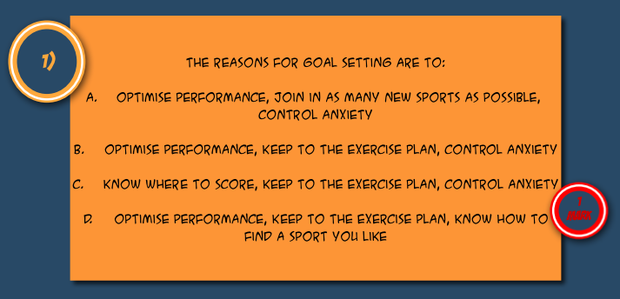
Explain the value of goal setting in terms of planning, developing and maintaining regular involvement in physical activity.

Slide 105

Describe, explain and apply the principle of setting SMART targets.

Slide 106

Describe the 6 main methods of training.

Slide 107
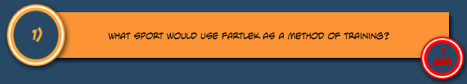
Explain which sports/activities each method is most suited to.

Slide 108
Explain the term reversibility, why it might occur and its impact on performance.

Slide 109
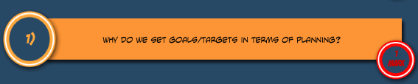
Explain the value of goal setting in terms of planning, developing and maintaining regular involvement in physical activity.

Slide 110
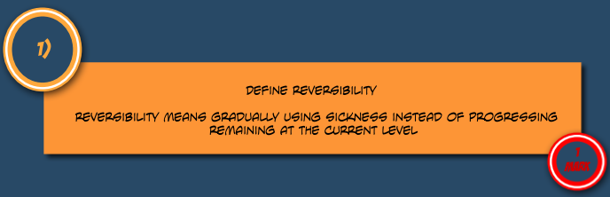
Explain the term reversibility, why it might occur and its impact on performance.

Slide 111
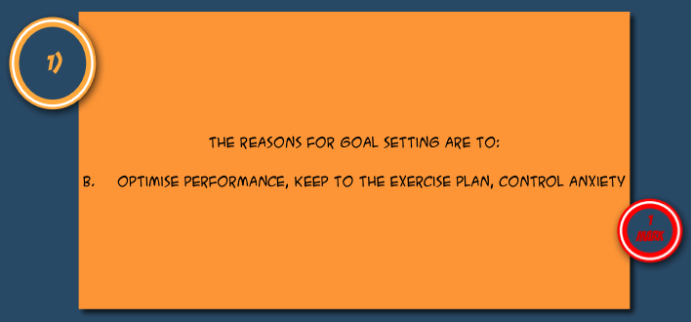
Explain the value of goal setting in terms of planning, developing and maintaining regular involvement in physical activity.

Slide 112
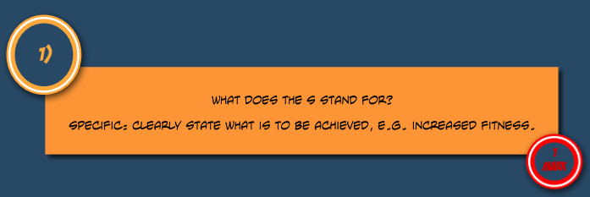
Describe, explain and apply the principle of setting SMART targets.

Slide 113
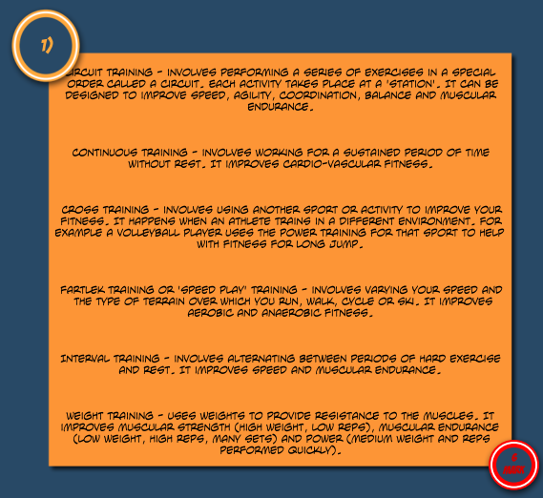
Describe the 6 main methods of training.

Slide 114
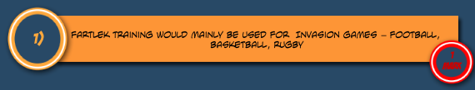
Explain which sports/activities each method is most suited to.

Slide 115
Explain the term reversibility, why it might occur and its impact on performance.

Slide 116
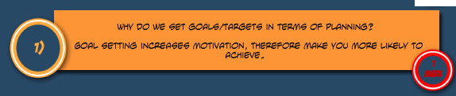
Explain the value of goal setting in terms of planning, developing and maintaining regular involvement in physical activity.

Slide 117
Explain the term reversibility, why it might occur and its impact on performance.
Jared uses the FITT principle of training to make sure he is fit for his activity.
Complete the table below
Explaining each component of the FITT principle.
Giving specific examples of its application to bring about overload in a personal exercise programme(PEP)
Component for principle | Explanation of component | Example of application to create overload
F
I
T
T |  | N/A

Slide 118
Explain the value of goal setting in terms of planning, developing and maintaining regular involvement in physical activity.
Define Progressive Overload and suggest how it helps and individual improve.

Slide 119
Describe, explain and apply the principle of setting SMART targets.
SMART stands for: (5)

Slide 120
Describe the 6 main methods of training.
Define the following methods of training.
Circuit training
Continuous Training
Cross training
Fartlek Training
Interval training
Weight training

Slide 121
Explain which sports/activities each method is most suited to.
Fill in the below table with reference to which sports each method of training would be suited to developing.
Method of training | Examples of sports that would use it
Circuit training
Continuous training
Cross training
Fartlek training
Interval training
Weight training

Slide 122
Explain the term reversibility, why it might occur and its impact on performance.
Define the term Reversibility and suggest when this would happen to an athlete.

Slide 123
Explain the value of goal setting in terms of planning, developing and maintaining regular involvement in physical activity.
Eshan is inspired by performers in the run up to the London 2012 Olympic and Paralympic Games, and is determined to improve his performance. He decides to set SMART targets as a first step to achieving his long-term goal. (6)
Discuss the use of target setting to improve performance. You must make reference to examples in your answer.

Slide 124
Explain the term reversibility, why it might occur and its impact on performance.
Jared uses the FITT principle of training to make sure he is fit for his activity.
Complete the table below
Explaining each component of the FITT principle.
Giving specific examples of its application to bring about overload in a personal exercise programme(PEP)
Component for principle | Explanation of component | Example of application to create overload
F | Frequency – how often you train (Do not accept frequency on its own) | Training once a week and then increasing to train twice a week
I | Intensity – How hard the person is working (Do not accept Intensity on its own) | Sprinting 20 shuttles rather than 18 (Do not accept training harder)
T | Time – How long a person trains for (Do not accept Time on its own) | First session was 20mins but by the 5th session it was 30 mins/equivalent (Do not accept training longer)
T | Type – the training must match the needs of the activity (Do not accept type on its own) | N/A

Slide 125
Explain the value of goal setting in terms of planning, developing and maintaining regular involvement in physical activity.
Progressive Overload is defined as which of the following? (1)
Working the body harder than normal and then increasing the intensity gradually.
By progressively increasing the weight it an individuals strength will increase as it allows for rest and recovery to take place. It also increase motivation as the individual will have progressive success.

Slide 126
Describe, explain and apply the principle of setting SMART targets.
5. SMART stands for: (1)
Specific,
Measurable
Achievable
Realistic
Time bound

Slide 127
Describe the 6 main methods of training.
Define the following methods of training.
Circuit training - involves performing a series of exercises in a special order called a circuit. Each activity takes place at a 'station'. It can be designed to improve speed, agility, coordination, balance and muscular endurance.
Continuous Training - involves working for a sustained period of time without rest. It improves cardio-vascular fitness.
Cross training - involves using another sport or activity to improve your fitness. It happens when an athlete trains in a different environment. For example a volleyball player uses the power training for that sport to help with fitness for long jump.
Fartlek Training - involves varying your speed and the type of terrain over which you run, walk, cycle or ski. It improves aerobic and anaerobic fitness.
Interval training - involves alternating between periods of hard exercise and rest. It improves speed and muscular endurance.
Weight training - uses weights to provide resistance to the muscles. It improves muscular strength (high weight, low reps), muscular endurance (low weight, high reps, many sets) and power (medium weight and reps performed quickly).

Slide 128
Explain which sports/activities each method is most suited to.
Fill in the below table with reference to which sports each method of training would be suited to developing.
Method of training | Examples of sports that would use it
Circuit training | Develops general fitness - all sports can benefit
Continuous training | Marathon Running, Long distance events
Cross training | Sprinters, racket sports
Fartlek training | Invasion games – football, basketball, rugby
Interval training | Football, Hockey, Swimming, Athletics
Weight training | Rugby, Weight Lifting,

Slide 129
Explain the term reversibility, why it might occur and its impact on performance.
Define the term Reversibility and suggest when this would happen to an athlete.
Reversibility means gradually losing fitness instead of progressing or remaining at the current level.
This happens when a person is ill or injured.
Some people keep their fitness longer than others; this may be related to how long they have taken to build up their fitness or how serious their illness/injury was.
However, anyone will lose fitness if they stop training.
THIS IS A PRINCIPLE OF TRAINING YOU DO NOT WANT TO USE

Slide 130
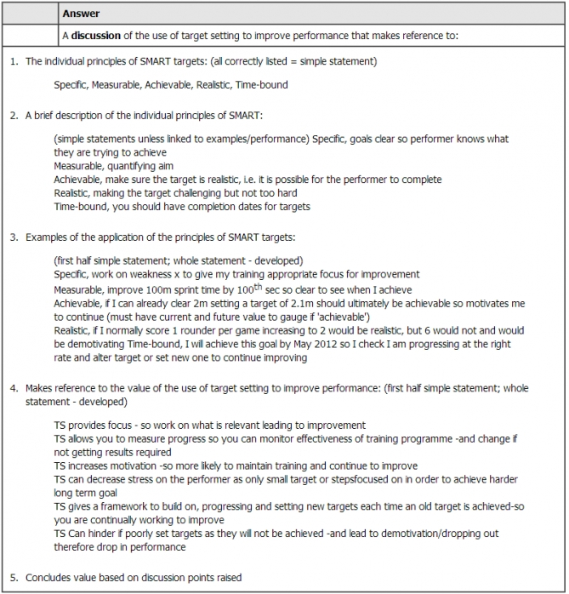
Explain the value of goal setting in terms of planning, developing and maintaining regular involvement in physical activity.
Click To Enlarge

Slide 131
Topic 1.1.5: Your personal health and well-being
Topic | Key Concepts | 1-2 Mark Questions | Mark Questions | 6 Mark Questions – on Your personal health and well-being | 6 Mark Questions Answers
Know the links between exercise, diet, work and rest and explain how these factors influence your personal health and well-being
Recall the 7 factors of a balanced diet.
Explain how each of these factors fits into a balanced, healthy lifestyle (i.e. give examples of foods which contain each nutrient; state their function; give examples of an athlete who would need to consume each nutrient).
Understand the importance of the right timing of dietary intake for optimum performance (pre, post and during exercise; carbo-loading)
Explain how blood flow (blood shunting) changes during exercise.

Slide 132
Know the links between exercise, diet, work and rest and explain how these factors influence your personal health and well-being
Diet and Sport
As well as thinking about having a balanced diet and getting all of the nutrients your body needs on a daily basis, athletes also have to think about what foods are going to benefit their sporting performance and when they should eat to fit around training and competitions.
Athletes involved in different sports will have very different diets.
For example, a weight lifter will eat a diet high in protein to help their muscles grow. An endurance athlete will have a diet high in carbohydrates to store their muscles with glycogen for energy.

Slide 133
The 7 factors of a balanced diet.
Vitamins
Minerals
Fat
Protein
Carbohydrates
Fibre
Water

Slide 134
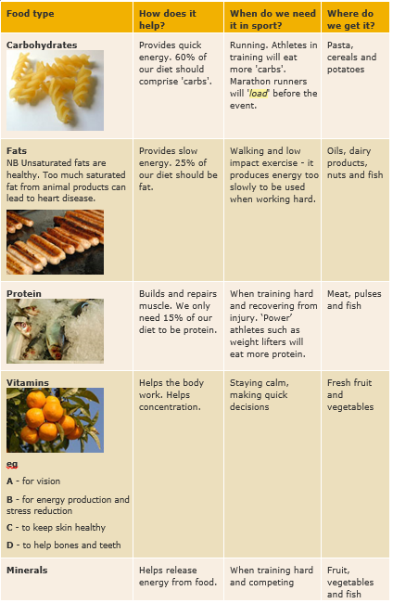
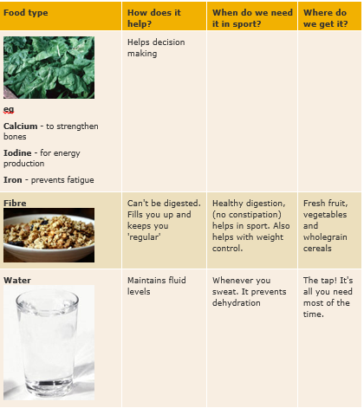
Explain how each of these factors fits into a balanced, healthy lifestyle.
Click to enlarge

Slide 135
Understand the importance of the right timing of dietary intake for optimum performance (pre, post and during exercise; carbo-loading)
Caro-Loading
When building up to a competition, some athletes will also use a technique called carbo-loading, where they eat a lot of carbohydrate rich foods in the run up to the event.
Why Carbo-Load
This ensures their muscles and liver are stocked up with glycogen so they have plenty of energy.
Eating During exercise
During an activity you shouldn't eat anything as your digestive system may not be able to cope as the blood is being diverted to your working muscles, not your stomach!
Drinking Water
You should always make sure you keep drinking throughout exercise though, to replace the fluid you are loosing through sweat and breathing out more water vapour.
Post Exercise
You should always make sure you keep drinking throughout exercise though, to replace the fluid you are loosing through sweat and breathing out more water vapour.

Slide 136
Explain how blood flow (blood shunting) changes during exercise.
Blood Shunting definition– This is the term given to the process which results in the redistribution of blood flow
Less blood is available to digest food in the gut – which can cause cramp/discomfort
This is why you should exercise 2-3 hours after eating
At the beginning of exercise blood is sent to the working muscles
Blood Shunting

Slide 137
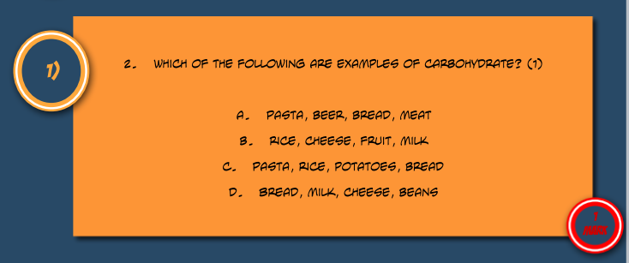
Know the links between exercise, diet, work and rest and explain how these factors influence your personal health and well-being

Slide 138
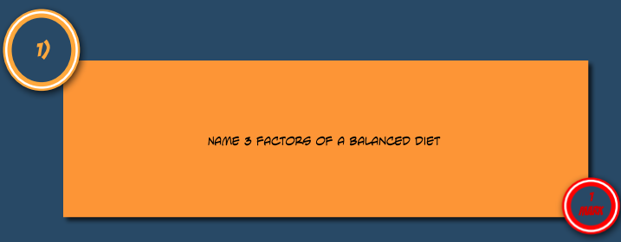
Recall the 7 factors of a balanced diet.

Slide 139

Explain how each of these factors fits into a balanced, healthy lifestyle (i.e. give examples of foods which contain each nutrient; state their function; give examples of an athlete who would need to consume each nutrient).

Slide 140
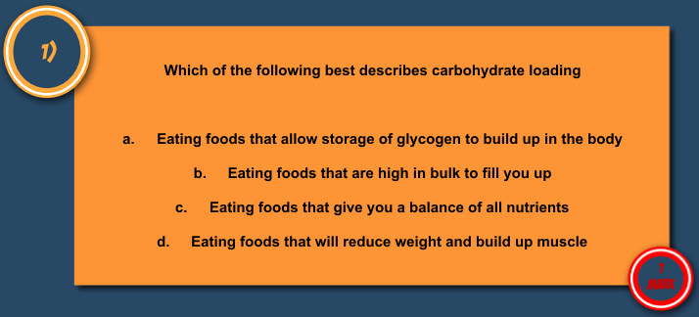
Understand the importance of the right timing of dietary intake for optimum performance (pre, post and during exercise; carbo-loading)

Slide 141

Explain how blood flow (blood shunting) changes during exercise.

Slide 142
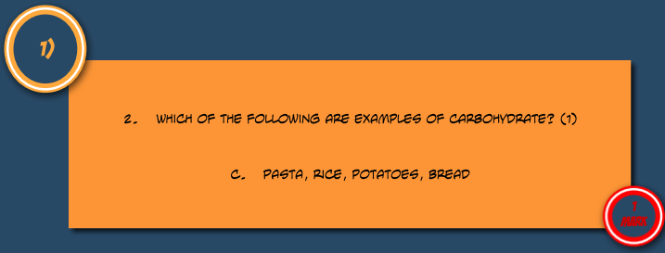
Know the links between exercise, diet, work and rest and explain how these factors influence your personal health and well-being

Slide 143
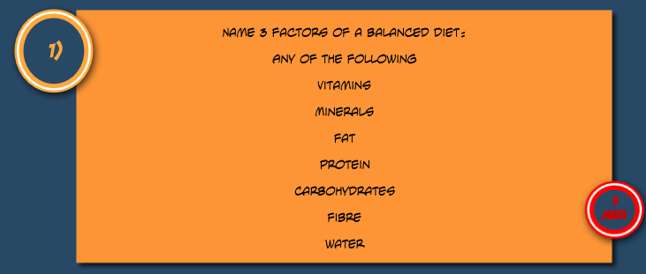
Recall the 7 factors of a balanced diet.

Slide 144

Explain how each of these factors fits into a balanced, healthy lifestyle (i.e. give examples of foods which contain each nutrient; state their function; give examples of an athlete who would need to consume each nutrient).

Slide 145
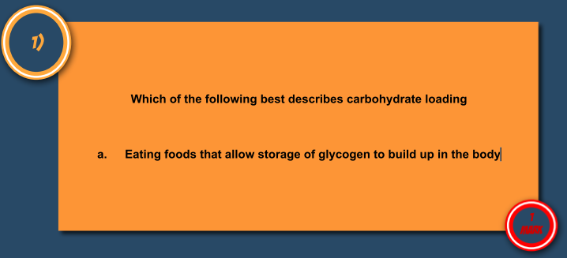
Understand the importance of the right timing of dietary intake for optimum performance (pre, post and during exercise; carbo-loading)

Slide 146
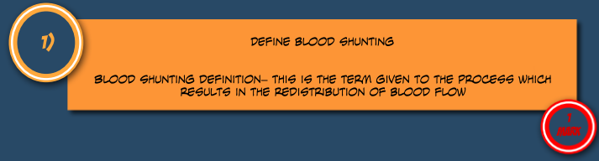
Explain how blood flow (blood shunting) changes during exercise.

Slide 147
Know the links between exercise, diet, work and rest and explain how these factors influence your personal health and well-being
A balanced diet has many beneficial effects on the body. These benefits can include a reduced chance of health problems, name 5 health problems which a balanced diet can help to avoid.(5)

Slide 148
Recall the 7 factors of a balanced diet.
Describe carbo-loading and the benefits it has on performance? (3)

Slide 149
Explain how each of these factors fits into a balanced, healthy lifestyle (i.e. give examples of foods which contain each nutrient; state their function; give examples of an athlete who would need to consume each nutrient).
Name 4 sports which require a higher level of calorie intake (4)

Slide 150
Understand the importance of the right timing of dietary intake for optimum performance (pre, post and during exercise; carbo-loading)
Discuss factors which can affect energy requirements for an individual (6)

Slide 151
Explain how blood flow (blood shunting) changes during exercise.
Describe two possible effects of dehydration on an athlete (2)

Slide 152
Know the links between exercise, diet, work and rest and explain how these factors influence your personal health and well-being
A balanced diet has many beneficial effects on the body.
These benefits can include a reduced chance of health problems, name 5 health problems which a balanced diet can help to avoid.(5)
Heart disease
High Blood Pressure
Stress
Stroke
High Cholesterol

Slide 153
Recall the 7 factors of a balanced diet.
Describe carbo-loading and the benefits it has on performance? (3)
Diet is adapted in the week leading up to the competition, allows a build up of glycogen in the body ready to be used when needed.
It will reduce levels of fatigue and so help to maintain a high standard of performance

Slide 154
Explain how each of these factors fits into a balanced, healthy lifestyle (i.e. give examples of foods which contain each nutrient; state their function; give examples of an athlete who would need to consume each nutrient).
Name 4 sports which require a higher level of calorie intake (4)
Rugby, Marathon running, Tennis, Football etc.

Slide 155
Understand the importance of the right timing of dietary intake for optimum performance (pre, post and during exercise; carbo-loading)
Discuss factors which can affect energy requirements for an individual (6)
Amount of Exercise, Age, Sex, Size, Pace of Life, Level of Exercise Undertaken, Metabolism, Lifestyle

Slide 156
Explain how blood flow (blood shunting) changes during exercise.
Describe two possible effects of dehydration on an athlete (2)
Make them weak or disorientated

Slide 157
Topic 1.2.1: Physical activity and your healthy mind and body – Part 1
Part 1
Part 2
Part 3

Slide 158
Topic 1.2.1: Physical activity and your healthy mind and body – Part 1
Topic | Key Concepts | 1-2 Mark Questions | Mark Questions | 6 Mark Questions – on Physical activity and your healthy mind and body | 6 Mark Questions Answers
Know the characteristics of different body types (somatotypes): endomorph, mesomorph, ectomorph.
Explain the effect each somatotype can have on participation and performance.
Identify activities where different somatotypes are an advantage.
Understand optimum weight, and explain why it varies according to height, gender, bone structure and muscle girth and how it can affect performance and participation in physical activity.
Define the terms anorexic, obese, overfat, overweight and underweight.

Slide 159
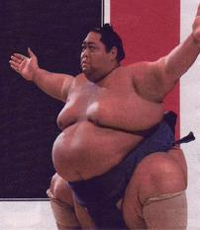
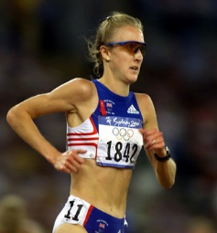
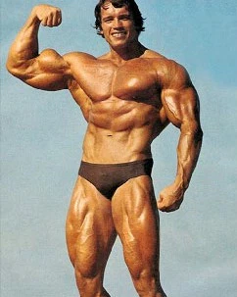
Know the characteristics of different body types (somatotypes): endomorph, mesomorph, ectomorph.
Mesomorphs - wedge-shaped body, wide shoulders, narrow hips, muscular. Ideal body type for sprinters.
Endomorphs - pear-shaped body, wide hips, wide shoulders, can have a lot fat on body, arms and thighs. When fit, ideal body type for weightlifting, wrestling.
Somatotypes – bodies come in all shapes and sizes but can be grounded into three basic types.
Endomorph
Ectomorph
Mesomorph
Ectomorphs - narrow-shaped body, are thin faced, with little fat or muscle. This is the ideal body type for long-distance runners.
Click the somatotype for a definition

Slide 160
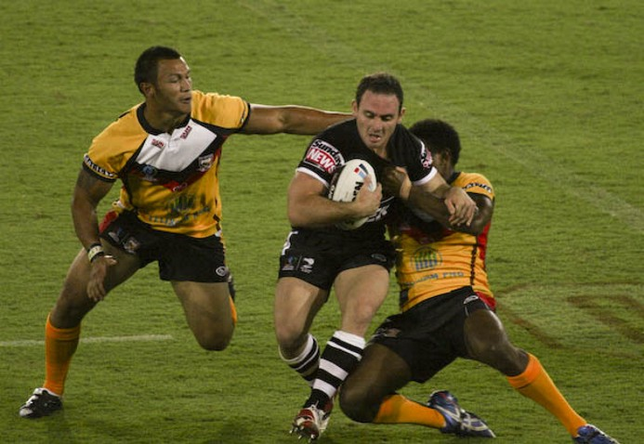
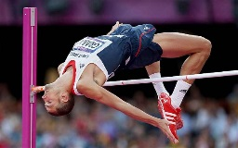
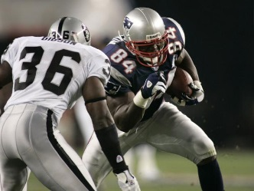
Explain the effect each somatotype can have on participation and performance.
Certain body types are more suited for certain Sports. Take athletics for example, it's not surprising that throwers ( who are predominantly mesomorphic / endomorphic) can't be different shapes to high jumpers ( who are predominantly ectomorphic).
Body Type | Sport | Picture (click to enlarge)
Endomorph | Sports that depend on power Rugby, Sumo Wrestling
Ectomorph | Tend to excel at long distance events Marathons, High jump
Mesomorph | Tend to be involved in sports which require strength and sudden burst of energy. American football, Sprinting

Slide 161
Identify activities where different somatotypes are an advantage.
Certain body types are more suited for certain Sports. Take athletics for example, it's not surprising that throwers ( who are predominantly mesomorphic / endomorphic) can't be different shapes to high jumpers ( who are predominantly ectomorphic).
Body Type | Advantage | Picture (click to enlarge)
Endomorph | Strength, pushing, throwing
Ectomorph | Jumping, running for long periods
Mesomorph | Speed, Power, Strength

Slide 162
Understand optimum weight, and explain why it varies according to height, gender, bone structure and muscle girth and how it can affect performance and participation in physical activity.
Factors affecting optimum weight
Optimum weight in sport
Losing weight
Click picture for more info

Slide 163
Gender
Bone structure
Muscles Girth
In most cases muscle girth increases with training. There for sports people who need strong muscles, such as England rugby star Andrew Sheridan, have a large muscle girth.
Genetic
Men and women have different body composition; men tend to have more muscle and larger bones. Therefore males and females have different charts to find the optimal weight
Bodies have different bone structures, sometimes referred to as a frame size.
As with bone structure, people naturally have different muscle growth which means that they weigh more; simple charts that measure optimum weight only according to height messages that people are overweight (for example BMI).
Body weight and the Shape I like the past onto the genetics of the parents to the child

Slide 164
Optimum weight in sport
The optimum weight for individual sports people varies widely according to the sport; rugby in horse racing, for example, have quite different requirements.
In Rugby, optimum weight maybe higher compared with people of similar height as rugby players need more muscular strength.
Where as a jockey needs to be short in height, with small bone structure a minimum amount of muscle.

Slide 165
Losing weight
Many people need to lose weight to reach the optimal weight.
In some sports, such as boxing horse racing, it is necessary to lose weight rapidly, as boxers and jockeys need to make the weight they are fighting or riding at
People who want to lose weight you can do so by:
Decreasing calorie intake (dieting)
Increasing calorie expenditure ( exercising)
Doing both ( dieting and exercise)

Slide 166
Define the terms anorexic, obese, overfat, overweight and underweight.
Anorexia
Obese
Overfat
Underweight
Overweight
Having weight in excess of normal ( not home for less accompanied by overfatness
Weighing less than a normal healthy all required weight
Having body fat in excess of normal
A term used to describe people who are very overfat
I prolong eating disorder due to loss of appetite

Slide 167

Know the characteristics of different body types (somatotypes): endomorph, mesomorph, ectomorph.

Slide 168

Explain the effect each somatotype can have on participation and performance.

Slide 169

Identify activities where different somatotypes are an advantage.

Slide 170

Understand optimum weight, and explain why it varies according to height, gender, bone structure and muscle girth and how it can affect performance and participation in physical activity.

Slide 171

Define the terms anorexic, obese, overfat, overweight and underweight.

Slide 172
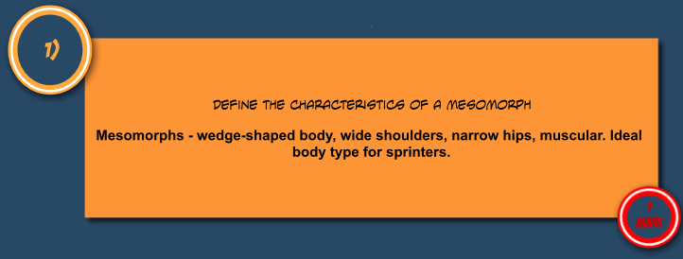
Know the characteristics of different body types (somatotypes): endomorph, mesomorph, ectomorph.

Slide 173
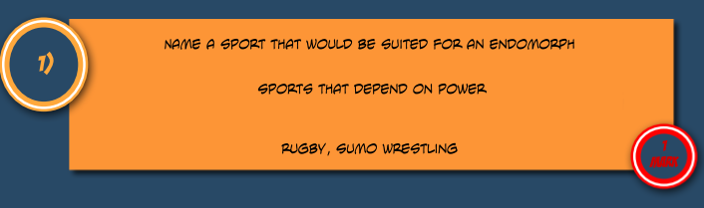
Explain the effect each somatotype can have on participation and performance.

Slide 174
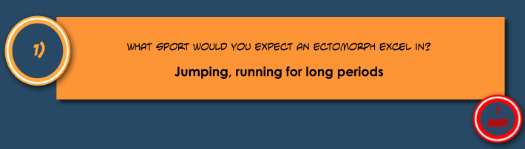
Identify activities where different somatotypes are an advantage.

Slide 175
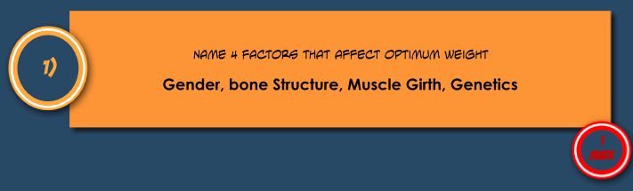
Understand optimum weight, and explain why it varies according to height, gender, bone structure and muscle girth and how it can affect performance and participation in physical activity.

Slide 176
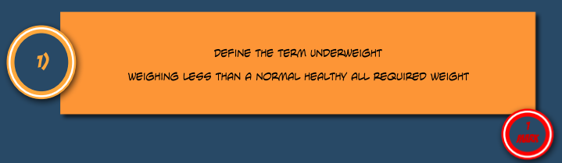
Define the terms anorexic, obese, overfat, overweight and underweight.

Slide 177
Know the characteristics of different body types (somatotypes): endomorph, mesomorph, ectomorph.
Expected weight and optimum weight may affect participation in physical activity.
Describe these effects (5)

Slide 178
Explain the effect each somatotype can have on participation and performance.
Complete the following table
Key Term | Description
Overweight
Overfat
Obese
Underweight

Slide 179
Identify activities where different somatotypes are an advantage.
Owais and Melvin are both “fit” for their activities. Owais the gymnast has a typical mesomorph body type, while Melvin the rock climber would be categorised as an ectomorph
Complete the table below:
Describe each body type
Explain how the body type could aid the boys’ performance in their chosen activities.
Body type | Description of body type | How the body type could aid the boys’ performance in their chosen activities
Mesomorph (gymnast)
Ectomorph (rock climber)

Slide 180
Understand optimum weight, and explain why it varies according to height, gender, bone structure and muscle girth and how it can affect performance and participation in physical activity.
Which of the following three body conditions is considered to be the most dangerous to health?
Obese, overweight, overfat
Why is it unlikely that an elite performer will have this condition

Slide 181
Define the terms anorexic, obese, overfat, overweight and underweight.
Explain why an injured athlete weight will increase if he maintains the same diet during the injury as you did while training/

Slide 182
Know the characteristics of different body types (somatotypes): endomorph, mesomorph, ectomorph.
Expected weight and optimum weight may affect participation in physical activity. Describe these effects (5)
Weight may hinder participation in some activities, may define which sports someone takes part in, how effectively skills are performed, how quickly fatigue sets in, speed of performing skills, speed, flexibility

Slide 183
Explain the effect each somatotype can have on participation and performance.
Complete the following table
Key Term | Description
Overweight | Having excess weight above the normal amount
Overfat | More body fat than you should have
Obese | Very overfat, more than 20% over the recommended weight
Underweight | Weighing less than is normal, healthy or required

Slide 184
Identify activities where different somatotypes are an advantage.
Owais and Melvin are both “fit” for their activities. Owais the gymnast has a typical mesomorph body type, while Melvin the rock climber would be categorised as an ectomorph
Complete the table below:
Describe each body type
Explain how the body type could aid the boys’ performance in their chosen activities.
Body type | Description of body type | How the body type could aid the boys’ performance in their chosen activities
Mesomorph (gymnast) | Muscular/wide shoulders and narrow hips | Greatest strength for balances/support positions, pull themselves up on the Rings. Greater power for faster movement in tumbling routines
Ectomorph (rock climber) | slight build/ tall and thin/ slim/ equivalent | Tall - good reach for choice of hand-held / foothold / equivalent Thin - less weight to support make it easier to climb/ pull-up rockface/ equivalent

Slide 185
Understand optimum weight, and explain why it varies according to height, gender, bone structure and muscle girth and how it can affect performance and participation in physical activity.
Which of the following three body conditions is considered to be the most dangerous to health?
Obese, overweight, overfat
Why is it unlikely that an elite performer will have this condition
Obese
They will be burning off a lot of calories during the training / have a carefully planned diet to make sure that they do not gain weight

Slide 186
Define the terms anorexic, obese, overfat, overweight and underweight.
Explain why an injured athlete weight will increase if he maintains the same diet during the injury as you did while training/
He is maintaining the same calorie input, but not using as much, the calorie not being used will then stored as fat

Slide 187
Topic 1.2.1: Physical activity and your healthy mind and body – Part 2
Topic | Key Concepts | 1-2 Mark Questions | Mark Questions | 6 Mark Questions - on Physical activity and your healthy mind and body | 6 Mark Questions Answers
Explain how the above conditions might affect physical activity.
Identify the 2 types of drugs: recreational (smoking and alcohol) and performance enhancing (peptide hormones, anabolic steroids, narcotics/analgesics, stimulants, diuretics and beta blockers).
Explain the impact of performance enhancing drugs on well-being and performance (i.e. potential benefits, side-effects, examples of athletes who may use them).
Give reasons why some performers might risk taking performance-enhancing drugs.
Explain how the above conditions might affect physical activity.

Slide 188
Explain how anorexic, obese, overfat, overweight and underweight might affect physical activity.

Slide 189
Identify the 2 types of drugs: recreational (smoking and alcohol) and performance enhancing (peptide hormones, anabolic steroids, narcotics/analgesics, stimulants, diuretics and beta blockers).
Performance Enhancing
Anabolic steroids
Recreational
Diuretics
Narcotic analgesics
Stimulants
Peptide hormones including erythropoietin/EPO
Beta blockers
Nicotine
Marijuana
Alcohol
Caffeine
Click the pictures for more information

Slide 190
Drug | Definition | Why would you take them
Anabolic steroids | Drugs that mimic testosterone to promote bone and muscle growth | Increase muscles growth and aid recovery
Beta blockers | Drugs that are used to control the heart rate and have a calming and relaxing effect. | Calm nerves
Diuretics | Drugs that elevate the rate of urine production | To mask other drugs
Narcotic analgesics | Drugs that can be used to reduce pain | To train while injured
Stimulants | Drugs that have an effect in the central nervous system, such as increase mental and/or physical alertness | Improve reaction time
Peptide hormones including erythropoietin/EPO | Drugs that causes other hormones to be produced | Increase muscles growth and aid recovery
Drug | Info
Nicotine | Nicotine is the addictive substance in tobacco smoke.
Marijuana | Cannabis is an illegal drug that can be smoked, producing feelings of well-being. But like tobacco it can cause lung cancer and bronchitis. Unlike tobacco, it can cause permanent damage to the mental health of its users.
Alcohol | Alcohol is addictive. Long-term effects of alcohol include damage to the liver and brain, and it is often the cause of weight gain.
Caffeine | Stimulants include caffeine - found in cola drinks and coffee, cannabis and amphetamines. They increase the transmission of signals from one nerve cell to the next. This increases alertness, heart rate and breathing rate.

Slide 191
Explain the impact of performance enhancing drugs on well-being and performance (i.e. potential benefits, side-effects, examples of athletes who may use them).
Drug | Benefit | Athletes that would use it | Side effects
Anabolic steroids | Increase muscles growth and aid recovery | Power Athletes – E.g. sprinters | Increase risk of heart attack, high blood pressure, liver disease, increase risk of muscle injury, infertility.
Beta blockers | Calm nerves | Darts players, Archers | Can reduce heart rate to a dangerous level
Diuretics | To mask other drugs | Anyone taking drugs, Boxers/Jockeys trying to lose weight | Dehydration, which can cause dizziness, muscle cramps, headaches and nausea. Long term effect such as kidney problems.
Narcotic analgesics | To train while injured | Anyone who is injured | Addictive
Stimulants | Improve reaction time | Sprinters, Goalkeepers, Boxers | Can cause heart failure, addictive
Peptide hormones including erythropoietin/EPO | Increase muscles growth and aid recovery | Any athlete trying to train more | EPO - risk of stroke or heart problems and HGH - abnormal growth, heart disease, diabetes, arthritis etc.

Slide 192
Give reasons why some performers might risk taking performance-enhancing drugs.
Some people take drugs to enhance or improve their performance or encourage to do so by the coaches or fellow athletes.
Professionals who compete the highest levels can make lots of money. Some athletes might take drugs so they can compete at higher levels than they would otherwise have reached.
Another incentive is that the competitive life of a professional sportsman is comparatively short and so they may take drugs to prolong the career, in order to make more money.
This tangible incentive create a huge temptation for athletes complete faster stronger for longer and performance enhancing drugs can help them achieve this.

Slide 193
Explain how the above conditions might affect physical activity.
Drug | Effect in sport | Why would you take them
Anabolic steroids | Increase Strengthen, Speed, Power | Increase muscles growth and aid recovery
Beta blockers | Increases focus | Calm nerves
Diuretics | Can mask other drugs from drug tests. | To mask other drugs
Narcotic analgesics | Can continue training even when injured, train for longer | To train while injured
Stimulants | React quicker, e.g. to the starting gun in 100m | Improve reaction time
Peptide hormones including erythropoietin/EPO | Increases size allows shorter rest periods between training. | Increase muscles growth and aid recovery

Slide 194

Explain how the above conditions might affect physical activity.

Slide 195

Identify the 2 types of drugs: recreational (smoking and alcohol) and performance enhancing (peptide hormones, anabolic steroids, narcotics/analgesics, stimulants, diuretics and beta blockers).

Slide 196

Explain the impact of performance enhancing drugs on well-being and performance (i.e. potential benefits, side-effects, examples of athletes who may use them).

Slide 197

Give reasons why some performers might risk taking performance-enhancing drugs.

Slide 198
Explain how the above conditions might affect physical activity.

Slide 199

Explain how the above conditions might affect physical activity.

Slide 200

Identify the 2 types of drugs: recreational (smoking and alcohol) and performance enhancing (peptide hormones, anabolic steroids, narcotics/analgesics, stimulants, diuretics and beta blockers).

Slide 201

Explain the impact of performance enhancing drugs on well-being and performance (i.e. potential benefits, side-effects, examples of athletes who may use them).

Slide 202

Give reasons why some performers might risk taking performance-enhancing drugs.

Slide 203
Explain how the above conditions might affect physical activity.

Slide 204
Explain how the above conditions might affect physical activity.
An athlete is intending to cheat in order to raise their performance in the 100m, explain how they could do this through drug taking (6)

Slide 205



Identify the 2 types of drugs: recreational (smoking and alcohol) and performance enhancing (peptide hormones, anabolic steroids, narcotics/analgesics, stimulants, diuretics and beta blockers).
Explain which performance enhancing drugs the following athletes would be best suited to and why they would take them.

Slide 206
Explain the impact of performance enhancing drugs on well-being and performance
Explain the impact of performance enhancing drugs on well-being and performance by filling in the below table
Drug | Benefit | Athletes that would use it | Side effects
Anabolic steroids |  | Power Athletes – E.g. sprinters
 |  | Darts players, Archers
Diuretics |  | Anyone taking drugs, Boxers/Jockeys trying to lose weight | Dehydration, which can cause dizziness, muscle cramps, headaches and nausea. Long term effect such as kidney problems.
Narcotic analgesics | To train while injured | Anyone who is injured | Addictive
 | Improve reaction time |  | Can cause heart failure, addictive
Peptide hormones including erythropoietin/EPO | Increase muscles growth and aid recovery |  | EPO - risk of stroke or heart problems and HGH - abnormal growth, heart disease, diabetes, arthritis etc.

Slide 207
Give reasons why some performers might risk taking performance-enhancing drugs.
Explain why some professional athletes may take performance enhancing drugs.
Give reference to tangible and intangible rewards

Slide 208
Explain how the above conditions might affect physical activity.
Fill in the below table
Drug | Effect in sport | Why would you take them
Anabolic steroids
Beta blockers
Diuretics
Narcotic analgesics
Stimulants
Peptide hormones including erythropoietin/EPO

Slide 209
Explain how the above conditions might affect physical activity.
An athlete is intending to cheat in order to raise their performance in the 100m, explain how they could do this through drug taking (6)
Use Anabolic Steroids to increase muscle mass to improve speed
Use Stimulants to increase awareness for sprint start
Narcotic Analgesics to recover quicker and be able to compete more quickly
Peptide Hormones to encourage muscle growth

Slide 210
Identify the 2 types of drugs: recreational (smoking and alcohol) and performance enhancing (peptide hormones, anabolic steroids, narcotics/analgesics, stimulants, diuretics and beta blockers).
Explain which performance enhancing drugs the following athletes would be best suited to and why they would take them.
Archer - Beta Blockers
Sprinter - Anabolic steroids
Boxer Stimulants
Reasons why
Pressure from the media
Sponsorship
Rewards of success
Money
Wanting to be the best
Make headline news so they are well-known
World famous status to prepare for life after competing

Slide 211
Explain the impact of performance enhancing drugs on well-being and performance
Explain the impact of performance enhancing drugs on well-being and performance by filling in the below table
Drug | Benefit | Athletes that would use it | Side effects
Anabolic steroids | Increase muscles growth and aid recovery | Power Athletes – E.g. sprinters | Increase risk of heart attack, high blood pressure, liver disease, increase risk of muscle injury, infertility.
Beta blockers | Calm nerves | Darts players, Archers | Can reduce heart rate to a dangerous level
Diuretics | To mask other drugs | Anyone taking drugs, Boxers/Jockeys trying to lose weight | Dehydration, which can cause dizziness, muscle cramps, headaches and nausea. Long term effect such as kidney problems.
Narcotic analgesics | To train while injured | Anyone who is injured | Addictive
Stimulants | Improve reaction time | Sprinters, Goalkeepers, Boxers | Can cause heart failure, addictive
Peptide hormones including erythropoietin/EPO | Increase muscles growth and aid recovery | Any athlete trying to train more | EPO - risk of stroke or heart problems and HGH - abnormal growth, heart disease, diabetes, arthritis etc.

Slide 212
Give reasons why some performers might risk taking performance-enhancing drugs.
Some people take drugs to enhance or improve their performance or encourage to do so by the coaches or fellow athletes.
Professionals who compete the highest levels can make lots of money. Some athletes might take drugs so they can compete at higher levels than they would otherwise have reached.
Another incentive is that the competitive life of a professional sportsman is comparatively short and so they may take drugs to prolong the career, in order to make more money.
This tangible incentive create a huge temptation for athletes complete faster stronger for longer and performance enhancing drugs can help them achieve this.

Slide 213
Explain how the above conditions might affect physical activity.
Fill in the below table
Drug | Effect in sport | Why would you take them
Anabolic steroids | Increase Strengthen, Speed, Power | Increase muscles growth and aid recovery
Beta blockers | Increases focus | Calm nerves
Diuretics | Can mask other drugs from drug tests. | To mask other drugs
Narcotic analgesics | Can continue training even when injured, train for longer | To train while injured
Stimulants | React quicker, e.g. to the starting gun in 100m | Improve reaction time
Peptide hormones including erythropoietin/EPO | Increases size allows shorter rest periods between training. | Increase muscles growth and aid recovery

Slide 214
Topic 1.2.1: Physical activity and your healthy mind and body – Part 3
Topic | Key Concepts | 1-2 Mark Questions | Mark Questions | 6 Mark Questions – on Physical activity and your healthy mind and body | 6 Mark Questions Answers
Identify the risks associated with participation in physical activities.
Explain how to reduce these risks, with special consideration to: warming up/cooling down; equipment and facilities; clothing; balanced competition; rules; readiness.

Slide 215
Identify the risks associated with participation in physical activities.
There are 3 main areas
within this section
Prevention of injury
Treating sports injuries
Causes and types of injury
Click on a section for more information

Slide 216

Prevention of injury
When you take up a sport, there’s always that worry you might hurt yourself. Some sporting activities, like white water rafting, are obviously more dangerous than others because factors including the environment, weather and the raft itself influence how safe you’ll be.
Risk responsibility
Playing by the rules
The authorities/NGB are responsible for:
There are a number of reasons why players should play by the rules:
The rules - to reduce dangerous play
Referees - to check the environment and insist on fair play
Insisting on protective equipment and removal of jewellery
Balancing competition - by age, weight, gender, skill level
It reduces risk to themselves and others.
It stops the players being penalised. Giving away points, free shots, getting sent off or disqualified for breaking the rules does not help the player or the team.
The sport cannot happen unless players cooperate with the opposition whilst competing.
Each player is responsible for:
Being fit enough
Using correct technique
Wearing the right clothing and equipment, e.g. making sure shoes fit correctly
Checking that the environment is safe
Warming up and cooling down
Etiquette - playing fair and respecting their opponents

Slide 217
Treating sports injuries
Fractures and dislocations
Signs:
swelling
unusual shape or deformity
signs of shock (pale, clammy skin)
Symptoms of fractures/dislocations:
tenderness at the site (fracture)
'sickening' pain (dislocation)
Nausea
Bone and joint injuries - Assess injury by considering:
Skin damage
Cuts – dry the skin around the cut and cover with a clean dressing.
Grazes – check for dirt within the graze. Cover with a specialist non-stick dressing.
Blisters – do not break the blister. Cover it with a specialist plaster that stays in place until it falls off naturally. This eases pain and protects the area from further damage.
Emergencies
Dehydration
lie the sufferer down in a cool place
raise and support legs
give plenty of water
Hypothermia
move sufferer to a warmer, sheltered area
provide extra clothing or a survival bag
give warm drinks
keep checking for pulse and breathing
Unconsciousness/Concussion Follow the DRABC (Dr ABC) checklist

Slide 218
Explain how to reduce these risks, with special consideration to: warming up/cooling down; equipment and facilities; clothing; balanced competition; rules; readiness.
Warming up/ cooling down
Checking equipment and facilities
Protective equipment and clothing
Balanced competition
Playing to the rules of the competition
Physical readiness
Preventing injury

Slide 219

Identify the risks associated with participation in physical activities.

Slide 220
Explain how to reduce these risks, with special consideration to: warming up/cooling down; equipment and facilities; clothing; balanced competition; rules; readiness.

Slide 221

Identify the risks associated with participation in physical activities.

Slide 222
Explain how to reduce these risks, with special consideration to: warming up/cooling down; equipment and facilities; clothing; balanced competition; rules; readiness.
Warming up/ cooling down
Checking equipment and facilities
Protective equipment and clothing
Balanced competition
Playing to the rules of the competition
Physical readiness
Preventing injury

Slide 223
Identify the risks associated with participation in physical activities.
Describe two benefits of a cool down after physical activity. (2)

Slide 224
Explain how to reduce these risks, with special consideration to: warming up/cooling down; equipment and facilities; clothing; balanced competition; rules; readiness.
State 4 safety considerations a person may need to think about before taking part in a hockey match (4)

Slide 225
Identify the risks associated with participation in physical activities.
Describe two benefits of a cool down after physical activity. (2)
slows down heart rate, stops build up of lactic acid, prevent cramp

Slide 226
Explain how to reduce these risks, with special consideration to: warming up/cooling down; equipment and facilities; clothing; balanced competition; rules; readiness.
State 4 safety considerations a person may need to think about before taking part in a hockey match (4)
Any of the following
State of the pitch,
if goalkeeper then padding,
shin pads,
mouth guard,
stick in good condition,
correct footwear etc..

Slide 227








Topic 1.2.2: A healthy, active lifestyle and your cardiovascular system
Topic | Key Concepts | 1-2 Mark Questions | Mark Questions | 6 Mark Questions - A healthy, active lifestyle and your cardiovascular system | 6 Mark Questions Answers
Identify and explain the immediate and short-term effects of participation in physical activity on the CV system (increased HR; systolic/diastolic BP; increased BP).
Identify and explain the effects of regular and long-term participation in exercise on the CV system (decreased resting HR, recovery rate, increased stroke volume, cardiac output, BP, healthy veins and arteries).
Understand the importance of rest and recovery time.
Explain the impact of diet on the CV system, in particular how it effects BP and cholesterol (LDL and HDL).
Identify the effects of recreational drugs on the CV system.

Slide 228
Identify and explain the immediate and short-term effects of participation in physical activity on the CV system (increased HR; systolic/diastolic BP; increased BP).
Immediate effect | Benefit
Increased heart rate | Increase in oxygenated blood to the working muscles
Increase blood pressure | Increase the rate in which blood is transported and lactic acid is removed
Blood temperature rises. | Blood vessels near skin open to allow heat to be lost.
Blood diverted to muscles | it is diverted from the digestive system to the muscles.

Slide 229
Identify and explain the effects of regular and long-term participation in exercise on the CV system (decreased resting HR, recovery rate, increased stroke volume, cardiac output, BP, healthy veins and arteries).
Long term effect | Benefit
Decreased resting heart rate | quicker recovery from exercise.
Increased Heart recover rate | quicker recovery from exercise.
Increased stroke volume | More oxygenated blood can be pumped per beat
Increased Cardiac output | More blood pump around the body
Increased number of capillaries in muscles.
Increased volume of blood and red blood cells.

Slide 230
Understand the importance of rest and recovery time.
Rest must be included in a personal exercise programme to allow time for recovery and adaptations to take place
Example someone training five times a week would probably be training in 3 days and resting two to allow adaptation to take place
Example,
Day 1: Training
Day 2: Rest
Day 3: Training
Day 4: Rest
Day 5: Training

Slide 231
Explain the impact of diet on the CV system, in particular how it effects BP and cholesterol (LDL and HDL).
Cholesterol is a substance found in the blood. It is made in the liver and is needed for healthy cell membranes. However, too much cholesterol in the blood increases the risk of heart disease, and of diseased arteries.
Good and bad cholesterol
The bloodstream transports cholesterol around the body attached to proteins. The combination of cholesterol and protein is called lipoprotein, and there are two types.
Low-density lipoproteins - LDLs - carry cholesterol from the liver to the cells.
High-density lipoproteins - HDLs - carry excess cholesterol back to the liver.
LDLs are often called 'bad' cholesterol because they lead to fat building up on artery walls, which causes heart disease. HDLs are often called ‘good’ cholesterol because they help to stop fat building up in the arteries.
Improving the balance
A high proportion of HDLs to LDLs is good for a healthy heart. Monounsaturated and polyunsaturated oils - as found in vegetable oils - help to reduce cholesterol levels in the blood, and also increase the proportion of HDLs compared with LDLs. Check your understanding of such oils by looking at Vegetable oils.
There are also drugs that can improve high blood pressure and high cholesterol levels.

Slide 232
Identify the effects of recreational drugs on the CV system.
Nicotine
Raises blood pressure
Puts heart under unnecessary stress
Alcohol
Lowers blood pressure
Reduces amount of oxygenated blood to the working muscles.

Slide 233

Identify and explain the immediate and short-term effects of participation in physical activity on the CV system (increased HR; systolic/diastolic BP; increased BP).

Slide 234

Identify and explain the effects of regular and long-term participation in exercise on the CV system (decreased resting HR, recovery rate, increased stroke volume, cardiac output, BP, healthy veins and arteries).

Slide 235

Understand the importance of rest and recovery time.

Slide 236

Explain the impact of diet on the CV system, in particular how it effects BP and cholesterol (LDL and HDL).

Slide 237

Identify the effects of recreational drugs on the CV system.

Slide 238

Identify and explain the immediate and short-term effects of participation in physical activity on the CV system (increased HR; systolic/diastolic BP; increased BP).

Slide 239

Identify and explain the effects of regular and long-term participation in exercise on the CV system (decreased resting HR, recovery rate, increased stroke volume, cardiac output, BP, healthy veins and arteries).

Slide 240

Understand the importance of rest and recovery time.

Slide 241

Explain the impact of diet on the CV system, in particular how it effects BP and cholesterol (LDL and HDL).

Slide 242

Identify the effects of recreational drugs on the CV system.

Slide 243
Identify and explain the immediate and short-term effects of participation in physical activity on the CV system (increased HR; systolic/diastolic BP; increased BP).
Describe and explain, using examples, both the immediate effects, and the long term effects of regular exercise on the cardiovascular system.

Slide 244
Identify and explain the effects of regular and long-term participation in exercise on the CV system (decreased resting HR, recovery rate, increased stroke volume, cardiac output, BP, healthy veins and arteries).
Describe 2 long term effects of exercise on the Circulatory System (2)

Slide 245
Understand the importance of rest and recovery time.
Explain the immediate effects of exercise on the Circulatory System (6)

Slide 246
Explain the impact of diet on the CV system, in particular how it effects BP and cholesterol (LDL and HDL).
How can a healthy, balanced diet have an effect on your Cardiovascular System (2)

Slide 247
Identify the effects of recreational drugs on the CV system.
How do recreational drugs affect blood pressure? (2)

Slide 248
Explain what makes up a HAL
Describe and explain, using examples, both the immediate effects, and the long term effects of regular exercise on the cardiovascular system.
Any of the following
Immediate effects to include;
Increased Heart Rate (example of resting HR – 60-80bpm).
Increased Blood pressure as greater amounts of blood is pumped around the body, increasing the pressure on the blood vessels.
Breathing becomes faster and deeper.
Body temperature increases.
Sweating occurs and requires fluids.
Muscles begin to ache.
Long term effects to include;
Decreased resting heart rate
Decrease in Heart’s recovery rate.
Increased Stoke Volume.
Cardiac Output can increase (CO = SV x HR).
Reduced blood pressure.
Greater number of capillaries and blood vessels become more flexible and efficient.
Knowledge and understanding of reasons why should be shown and examples used where appropriate.

Slide 249
Identify and explain the effects of regular and long-term participation in exercise on the CV system (decreased resting HR, recovery rate, increased stroke volume, cardiac output, BP, healthy veins and arteries).
Describe 2 long term effects of exercise on the Circulatory System (2)
Any of the following:
Helps strengthen the heart, cardiac hypertrophy, walls thicker, stroke volume increase, cardiac output increase

Slide 250
Understand the importance of rest and recovery time.
Explain the immediate effects of exercise on the Circulatory System (6)
Any of the following
Heart rate increases to deliver more oxygen to working muscles,
blood pressure increases,
blood shunted to working muscles,
blood vessels dilate at skin surface causing reddening,
arteries widen to let blood through,
sv increase, co increase

Slide 251
Explain the impact of diet on the CV system, in particular how it effects BP and cholesterol (LDL and HDL).
How can a healthy, balanced diet have an effect on your Cardiovascular System (2)
Any of the following:
Low fat, salt and sugar but high in fruit and vegetables can reduce blood pressure, reduced fats, and salt can reduce cholesterol levels

Slide 252
Identify the effects of recreational drugs on the CV system.
How do recreational drugs affect blood pressure? (2)
Any of the following
Smoking makes blood vessels contract, chemicals in alcohol cause blood vessels to tighten

Slide 253
Topic 1.2.3: A healthy, active lifestyle and your respiratory system
Topic | Key Concepts | 1-2 Mark Questions | Mark Questions | 6 Mark Questions - on A healthy, active lifestyle and your respiratory system | 6 Mark Questions Answers
Understand the main function of the respiratory system and respiration.
Identify and explain the immediate and short-term effects of participation in physical activity on the respiratory system (increased breathing rate; oxygen debt).
Identify and explain the effects of regular and long-term participation in exercise on the respiratory system (better delivery of O2 and removal of CO2 to/from the working muscles, increased lung volumes, increased number of alveoli, increased number of blood vessels).
Key terms of the respiratory system and respiration.

Slide 254

Understand the main function of the respiratory system and respiration.

Slide 255
Identify and explain the immediate and short-term effects of participation in physical activity on the respiratory system (increased breathing rate; oxygen debt).
Immediate effects when first exercising:
Increased rate of breathing
Increased depth of breathing – rise in tidal volume
Effects of regular training:
Increased strength of diaphragm and intercostal muscles.
Greater number of alveoli.
Increased ability of the lungs to extract oxygen from the air.
Increased vital capacity.
Increased amount of oxygen delivered to, and carbon dioxide removed from, the body.

Slide 256
Identify and explain the effects of regular and long-term participation in exercise on the respiratory system
Regular training can effect the respiratory system in the following ways
Increased lung volumes,
Increased number of alveoli,
Increased number of blood vessels
Better delivery of O2 and removal of CO2 to/from the working muscles,

Slide 257
Key terms of the respiratory system and respiration.
Oxygen Debt
The extra oxygen consumed during recovery from a period of strenuous physical activity, compared with the amount which would usually have been consumed over the same length of time at rest.
Tidal volume
The amount of air inspired and expired with each normal breath at rest or during exercise
Vital capacity
The greatest amount of air that can be made to pass into and out of the lungs by the most forceful inspiration and expiration.
Normally this is about 4-5 litres

Slide 258

Understand the main function of the respiratory system and respiration.

Slide 259

Identify and explain the immediate and short-term effects of participation in physical activity on the respiratory system (increased breathing rate; oxygen debt).

Slide 260

Identify and explain the effects of regular and long-term participation in exercise on the respiratory system (better delivery of O2 and removal of CO2 to/from the working muscles, increased lung volumes, increased number of alveoli, increased number of blood vessels).

Slide 261

Understand the main function of the respiratory system and respiration.

Slide 262

Understand the main function of the respiratory system and respiration.

Slide 263

Identify and explain the immediate and short-term effects of participation in physical activity on the respiratory system (increased breathing rate; oxygen debt).

Slide 264

Identify and explain the effects of regular and long-term participation in exercise on the respiratory system (better delivery of O2 and removal of CO2 to/from the working muscles, increased lung volumes, increased number of alveoli, increased number of blood vessels).

Slide 265

Key terms of the respiratory system and respiration.

Slide 266
Understand the main function of the respiratory system and respiration.
The Respiratory System is made up of different parts each having a specific function.
Please complete the table below (4)
Part | Function
Trachea
 | Protective cage around the organs in the chest, these protect the lungs
Bronchi
 | Where gaseous exchange takes place

Slide 267
Identify and explain the immediate and short-term effects of participation in physical activity on the respiratory system (increased breathing rate; oxygen debt).
Describe 2 long term effects of exercise on the Respiratory System (2)

Slide 268
Identify and explain the effects of regular and long-term participation in exercise on the respiratory system
Explain the immediate effects of exercise on the Respiratory System (6)

Slide 269
Key terms of the respiratory system and respiration.
Describe oxygen debt, how it can occur and state what the body’s response to it is (4)

Slide 270
Understand the main function of the respiratory system and respiration.
The Respiratory System is made up of different parts each having a specific function.
Please complete the table below (4)
Part | Function
Trachea | Allows Air To Travel To Bronchi
Ribs | Protective cage around the organs in the chest, these protect the lungs
Bronchi | Takes Air To Bronchioles
Alveoli | Where gaseous exchange takes place

Slide 271
Identify and explain the immediate and short-term effects of participation in physical activity on the respiratory system (increased breathing rate; oxygen debt).
Describe 2 long term effects of exercise on the Respiratory System (2)
Any of the following:
Diaphragm and intercostal muscles strengthen, gaseous exchange more efficient, increase vc, more o2 to working muscles

Slide 272
Identify and explain the effects of regular and long-term participation in exercise on the respiratory system (better delivery of O2 and removal of CO2 to/from the working muscles, increased lung volumes, increased number of alveoli, increased number of blood vessels).
. Explain the immediate effects of exercise on the Respiratory System (6)
Any of the following:
Tidal volume increases, reduces build up of co2, breathing rate increases, breathing shallow to repay o2 debt, waste water released, energy released

Slide 273
Key terms of the respiratory system and respiration.
Describe oxygen debt, how it can occur and state what the body’s response to it is (4)
The body needs more oxygen than it can get, can occur when high level of activity occurs, breathing rate increases and becomes deeper to repay it.

Slide 274
Topic 1.2.4: A healthy, active lifestyle and your muscular system
Part 1
Part 2

Slide 275
Topic 1.2.4: A healthy, active lifestyle and your muscular system – Part 1
Topic | Key Concepts | 1-2 Mark Questions | Mark Questions | 6 Mark Questions - on A healthy, active lifestyle and your muscular system | 6 Mark Questions Answers
Identify the major muscle groups (deltoid, trapezius, latissimus dorsi, pectorals, abdominals, biceps, triceps, gluteals, quadriceps, hamstrings, gastrocnemius).
Understand which physical activities benefit the major muscle groups.
Explain the role of muscles in movement (i.e. antagonist, agonist, the role of each muscle group)
Identify and explain the immediate and short-term effects of participation in exercise on the muscular system.
Identify and explain the effects of regular and long-term participation in exercise on the muscular system.

Slide 276


Identify the major muscle groups (deltoid, trapezius, latissimus dorsi, pectorals, abdominals, biceps, triceps, gluteals, quadriceps, hamstrings, gastrocnemius).
There are 11 specific muscles you need to know for your exam
Click to enlarge

Slide 277
Understand which physical activities benefit the major muscle groups.
Muscle | Location | Physical activity that would improve it
Deltoid | Shoulder | Bent over row, Military press
Trapezius | Back of Neck | Rowing , shoulder shrugs
Latissimus Dorsi | Back near shoulder blade | Lat-pull downs, pull ups
Pectorals | Chest | Bench press
Biceps | Front Upper arm | Bicep curls
Triceps | Back upper arm | Chin ups, triceps dips
Gluteals | Bum | Squats, Leg press, Lunges
Quadriceps | Front upper leg | Squats, Leg press, Lunges
Hamstring | Back upper leg | Squats, Leg press, Lunges
Gastrocnemius | Back lower leg (calf) | Calf raises

Slide 278
Explain the role of muscles in movement (i.e. antagonist, agonist, the role of each muscle group)
Muscles contract when they work. If a muscle contracts to create movement, it is called anisotonic contraction.
An isotonic contraction can be concentric, which is where the muscle shortens as the fibres contract or eccentric, where the fibres contract as the muscle lengthens.
When a muscle contracts with no resulting movement, it is an isometric contraction.
Antagonistic pairs
(click for more info)
Which muscle allows what movement
(click for more info)

Slide 279
Antagonistic pairs
Antagonistic pairs of muscles create movement when one (the prime mover) contracts and the other (the antagonist) relaxes. Examples of antagonistic pairs working are:
the quadriceps and hamstrings in the leg
the biceps and triceps in the arm

Slide 280

Which muscle allows what movement
Click to enlarge

Slide 281
Identify and explain the immediate and short-term effects of participation in exercise on the muscular system.
Immediate effects when first exercising:
Muscles contract more often
Blood flow to muscles increases
Muscle temperature rises
Little effect on bones and joints
Increase demand for oxygen to the working muscles
Lactic acid begins to build up

Slide 282
Identify and explain the effects of regular and long-term participation in exercise on the muscular system.
Long term effects of exercising:
Muscles increase in size (hypertrophy)
Muscular endurance improves
Muscles, tendons and ligaments around joints get stronger
Joints become more stable and flexibility at joints increases
Bone width and density increases

Slide 283

Identify the major muscle groups (deltoid, trapezius, latissimus dorsi, pectorals, abdominals, biceps, triceps, gluteals, quadriceps, hamstrings, gastrocnemius).

Slide 284

Understand which physical activities benefit the major muscle groups.

Slide 285

Explain the role of muscles in movement (i.e. antagonist, agonist, the role of each muscle group)

Slide 286

Identify and explain the immediate and short-term effects of participation in exercise on the muscular system.

Slide 287

Identify and explain the effects of regular and long-term participation in exercise on the muscular system.

Slide 288

Identify the major muscle groups (deltoid, trapezius, latissimus dorsi, pectorals, abdominals, biceps, triceps, gluteals, quadriceps, hamstrings, gastrocnemius).

Slide 289

Understand which physical activities benefit the major muscle groups.

Slide 290

Explain the role of muscles in movement (i.e. antagonist, agonist, the role of each muscle group)

Slide 291

Identify and explain the immediate and short-term effects of participation in exercise on the muscular system.

Slide 292

Identify and explain the effects of regular and long-term participation in exercise on the muscular system.

Slide 293
Identify the major muscle groups (deltoid, trapezius, latissimus dorsi, pectorals, abdominals, biceps, triceps, gluteals, quadriceps, hamstrings, gastrocnemius).
Explain the immediate effects of exercise on the Muscular System (6)

Slide 294
Understand which physical activities benefit the major muscle groups.
. Describe 2 long term effects of exercise on the Muscular System (2)

Slide 295
Explain the role of muscles in movement (i.e. antagonist, agonist, the role of each muscle group)
Describe what is happening during a bicep curl in the flexion stage with reference to the muscles (6)

Slide 296
Identify and explain the immediate and short-term effects of participation in exercise on the muscular system.
How can a healthy, balanced diet have an effect on your Muscular System (2)

Slide 297
Identify and explain the effects of regular and long-term participation in exercise on the muscular system.
Describe atrophy and suggest why it would happen?

Slide 298
Identify the major muscle groups (deltoid, trapezius, latissimus dorsi, pectorals, abdominals, biceps, triceps, gluteals, quadriceps, hamstrings, gastrocnemius).
Explain the immediate effects of exercise on the Muscular System (6)
Any of the following:
Working muscles produce heat, muscle contract and relax, ache in muscles, demand for more oxygen, build up of lactic acid, blood shunted to working muscles, cardiac muscles work harder, muscles fatigue

Slide 299
Understand which physical activities benefit the major muscle groups.
Describe 2 long term effects of exercise on the Muscular System (2)
Any of the following
Hypertrophy, Increase muscle size, Increase muscular endurance, Increase muscular strength

Slide 300
Explain the role of muscles in movement (i.e. antagonist, agonist, the role of each muscle group)
Describe what is happening during a bicep curl in the flexion stage with reference to the muscles (6)
Marks for the following points
Bicep contracts is prime mover, shortens, is agonist, origin is shoulder, insertion is radius
Triceps relaxes, lengthens, is antagonist, origin is shoulder, insertion is ulna,
Isotonic contraction

Slide 301
Identify and explain the immediate and short-term effects of participation in exercise on the muscular system.
How can a healthy, balanced diet have an effect on your Muscular System (2)
Proteins repair tissue, Protein build body cells, Proteins build muscle mass

Slide 302
Identify and explain the effects of regular and long-term participation in exercise on the muscular system.
Describe atrophy and suggest why it would happen?
Muscle reduce in size and strength after injury or lack of exercise

Slide 303
Topic 1.2.4: A healthy, active lifestyle and your muscular system – Part 2
Topic | Key Concepts | 1-2 Mark Questions | Mark Questions | 6 Mark Questions - on A healthy, active lifestyle and your muscular system | 6 Mark Questions Answers
Understand the potential for injuries such as strains and muscle atrophy.
Identify the common treatments for injuries (RICE)
Understand the need for rest.
Understand the effect of the diet on the muscular system.

Slide 304
Understand the potential for injuries such as strains and muscle atrophy.
Injuries occur in two ways; externally or internally.
External Force
Impact injuries are common in invasion sports
Impact with someone (tackle, collision, punch, kick) or something (landing hard, running into a post). These cause bruises, sprains, fractures, dislocations or concussion.
The environment – very hot or cold conditions. Heat causes dehydration. Cold causes hypothermia.
Internal Force
Very sudden, powerful movements can tear or strain muscles and tendons.

Slide 305
Identify the common treatments for injuries (RICE)
Rest.
Ice.
Compression.
Elevation.
Stop activity to prevent further injury.
Apply an ice pack to reduce blood flow, pain and swelling.
Wrap a bandage tightly around the area to reduce internal bleeding and swelling.
Raise the injury above heart level to reduce swelling and throbbing.
RICE treatment is used for strains, sprains and bruises.

Slide 306
Understand the need for rest.
Rest (recovery) – It is important to have rest in your training to allow your body to recover. This could include rest between sets or complete rest days.
Rest allows muscles to:
Repair The Damage Caused By Exercise
Rebuild Before The Next Exercise Session
Strengthen Muscles

Slide 307
Understand the effect of the diet on the muscular system.
Proper diet is another important part of the recovery process.
Energy stores need to be replenished soon after exercise with carbohydrates of fluids.
The muscular system to recover it is essential to have adequate amounts of protein in the diet, this helps muscles to build and repair preventing atrophy.
It is also important to eat within 2 hours of stopping exercise; eating after a long interval is not as beneficial.

Slide 308

Understand the potential for injuries such as strains and muscle atrophy.

Slide 309

Identify the common treatments for injuries (RICE)

Slide 310
Understand the need for rest.

Slide 311

Understand the effect of the diet on the muscular system.

Slide 312

Understand the potential for injuries such as strains and muscle atrophy.

Slide 313

Identify the common treatments for injuries (RICE)

Slide 314
Understand the need for rest.

Slide 315

Understand the effect of the diet on the muscular system.

Slide 316
Understand the potential for injuries such as strains and muscle atrophy.
How do the following drugs affect the Muscular System? (4)
Anabolic steroids
Narcotic analgesics
Peptide hormones
Blood doping

Slide 317
Identify the common treatments for injuries (RICE)
Give an example of an overuse injury, describe how it happens, how to avoid it and how to treat it (4)

Slide 318
Understand the need for rest.
Name 2 sports for which good posture is vital (2)

Slide 319
Understand the effect of the diet on the muscular system.
What effect does protein have on your Muscular System?

Slide 320
Understand the potential for injuries such as strains and muscle atrophy.
How do drugs affect the Muscular System? (4)
Anabolic steroids – Build muscle tissue, speed up recovery
Narcotic analgesics – Can compete without pain
Peptide hormones – Encourage muscle growth
Blood doping – more Oxygen carried to muscles

Slide 321
Identify the common treatments for injuries (RICE)
Give an example of an overuse injury, describe how it happens, how to avoid it and how to treat it (4)
Sport - Tennis/golfers elbow,
How it happens –too much use of tendons,
How to avoid it - choose correct sized equipment, moderate the amount of play,
How to treat it - use rice to treat or seek medical advice

Slide 322
Understand the need for rest.
Name 2 sports for which good posture is vital (2)
Gymnastics, Diving, Dance

Slide 323
Understand the effect of the diet on the muscular system.
What effect does protein have on your Muscular System?
Proteins repair tissue, Protein build body cells, Proteins build muscle mass

Slide 324
Topic 1.2.5: A healthy, active lifestyle and your skeletal system
Part 1
Part 2

Slide 325
Topic 1.2.5: A healthy, active lifestyle and your skeletal system – Part 1
Topic | Key Concepts | 1-2 Mark Questions | Mark Questions | 6 Mark Questions - on A healthy, active lifestyle and your skeletal system | 6 Mark Questions Answers
Identify the 3 functions of the skeletal system during physical activity: movement, support, and protection.
Identify and explain the ranges of movement possible at a hinge and ball and socket joint (flexion, extension, abduction, adduction and rotation).
Identify and explain the effects of regular and long-term participation in exercise on the skeletal system.
Explain the importance of weight-bearing exercise in preventing osteoporosis.
Identify the potential for injuries such as fractures.

Slide 326

Identify the 3 functions of the skeletal system during physical activity: movement, support, and protection.
Skeletal System Functions
Protection
Shape
Support
Movement
Blood Production
The cranium and ribs protect the brain and vital organs in the chest.
Gives shape to the body and makes you tall or short.
Holds your vital organs in place when playing sport. The vertebral column holds the body upright.
Muscles are attached to bones, which are jointed. When the muscles contract the bones move.
Red blood cells (to carry oxygen) and white blood cells (to protect against infection) are produced in the bone marrow of some bones.

Slide 327
Identify and explain the ranges of movement possible at a hinge and ball and socket joint (flexion, extension, abduction, adduction and rotation).
Click to each box for more information
Movement
Joints

Slide 328





Movement
Movement | Description | Sporting Example | Picture – Click to enlarge
Abduction | Movement away from the mid-line of the body | Cricket bowl – hip abduction
Adduction | Movement towards the mid-line of the body | Football kick – taking a shot
Extension | Straightening limbs at a joint | Basketball set shot
Flexion | Bending the limbs at a joint. | Weight lifting – Squatting
Rotation | A circular movement around a fixed point | Hip rotation on a golf swing

Slide 329

Joint | Location | Movement | Picture – Click to enlarge
Hinge Joint | Elbow, Knee | Extension, Flexion
Ball & socket joint | Hip, Shoulder | Abduction, Adduction, Rotation

Slide 330
Identify and explain the effects of regular and long-term participation in exercise on the skeletal system.
Immediate effects when first exercising:
Muscles contract more often
Blood flow to muscles increases
Muscle temperature rises
Little effect on bones and joints
Increase demand for oxygen to the working muscles
Lactic acid begins to build up

Slide 331
Explain the importance of weight-bearing exercise in preventing osteoporosis.
Exercise which strengthens the bones can prevent osteoporosis or the onset.
Weight bearing exercises such as walking, running, tennis and aerobic are all good as they put weight and pressure on certain bones, increasing their strength.
Exercises that are not weight bearing or swimming, when the body is supported by water and cycling when the body is supported by the bike

Slide 332
Identify the potential for injuries such as fractures.
Fractures are breaks or cracks in the bone. A broken bone is the same as a fracture! They can also be either open or closed.
Open fractures involve the broken end of the bone coming through the skin
All fractures usually cause bruising and swelling because of associated damage to surrounding blood vessels
They are also very painful because nerves within the bone are damaged
Types of fracture
Closed fractures are more common and mean that the skin isn't broken

Slide 333


Identify the 3 functions of the skeletal system during physical activity: movement, support, and protection.

Slide 334



Identify and explain the ranges of movement possible at a hinge and ball and socket joint (flexion, extension, abduction, adduction and rotation).

Slide 335


Identify and explain the effects of regular and long-term participation in exercise on the skeletal system.
Click to enlarge

Slide 336

Explain the importance of weight-bearing exercise in preventing osteoporosis.

Slide 337

Identify the potential for injuries such as fractures.

Slide 338


Identify the 3 functions of the skeletal system during physical activity: movement, support, and protection.

Slide 339



Identify and explain the ranges of movement possible at a hinge and ball and socket joint (flexion, extension, abduction, adduction and rotation).

Slide 340

Identify and explain the effects of regular and long-term participation in exercise on the skeletal system.

Slide 341

Explain the importance of weight-bearing exercise in preventing osteoporosis.

Slide 342

Identify the potential for injuries such as fractures.

Slide 343
Identify the 3 functions of the skeletal system during physical activity: movement, support, and protection.
Name & describe 3 functions of the skeletal system

Slide 344
Identify and explain the ranges of movement possible at a hinge and ball and socket joint (flexion, extension, abduction, adduction and rotation).
Name the movement and the joint used in the shoulder action in a tennis serve (1)

Slide 345
Identify and explain the effects of regular and long-term participation in exercise on the skeletal system.
Describe 4 long term effects of exercise on the Skeletal System

Slide 346
Explain the importance of weight-bearing exercise in preventing osteoporosis.
What effect does protein have on your Muscular System?

Slide 347
Identify the potential for injuries such as fractures.
Describe a compound fracture and the term dislocation ?

Slide 348
Identify the 3 functions of the skeletal system during physical activity: movement, support, and protection.
Name & describe 3 functions of the skeletal system
3 of the following:
  Protection
    The cranium and ribs protect the brain and vital organs in the chest.
  Shape
    Gives shape to the body and makes you tall or short.
  Support
    Holds your vital organs in place when playing sport. The vertebral column holds the body upright.
  Movement
    Muscles are attached to bones, which are jointed. When the muscles contract the bones move.
  Blood Production
    Red blood cells (to carry oxygen) and white blood cells (to protect against infection) are produced in the bone marrow of some bones.

Slide 349
Identify and explain the ranges of movement possible at a hinge and ball and socket joint (flexion, extension, abduction, adduction and rotation).
Name the movement and the joint used in the shoulder action in a tennis serve (1)
Movement: Abduction
Joint: Ball and Socket

Slide 350
Identify and explain the effects of regular and long-term participation in exercise on the skeletal system.
Describe 4 long term effects of exercise on the Skeletal System (4)
Increasing bone density, slows the loss of calcium, increases flexibility of joints, strengthens tendons and ligaments

Slide 351
Explain the importance of weight-bearing exercise in preventing osteoporosis.
What effect does protein have on your Muscular System?

Slide 352
Identify the potential for injuries such as fractures.
Describe a compound fracture and the term dislocation ?
Compound Facture –
Bone comes through skin, risk of infection
Dislocation -
Joint moved outside its desired range

