Slide 1
Route 1
Route 2
Route 3
Open Day 2016
Tours
Route 4

Slide 2
Open Day 2016
Tours
Route 1
Home

Slide 3
IF YOU CAN’T ANSWER A QUESTION, ASK THEM TO REMIND YOU AT THE END WHERE YOU CAN DIRECT THEM TO A MEMBER OF STAFF.
Home

Slide 4
INTRODUCE YOURSELVES
SMILE
& TALK LOUD AND CLEAR.
Home

Slide 5
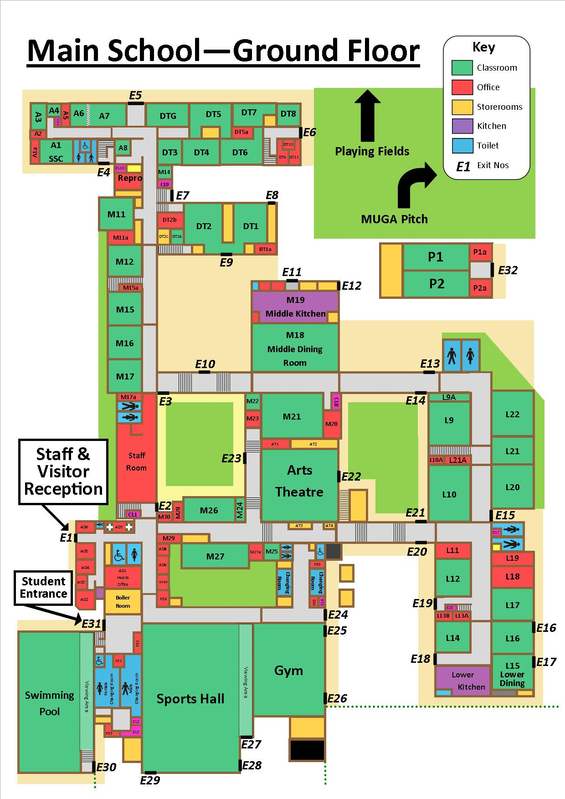
Visitors turn right out of Arts Theatre. Visit a music room only briefly. Continue to main reception, turn left past Finance office to the sports hall only.
Home
Home

Slide 6
Turn right through two sets of doors. This is now the school’s Sports Centre is now being run by our community manager, then right through the car park (look out for cars reversing etc.). Enter school through the main reception and aim for exit adjacent to the staffroom. Walk through courtyard (parallel to staffroom).
Home
Home

Slide 7
Japanese
Gardens
Enter school; turn left onto middle school corridor. Visit a Maths room (M17, M16 or M15). Point out the Japanese Gardens as a place for students to use during break and dinner times. Seating provided from Parents’ Association funding.
Home
Home

Slide 8
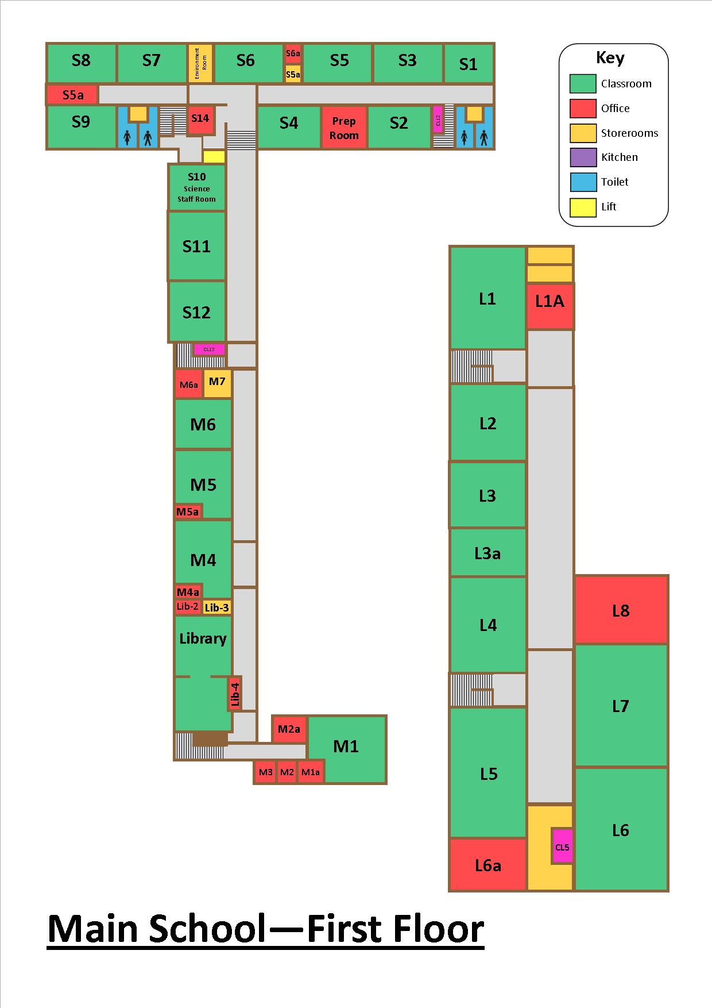
At top of stairs, visit IT rooms/library return back across the top floor toward science.
Home
Home

Slide 9
Home
Home

Slide 10
Visit one Science classroom. Exit Science using the stairs leading down to A Block.
Home

Slide 11
Take the visitors down to the new Art Department.
Home
Home

Slide 12
Turn around and point out DT5 & DT6 (used for all the Graphics) and point out DT3 used for Textiles.
Walk through DT5/6/7 where Food and Textiles are taught.
Exit Food Technology – DT8 on your left (A Level Food room) - do not enter. Turn right out of external door.
Home
Home

Slide 13
Point out MUGA (multi-purpose games area) built with the aid of Lottery funding, and tennis courts.
Home
Home

Slide 14
Walk into DT1 or DT2. Then walk out through the middle doors that you have just entered and over towards the Pod.
Home
Home

Slide 15
On your left, point out POD1 – Learning Support. Enter school through doors towards Main dining room. Turn right and enter either M21 or M18 (Drama rooms). Explain M18 is used at break and lunchtime for serving food.
Home
Home

Slide 16
Re-trace your steps towards the new Maths Department.
Point out L10 – Pastoral Office
Home
Home

Slide 17
Continue walking.
Point out L11 – Pastoral Support Room
Geography rooms L12 or L17.
Point out lower school dining area used to serve breakfast, snacks at break and lunch.
Home
Home

Slide 18
Use the stairs near L14 to climb up to the new Humanities Department.
Home
Home

Slide 19
Walk along this corridor – enter one of the rooms. Return to the lower school corridor by the stairs near L1.
Home
Home

Slide 20
Turn right. Walk across to B Block.
Home
Home

Slide 21
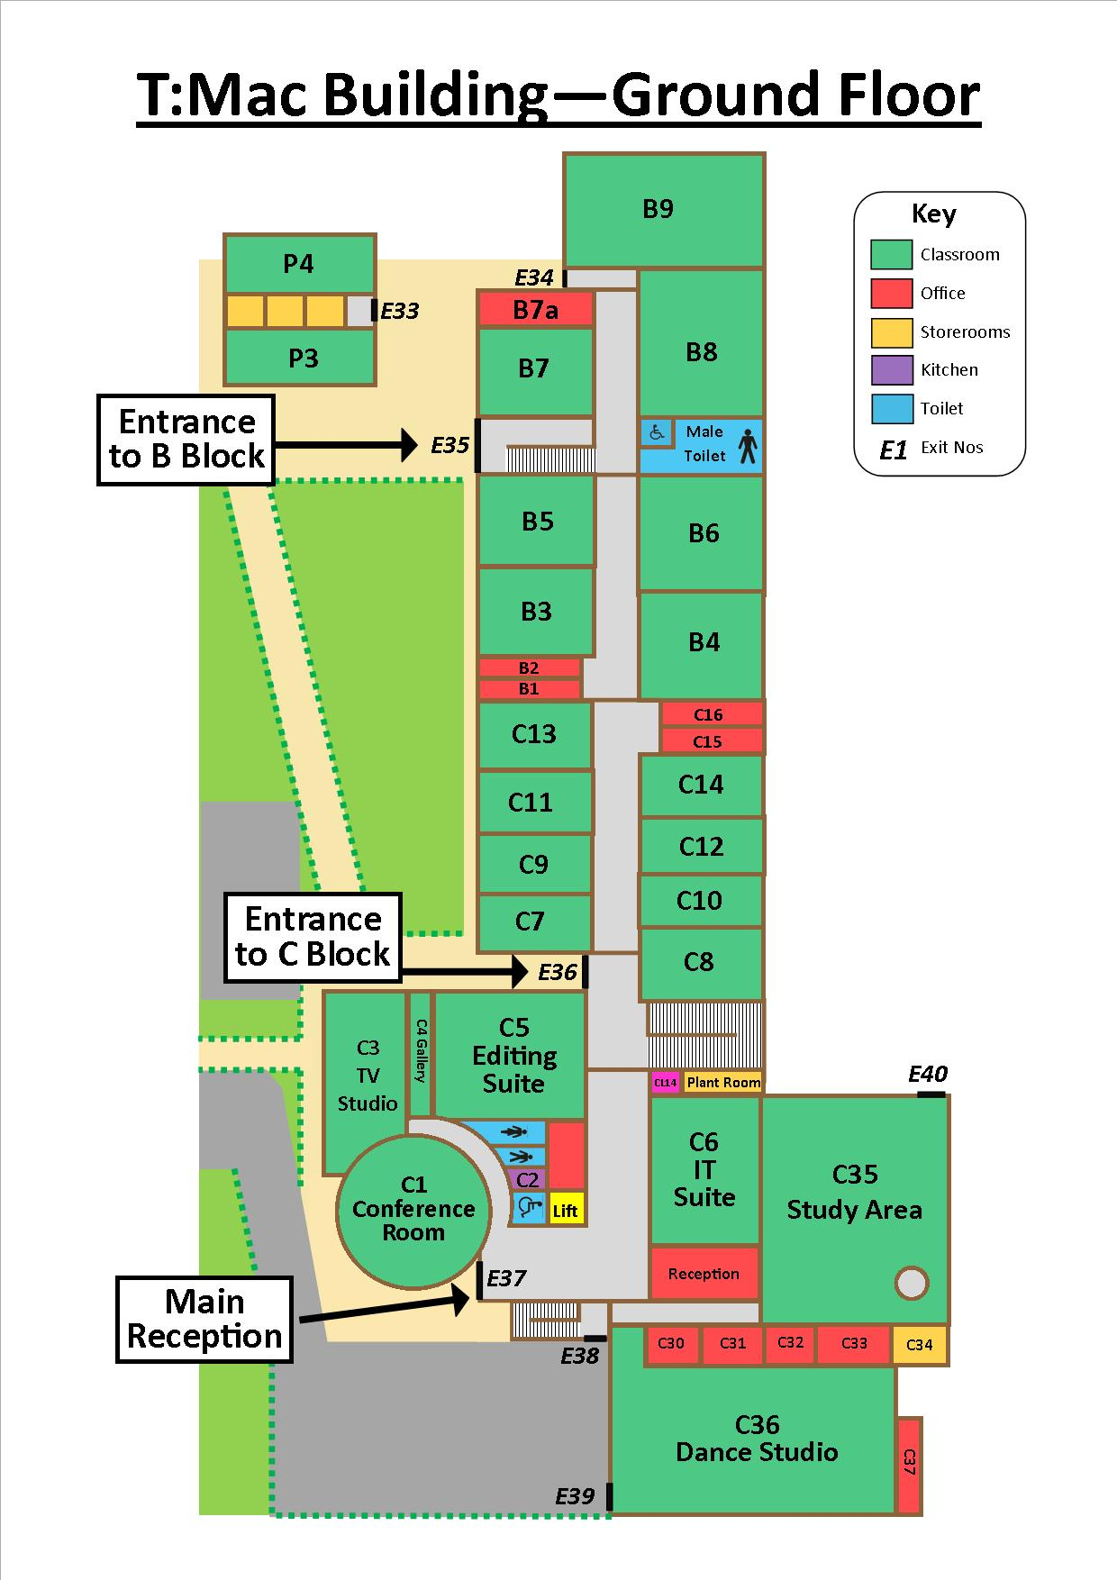
Point out the POD 2 is used by English.
Home
Home

Slide 22
Enter B Block – walk along ground floor only. Enter an MFL room (B block), through the double doors to C Block (6th Form teaching areas).
Home
Home

Slide 23
Show C1, C5 and C6 and the Dance Studio area.
Home
Home

Slide 24
Point out study area. Explain main purpose of room as a place where 6th form students can come to study and complete work.
Home
Home

Slide 25
In Sixth From reception walk up to 6th Form Common Room.
Exit Sixth Form reception.
Walk across to the Arts Theatre corridor via the Lower Dining Room.
Home
Home

Slide 26
Tour complete.
Home

Slide 27
Alumni 2016
Tours
Route 1
Home
Home

Slide 28
Alumni 2016
Tours
Route 2
Home
Home

Slide 29
IF YOU CAN’T ANSWER A QUESTION, ASK THEM TO REMIND YOU AT THE END WHERE YOU CAN DIRECT THEM TO A MEMBER OF STAFF.
Home
Home

Slide 30
INTRODUCE YOURSELVES
SMILE
& TALK LOUD AND CLEAR.
Home
Home

Slide 31
Visitors turn left out of Arts Theatre. Visit one Maths room. Point out L10 – Pastoral Support Office.
Turn left (opposite L21) and up the stairs to the new Humanities department.
Home
Home

Slide 32
Walk down the L corridor to L7. Visit
one room. Turn right down the stairs.
Home
Home

Slide 33
At the bottom of the stairs turn right. Walk along lower school corridor to a Geography room. Walk through Lower School Dining room used to serve breakfast, snacks at break and lunch.
Now exit through fire doors and walk across to C Block.
Home
Home

Slide 34
Show C1, C5 and C6 and the Dance Studio area.
Home
Home

Slide 35
Walk through to Study Area. Explain main purpose of room as a place where 6th form students can come to study and complete work.
Home
Home

Slide 36
Climb the stairs in the Study Area up to the Mezzanine.
Home
Home

Slide 37
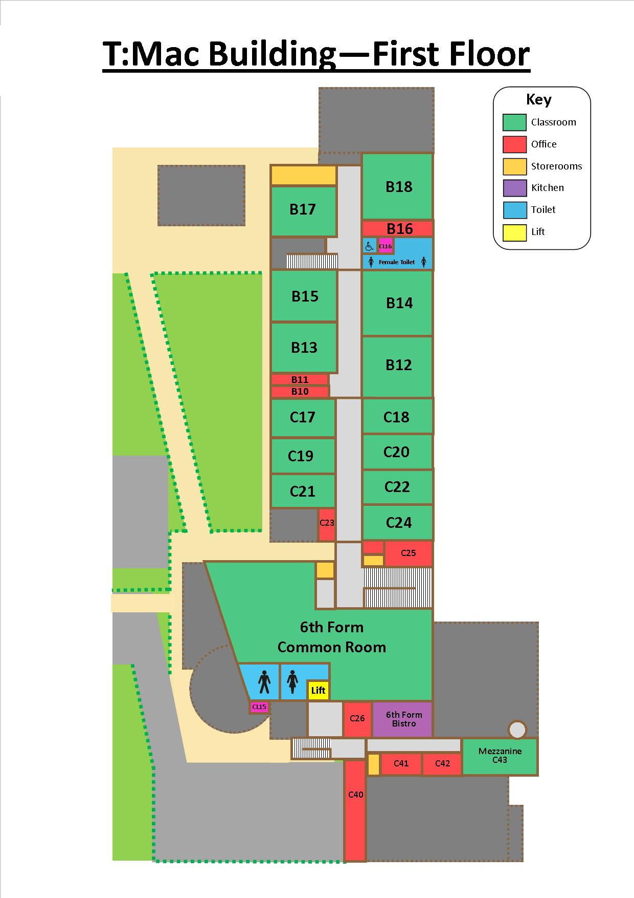
Walk through the common room, explain this space is used for Sixth Formers to relax at dinner times and break times.
Home
Home

Slide 38
Turn left at the top of the stairs and walk through the sixth form area and into B block along the top floor only. Enter a English room.
Home
Home

Slide 39
Escort visitors across back drive and enter school again by the entrance opposite the POD (explain POD used for Learning Support).
Home
Home

Slide 40
Turn right, down M21 corridor. Point out M21/M18 (used for Drama, serving food at break and lunchtime).
Home
Home

Slide 41
Turn right and visit the new Maths department rooms. Walk up the stairs to IT corridor.
Home
Home

Slide 42
At top of stairs, visit IT rooms/library return back across the top floor toward science.
Home
Home

Slide 43
Visit one Science classroom.
Exit Science using the stairs leading down to A Block.
Home
Home

Slide 44
Take the visitors down to the new Art Department classrooms.
Home
Home

Slide 45
Turn around and point out DT5 & DT6 used for Graphics and DT3 used for Textiles.
Walk through DT5/6/7 where Food and Textiles are taught.
Exit Food Technology – DT8 on your left (A Level Food room) - do not enter. Turn right out of external door.
Home
Home

Slide 46
Point out MUGA (multi-purpose games area) built with the aid of Lottery funding, and new tennis courts.
Enter by the Dining Hall doors, and walk round the Maths department and down towards the Sports Centre.
Home
Home

Slide 47
Visit either M26 or M27, and then visit the Sports Centre. Via the double doors near the Finance Office.
This is now the school’s Sports Centre which we took over from Serco this summer and is now being run by our community manager. Re-enter the main school via the double doors on the changing rooms corridor.
Home
Home

Slide 48
This is now the school’s Sports Centre which is now being run by our community manager.
Re-enter the gym.
Home
Home

Slide 49
Tour Complete.
Home

Slide 50
Alumni 2016
Tours
Route 2
Home

Slide 51
Alumni 2016
Tours
Route 3
Home
Home

Slide 52
IF YOU CAN’T ANSWER A QUESTION, ASK THEM TO REMIND YOU AT THE END WHERE YOU CAN DIRECT THEM TO A MEMBER OF STAFF.
Home

Slide 53
INTRODUCE YOURSELVES
SMILE
& TALK LOUD AND CLEAR.
Home

Slide 54
Visitors exit the arts theatre through the side doors and go right towards the drama office and through M21.
Home
Home

Slide 55
Exit M21 through the double doors and turn left onto the middle dining room corridor. Point out the dining room then continue down the steps and turn right by the staffroom door onto the M corridor.
Home
Home

Slide 56
Japanese
Gardens
Visit the new Maths department (M17, M16 or M15). Turn left and climb stairs after M15.
Home
Home

Slide 57
At top of stairs, visit IT rooms/library return back across the top floor toward science.
Home
Home

Slide 58
Home
Home

Slide 59
Visit one Science classroom.
Exit Science using the stairs leading down to A Block.
Home
Home

Slide 60
Take the visitors down to the new Art Department.
Home
Home

Slide 61
Turn around and point out DT5 & DT6 used for Graphics and DT3 used for Textiles.
Walk through DT5/6/7 where Food and Textiles are taught.
Exit Food Technology – DT8 on your left (A Level Food room) - do not enter. Turn right out of external door.
Home
Home

Slide 62
Point out MUGA (multi-purpose games area) built with the aid of Lottery funding, and new tennis courts.
Home
Home

Slide 63
Walk into DT1 or DT2. Then walk out through the middle doors that you have just entered and over towards the Pod.
Home
Home

Slide 64
On your left, point out the Pod (Learning Support). Enter school through the door opposite the POD (on the link corridor with middle dining room).
Turn left and walk towards the new Maths department and L10 (L Corridor).
Home
Home

Slide 65
Climb the stairs opposite L21 to the Humanities corridor.
Home
Home

Slide 66
Walk along this corridor – enter one of the rooms. Return to the lower school corridor by the stairs near L4.
Home
Home

Slide 67
Point out lower school dining area used to serve breakfast, snacks at break and lunch.
Continue walking along lower school corridor to Geography rooms L12 or L17.
Walk across to B Block.
Home
Home

Slide 68
Point out the POD 3 and 4 used by English.
Home
Home

Slide 69
Enter B Block – walk along ground floor only. Enter an MFL room (B block), through the double doors to C Block (6th Form teaching areas).
Home
Home

Slide 70
Show C1, C5 and C6 and the Dance Studio area.
Home
Home

Slide 71
Point out study area. Explain main purpose of room as a place where 6th form students can come to study and complete work.
Home
Home

Slide 72
In Sixth Form reception point up to 6th Form Common Room visit if you have time.
Exit Sixth Form reception – please avoid walking over the turfed area. Walk across to the Arts Theatre corridor Lower School Dining Room.
Home

Slide 73
Walk down past the Arts Theatre and visit the Music Department.
Walk past the Finance Office and into the Sports Centre and is now being run by our community manager.
Home
Home

Slide 74
Turn right up the finance office corridor and right again through the double doors towards the arts theatre.
Visit one music room only briefly.
Home

Slide 75
TOUR COMPLETE.
Home

Slide 76
Alumni 2016
Tours
Route 3
Home

Slide 77
Alumni 2016
Tours
Route 4
Home

Slide 78
IF YOU CAN’T ANSWER A QUESTION, ASK THEM TO REMIND YOU AT THE END WHERE YOU CAN DIRECT THEM TO A MEMBER OF STAFF.

Slide 79
INTRODUCE YOURSELVES
SMILE
& TALK LOUD AND CLEAR.

Slide 80
Turn left towards the sports centre reception and show them the sports hall on your left. This is now being run by our community manager.
Home

Slide 81
Walk across to the Sixth Form building.
Visit one Music room on your way.
Home

Slide 82
Show C1, C5 and C6 (gallery and studio) and Performance Arts area.
Home

Slide 83
Point out study area. Explain main purpose of room as a place where 6th form students can come to study and complete work.
Climb the stairs in the Study Area to the mezzanine.
Home

Slide 84
Turn right at the top of the stairs and walk through the sixth form common room and into C block along the top floor only.
Home

Slide 85
Walk through into B block along the top floor only. Enter an English room (B block).
Home

Slide 86
Walk over to the fire doors and enter school through the far Lower dining room door. Walk through Lower School Dining room used to serve breakfast, snacks at break and lunch.
Home

Slide 87
Enter the lower school corridor to Geography rooms L12 or L17. Turn left opposite L17 and climb the stairs to Humanities Corridor.
Home

Slide 88
Walk down the corridor and visit a room before coming down the stairs at the opposite end near L1.
Home

Slide 89
At the bottom of the stairs turn right. Visit a Maths Room. Point out L10 – Pastoral Support Room before turning left and walking toward M17.
Home

Slide 90
Point out the middle dining room and enter either M21 or M18 to show the drama department.
Home

Slide 91
Home

Slide 92
Japanese
Gardens
Re-trace steps towards the staff room and turn right onto the M corridor. Visit a Maths room (M17, M16 or M15).
Home

Slide 93
Continue down the M corridor until you reach DT2. Take visitors up the steps and show them DT2.
Japanese
Gardens
Home

Slide 94
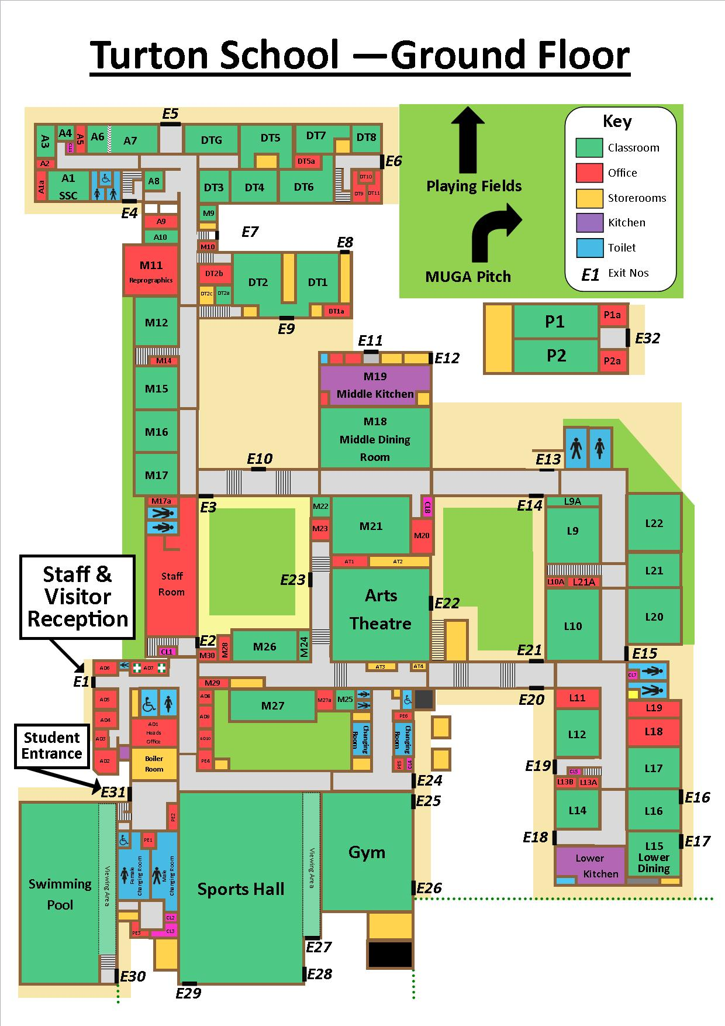
Continue up M corridor pointing out School Essentials M11. At the end of the corridor turn left in to A block.
Japanese
Gardens
Home

Slide 95
Take the visitors down to the new Art Department
Home

Slide 96
Turn around and point out DT5 & DT6 (used for Graphics) and point out DT3 used for Textiles.
Walk through DT5/6/7 where Food and Textiles are taught.
Exit Food Technology – DT8 on your left (A Level Food room) - do not enter. Turn right out of external door.
Home

Slide 97
Visit a science room.
At the junction near S6 turn left heading towards the library.
Home

Slide 98
At top of stairs, visit IT rooms/library and go down the stairs to main reception and make your way back to the Gym.
Home

Slide 99
TOUR COMPLETE.
Home

Slide 100
Open Day 2016
Tours
Route 4
Home

